Slide 1
RSHE
RSHE Life skills Knowledge and Skill Progression

Slide 2
RSHE
Year 1

Slide 3
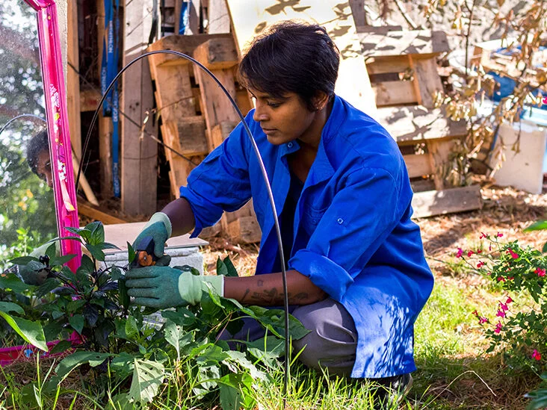
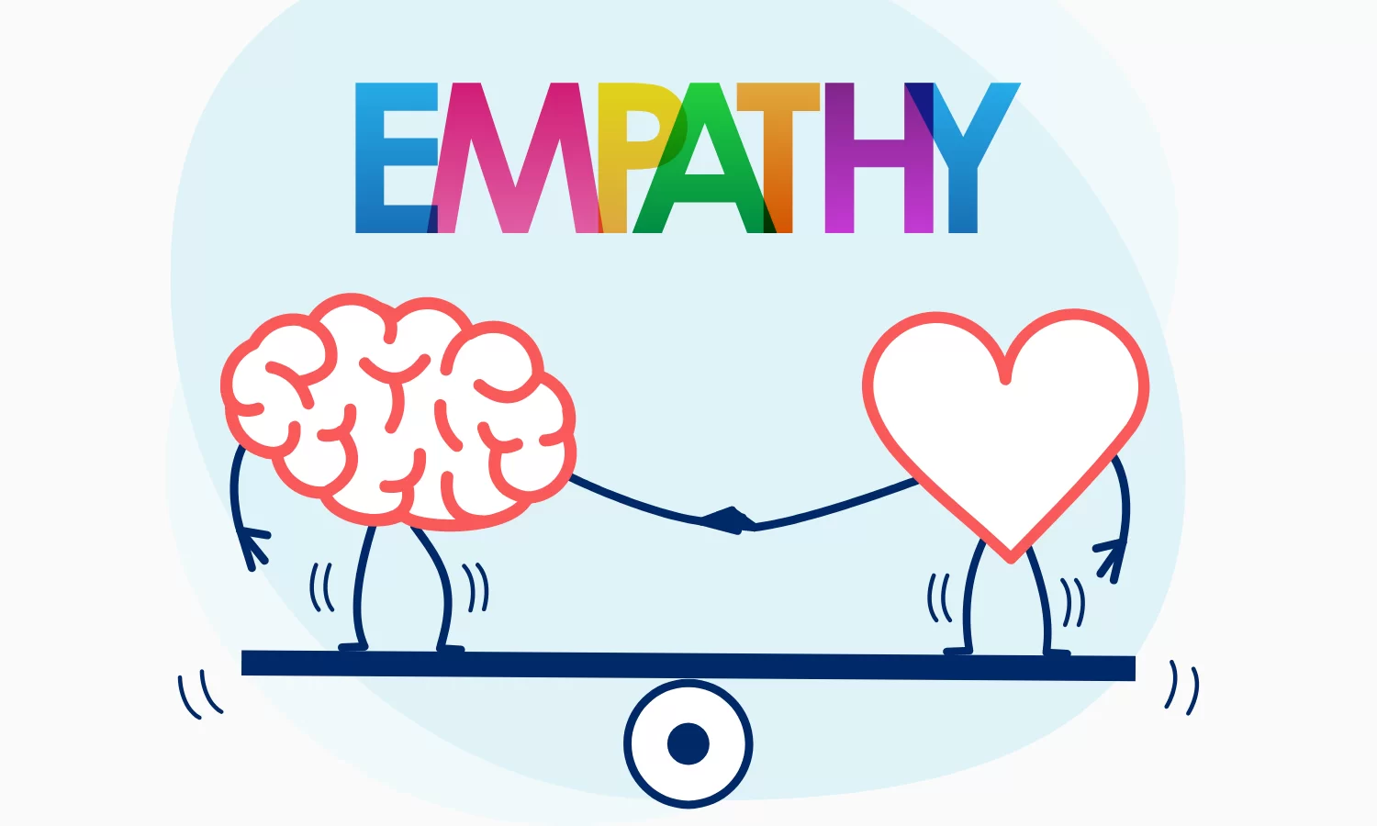
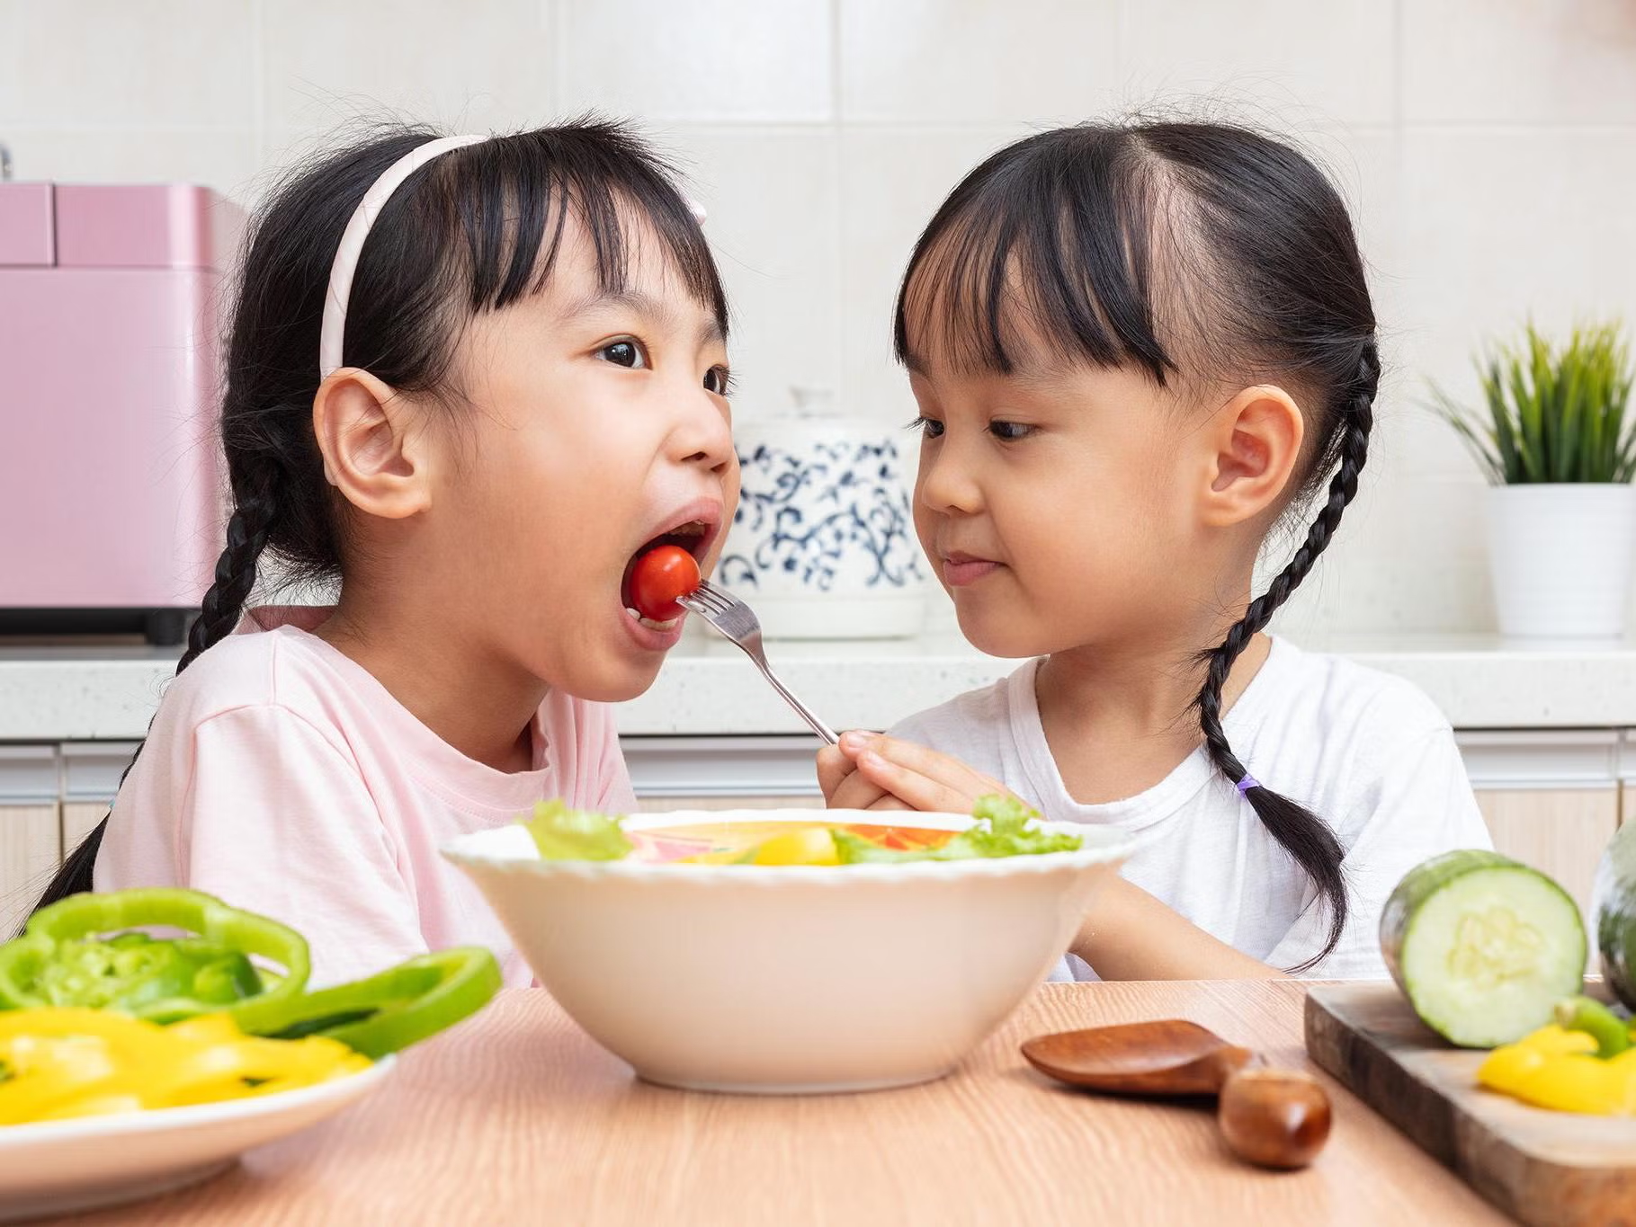
Year 1 RSHE Life skills-Wellbeing
RSHE
Vocabulary:
Learning Sequence:
Positive A desirable, constructive quality.
Give To offer or provide something.
Kind Being friendly, generous and considerate.
Kindness The quality of being friendly, generous and considerate.
Manners Polite social behaviour.
Play To do an activity for fun.
role-play To act out or perform a character or role.
Share To give or receive something with others.
Upset To be unhappy, disappointed or worried.
Active Taking part in activities that require movement.
Gardening The activity of looking after plants.
Grow When a seed becomes a full plant.
Movement To move the body around.
Plant The act of putting seeds into the ground.
Plants Living things that grow in soil.
To discover that it is good to make mistakes.
2) To take notice of feelings and emotions when listening to music.
3) To connect with others by showing empathy.
4) To give through sharing.
5) To move to improve green space.
Beautiful Very attractive or pleasing.
Create To make something new.
Discover Finding or learning something new or unknown.
Learn To gain new knowledge or skills.
Mistake An act or judgement that is misguided.
Angry A feeling of not liking something and being unhappy.
Calm Feeling relaxed.
Emotions Unconscious reactions to situations.
Feelings Sensations in the body.
Happy Feeling in a good mood.
Sad Feeling unhappy.
Scared Feeling frightened or worried.
Empathy To understand and care about the feelings of someone else.
Negative An unwelcome quality.
Perspective An attitude towards something or someone.

Slide 4
RSHE
Year 2

Slide 5
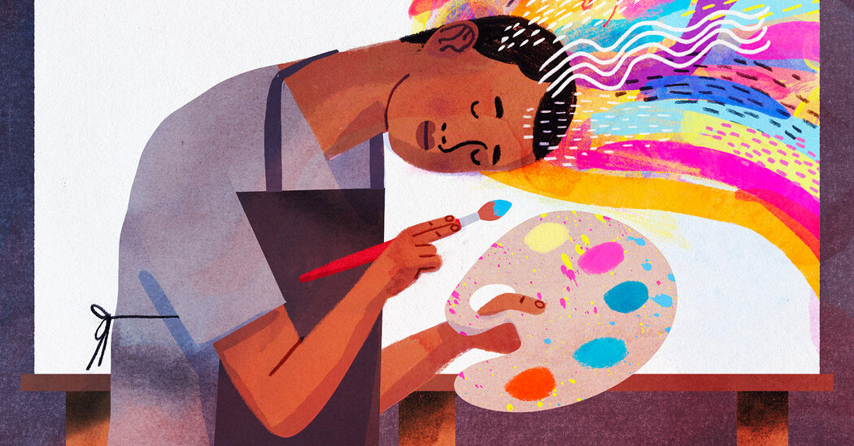
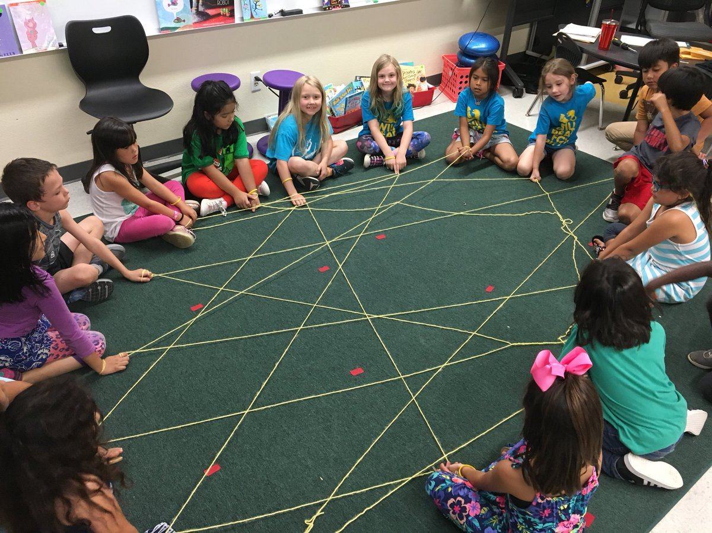
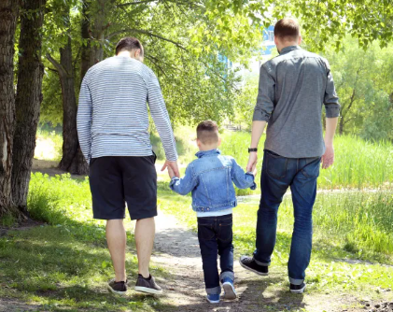
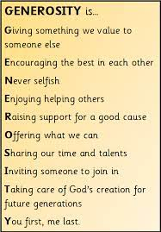
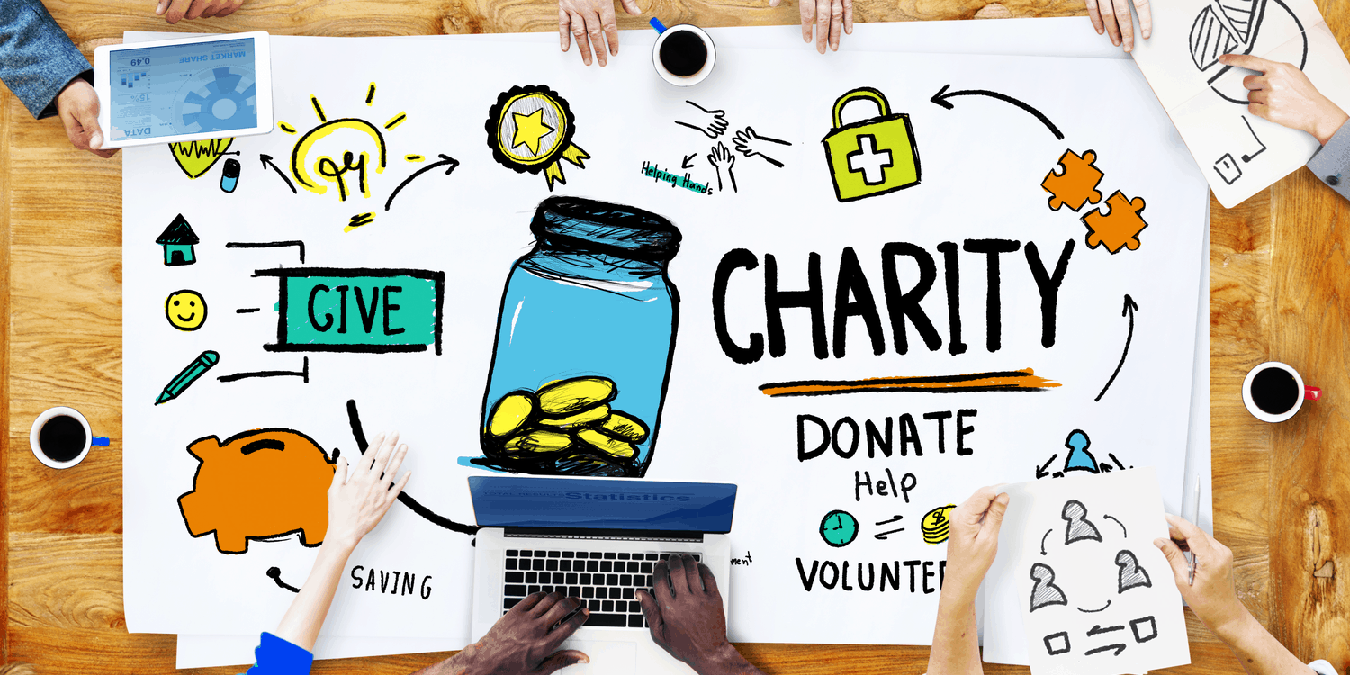
Year 2 RSHE Life skills-Wellbeing
Attitude A way of thinking about something.
Discover Finding or learning something new or unknown.
Listen To pay attention to sounds or spoken words to understand.
Opportunity A chance or moment to do something.
Perseverance The action of keeping going even if we find something difficult.
Problem solve To find the solution to a problem.
Teamwork The combined effective action or effort
Angry A strong feeling of not liking something and being unhappy.
Anxious Feeling worried or nervous.
Calm Feeling relaxed.
Emotions Unconscious reactions to situations.
Excited Feeling very happy and enthusiastic.
Feelings Sensations in the body.
Happy Feeling in a good mood.
Jealous The feeling of wanting what someone else has.
Sad Feeling unhappy.
Uncertain Not feeling sure. of a group.
Attribute A quality or feature possessed by somebody.
Compliment An expression of praise or admiration towards someone else.
Kindness Being considerate towards others.
Relationship How people are connected.
Respect Regard for the feelings of others.
Donation Something that is given to those in need.
Donate To give (money or possessions) for a good cause.
Generous Being willing to give, share or help without expecting anything in return.
Give To offer or provide something.
passing on To give something that you have used.
Receive To be given something.
Talents The skills that someone can do.
Healthy A person who is well.
Muscle Part of the body that helps with movement.
Pedometer A step counter.
physically active Taking part in activities that require movement.
Steps A movement made when walking.
Strengthen To get stronger.
Walk To move forward by putting one foot in front of the other.
RSHE
Vocabulary:
To discover the importance of perseverance.
To take notice of different feelings using colour and mark making techniques.
To connect with others through giving and receiving compliments.
To give generously.
To move through nature.
Learning Sequence:

Slide 6
RSHE
Year 3

Slide 7
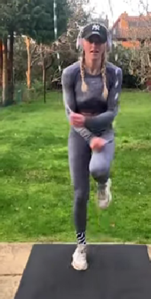
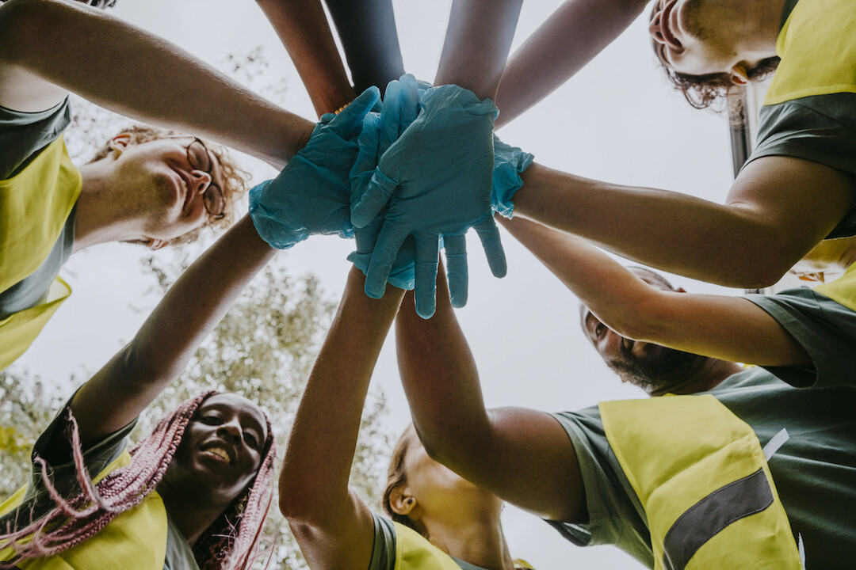
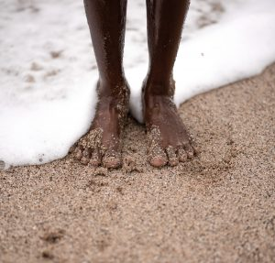
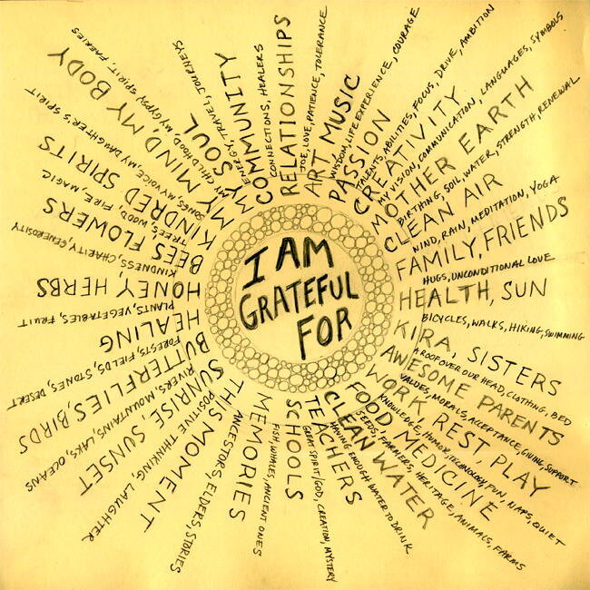
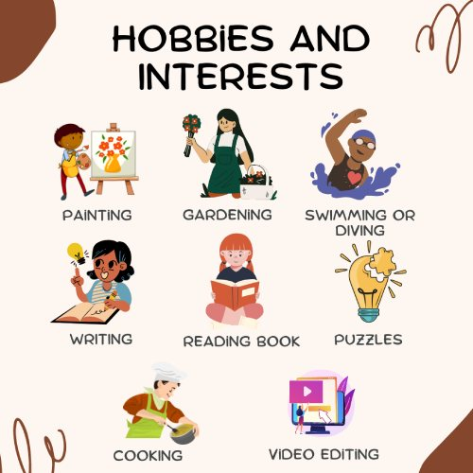
Year 3 RSHE Life skills-Wellbeing
RSHE
Vocabulary:
Discover Finding or learning something new or unknown.
Impact To have a strong effect on someone or something.
Improve To make or become better.
Practise To repeatedly do something in order to get better.
Progress To improve and become more advanced.
Reflect To think deeply or carefully about something.
Community The people living in a certain area.
Dopamine A happy chemical in the brain.
Environment The surrounding area and home to plants, animals and humans.
Grounding Connecting to the Earth's surface.
Notice Being aware of things.
Optimistic Believing that good things will happen.
Serotonin A happy chemical in the brain.
Volunteer Offering to do something for free.
Hobby An activity done for pleasure.
Interest An activity or subject that someone enjoys doing or studying.
Connect To form a relationship.
Relationship How people are connected.
Teamwork How a group of people work together.
Conversation Two or more people talking and listening.
Appreciate To recognise the full worth of someone or something.
Appreciation The recognition and enjoyment of the good qualities of someone or something.
Gift A thing given willingly to someone without payment.
Give To transfer something of yours to someone.
Grateful Feeling of appreciation for something done or received.
Gratitude The quality of being thankful and a readiness to show appreciation.
Kind To be friendly, generous and considerate.
Kindness The quality of being friendly, generous and considerate.
Taking part in activities that require movement
Exercise The action of moving your body.
Motion detection When an electrical device notices movement.
Program To provide a device with coded instructions.
Video games Games played electronically.
To discover that practice makes progress
To take notice of opportunities to make a positive change.
To connect with others through shared interests.
To give appreciation
To move using motion detection.
Learning Sequence:

Slide 8
RSHE
Year 4

Slide 9
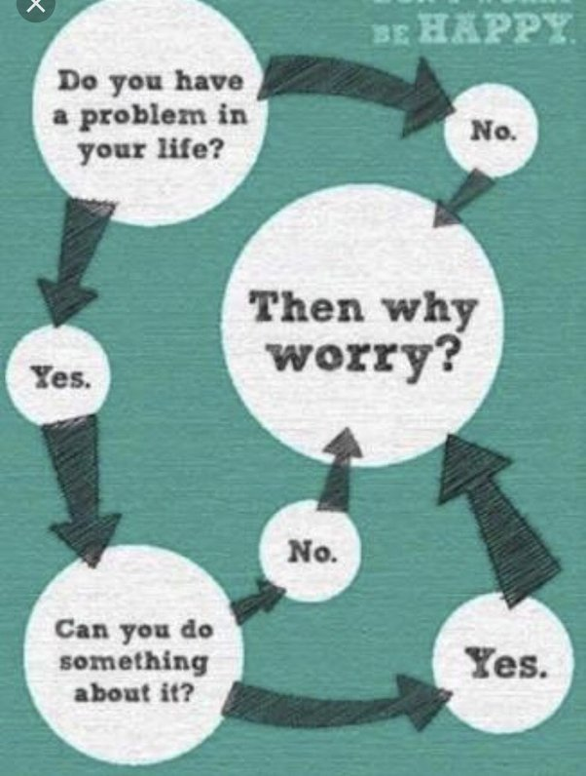
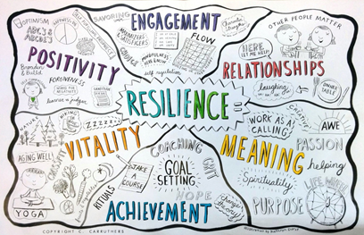
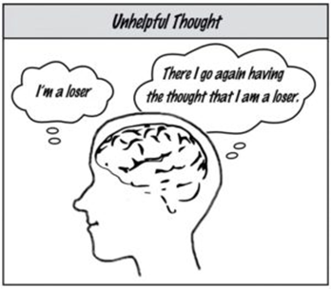
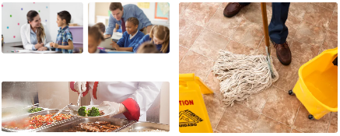
Year 4 RSHE Life skills-Wellbeing
RSHE
Discover Finding or learning something new or unknown.
Goal An aim or level to work towards.
Hurdles Difficulties and challenges that can be faced.
Life skill The things we do everyday to take care of ourselves and others.
Overcome To succeed in dealing with a problem or difficulty.
Mental Related to the mind.
Neuron Tiny messengers in the brain and nervous system that help us think, feel and do things.
Physical Related to the body.
Recognise To acknowledge the existence of something.
Resilience The capacity to recover quickly from difficulties.
Accomplishment Something a person has achieved.
Dopamine A happy chemical released by the brain.
Gratitude Being grateful.
Negative Expressing dislike.
Optimistic Believing good things will happen.
Positive Something good or desirable.
Serotonin A happy chemical released by the brain.
Thoughts An idea or opinion in the mind.
Benefit Something positive.
Communicate Sharing information.
Pen pal Someone you exchange information with who you might not have met.
Privacy Keeping personal information to yourself.
Safe Protected from harm.
Social Spending time with or seeing other people.
Supervision Someone ensuring activities are done correctly and safely.
Appreciate To recognise the full worth of someone or something.
Community A group of people living or sharing in the same place.
Contribute To give in order to help, provide or support someone or something.
Give To transfer something of yours to someone.
Kindness The quality of being friendly, generous and considerate.
Pledge A promise or commitment to a person or group.
Vocabulary:
To discover how to overcome mental or physical hurdles.
To take notice of my thoughts.
To connect with others by writing to them.
To give through an act of kindness.
To move to a beat.
Learning Sequence:

Slide 10
RSHE
Year 5

Slide 11
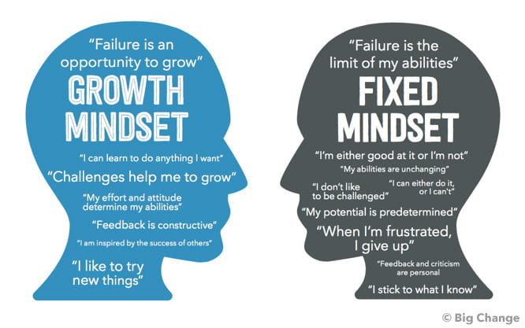
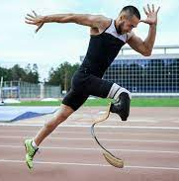
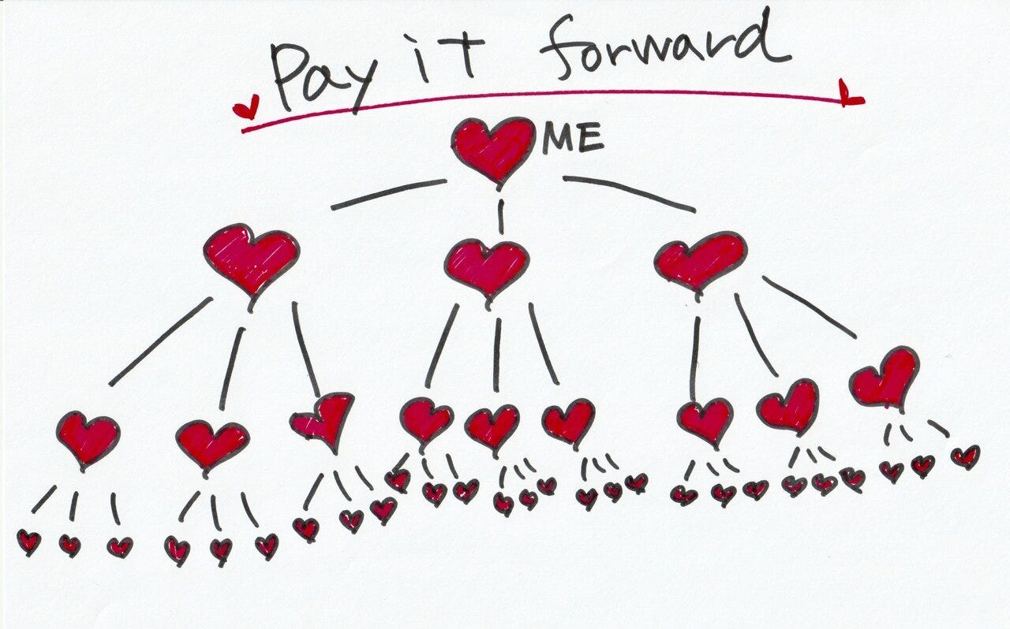
Year 5 RSHE Life skills-Wellbeing
RSHE
Fixed mindset A way of thinking that does not change and stops you from progressing.
Growth mindset
A way of thinking that recognises that with effort and actions you can change and progress.
Morse code
An alphabet or code in which letters are represented by combinations of long and short signals.
Support To help someone.
Loneliness Feeling on your own or isolated.
Infer To make an educated guess based on information.
Age restriction A rule that limits the age that certain things can be done or accessed.
Citizen The people who live in a town or country.
Collaboration Working together.
Connection A relationship.
Cooperation Joint effort.
Lonely Alone with no one to talk to.
Self-esteem How one feels about themself.
Support Being kind and offering help.
Teamwork A group of people working well together.
Appreciate To recognise the full worth of someone or something.
Give To transfer something of yours to someone.
Kindness The quality of being friendly, generous and considerate.
Paying it forward An expression for when the recipient of an act of kindness does something kind for someone else.
Recognition An acknowledgement of the existence of something.
Serotonin A chemical messenger (neurotransmitter) that helps brain and nervous system cells communicate.
Accessible Making something available to others.
Adapt To change something.
Benefit How something helps someone.
Disability A long-standing condition, illness or injury that makes it difficult for someone to do things.
Endorphin A happy chemical in the brain.
Equality When people receive the same treatment and have access to the same things.
Impairment When a body part does not work as expected.
.
Vocabulary:
To discover the benefits of having a growth mindset.
To take notice of others.
To connect with others as part of a team.
To give and receive kindness.
To move in adapted ways.
Learning Sequence:

Slide 12
RSHE
Year 6

Slide 13
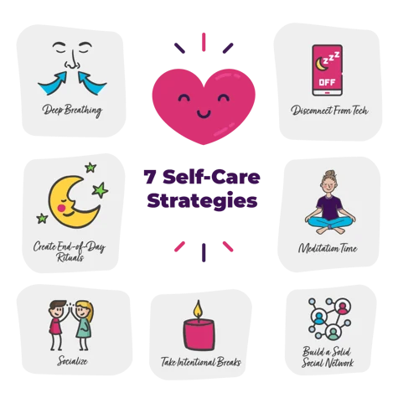
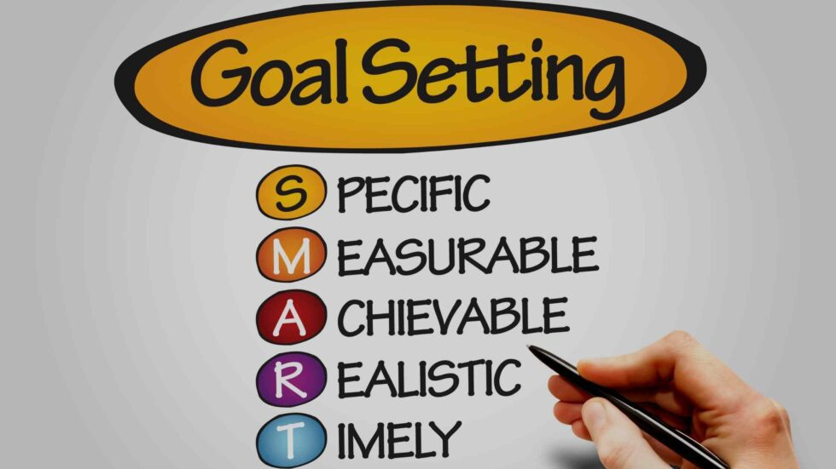
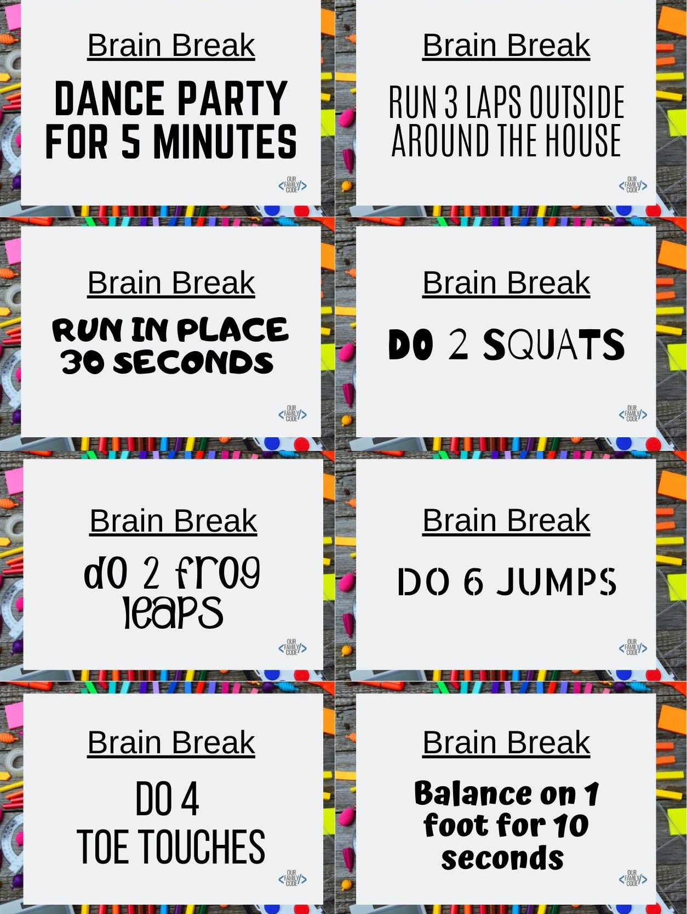
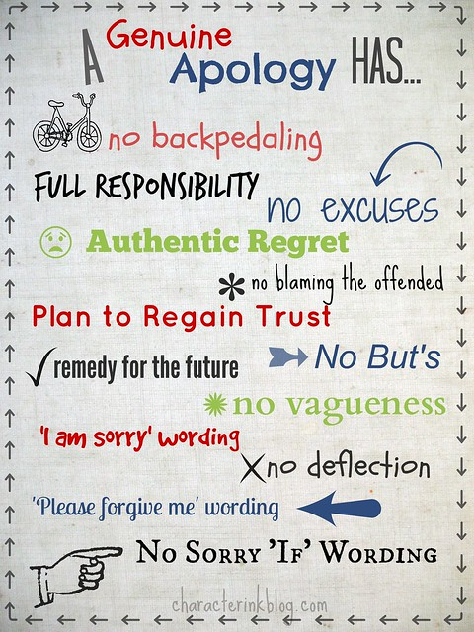
Year 6 RSHE Life skills-Wellbeing
RSHE
Achievable Likely to happen or be successful.
Advice Guidance or recommendation given to someone.
Discover Finding or learning something new or unknown.
Dream A desired goal a person hopes to achieve in the future.
Goal An aim or purpose.
Support To help and encourage someone.
Steps The actions or decisions made that bring someone closer to achieving a goal.
Vision board A collage of images and words representing a person's goals that are intended to inspire and motivate.
Cortisol The main stress hormone.
Replenish To refill something that has become depleted.
Recharge Restore with energy.
Stress A feeling of worry and tension.
Self-care Taking care of your own mental and physical wellbeing.
Commitment An agreement or pledge to do something.
Community A group of people living in the same space or having a common characteristic.
Support Provide assistance. volunteer
Undertaking a task for free.
Apology A regretful acknowledgement of an offence or failure.
Authentic Something is real or genuine and not a copy or fake.
Empathy The ability to understand and share the feelings of another.
Feeling An emotion state or reaction.
Forgiveness The action or process of accepting an apology or to stop feeling resentment.
Give Freely transfer the possession of something to someone.
Sorry Feeling regret or distressed for someone.
Reflect To think deeply or care about someone or something.
Repair To restore or mend something.
Respond To reply or take action as a reaction to something or someone.
Brain breaks Mental and physical activities used to break up a period of concentration.
Concentration Thinking carefully about something.
Endorphins A happy chemical in the brain.
Focus Giving attention to something.
Seratonin A happy chemical in the brain.
Vocabulary:
To discover how to set achievable goals.
To take notice of what I need.
To connect with others within a community.
To give an authentic apology.
To move to increase focus.
Learning Sequence:

