Slide 1
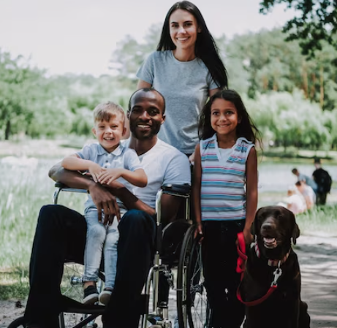
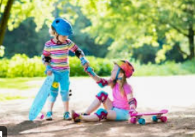
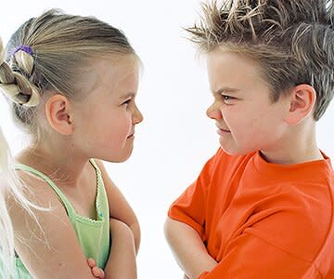
Year 1 RSHE Life skills – Family and Relationships
RSHE
Learning sequence
To understand that families look after us
To begin to understand the importance and characteristics of positive friendships
To begin to understand that friendships can have problems but we can overcome them
To begin to understand that being friendly to others makes them feel welcome and included
To begin to understand what is meant by a stereotype
Vocabulary
behaviour
care
emotions
family
feelings
friend
friendly
problem
stereotype

Slide 2
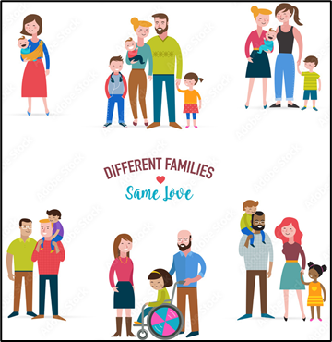
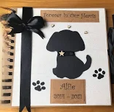
Year 2 RSHE Life skills – Family and Relationships
RSHE
Learning sequence
To begin to understand the range of families they may encounter now and in the future
To begin to understand that some friendships might make us feel unhappy and how to deal with this
To begin to understand the conventions of courtesy and manners
To begin to understand how loss and change can affect us
To develop an understanding of stereotypes and how these might affect job/career choices
Vocabulary
friend
family
feelings
stereotype
friendship
love
manners
emotions
respect

Slide 3
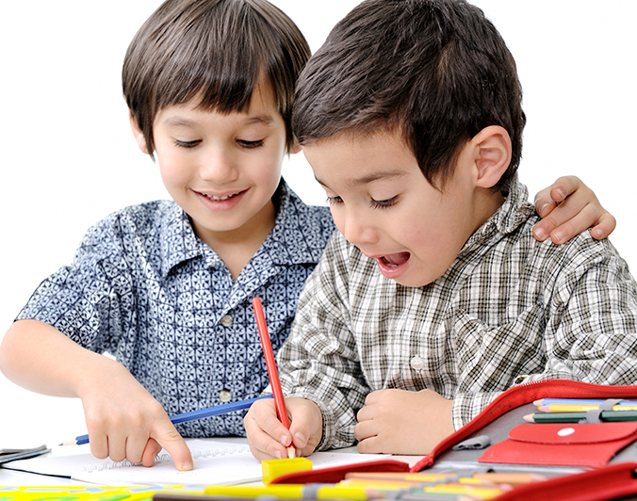
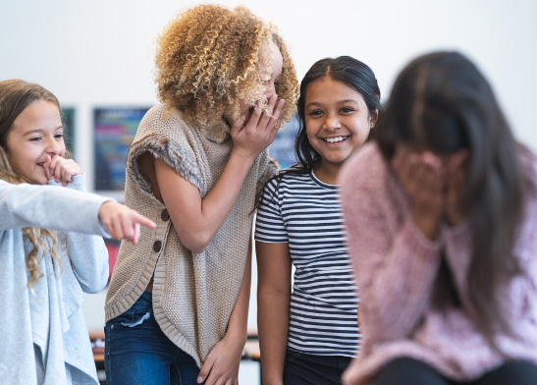
Year 3 RSHE Life skills – Family and Relationships
RSHE
Learning sequence
To understand that families love and support each other but sometimes problems can occur and help is available if needed.
To understand that friendships have ups and downs and that problems can be resolved.
To begin to understand the impact of bullying
To understand why trust is an important part of positive relationships
To begin to understand the differences between people and why it is important to respect these differences
To recognise that stereotypes are present in everyday life
Vocabulary
friendship
family
emotions
respect
stereotype
bullying
communicate
empathy
similar
solve
sympathy
trust

Slide 4
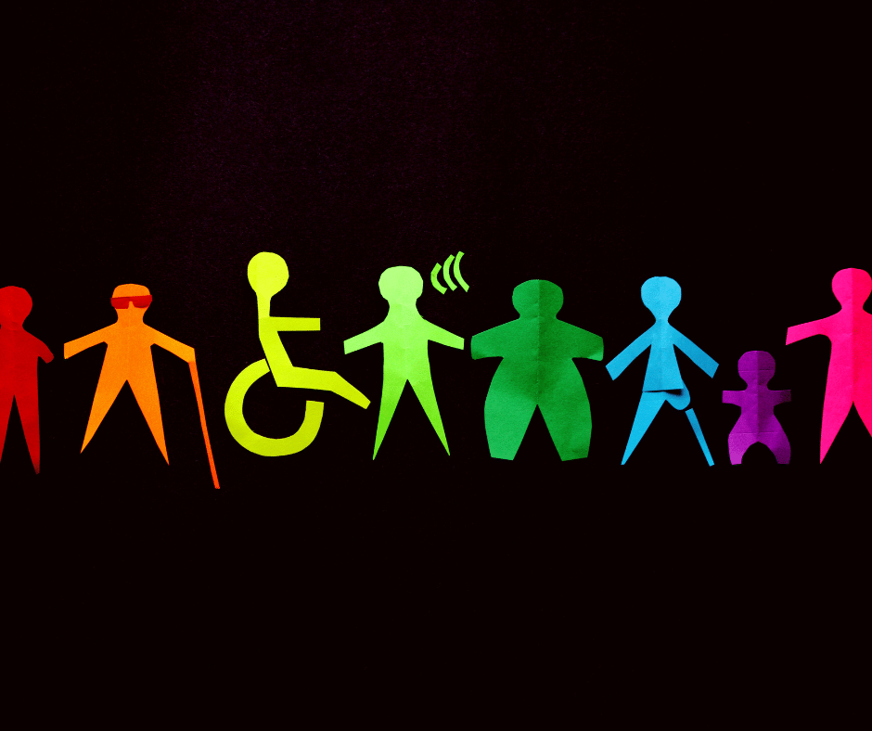
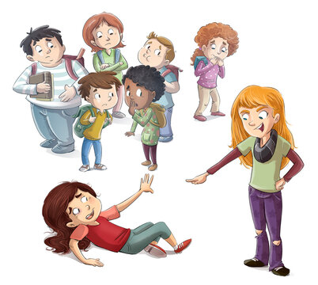
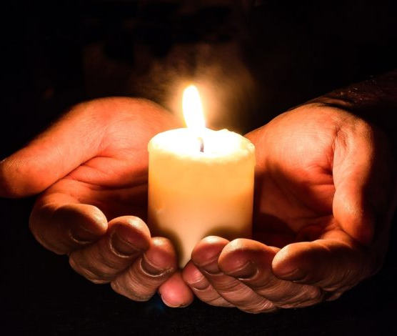
Year 4 RSHE Life skills – Family and Relationships
RSHE
Learning sequence
To develop understanding of courtesy and manners in a range of situations
To begin to understand the physical and emotional boundaries in friendships
To understand the impact of bullying and the responsibility of bystanders to help
To recognise that stereotypes can relate to a number of factors
To explore how we can help following a bereavement
Vocabulary
friendship
respect
stereotype
bullying
empathy
act of kindness
bystander
authority
boundaries
permission
bereavement

Slide 5
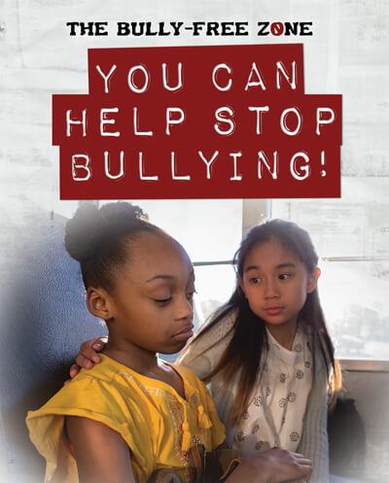
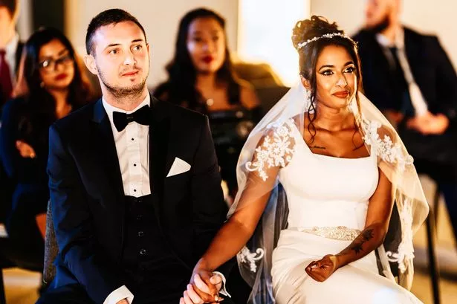
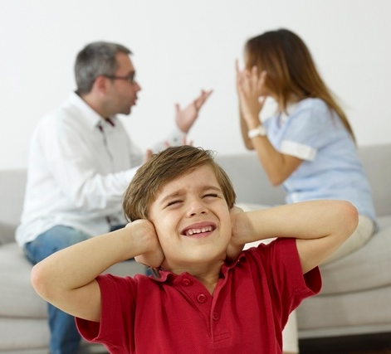
Year 5 RSHE Life skills – Family and Relationships
RSHE
Learning sequence
To understand how to form and maintain positive relationships
To explore the ups and downs of friendships
To understand the concept of marriage
To begin to understand self-respect.
To begin to understand that family relationships can sometimes make children feel unhappy and what they can do if this happens
To understand more about bullying and how to get help
To recognise how attitudes to gender have changed over time
To explore the impact of stereotypes and how they can lead to discrimination
Vocabulary
friendship
respect
stereotype
bullying
authority
bystander
attributes
cyberbullying
marriage
secret
wedding

Slide 6
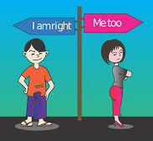
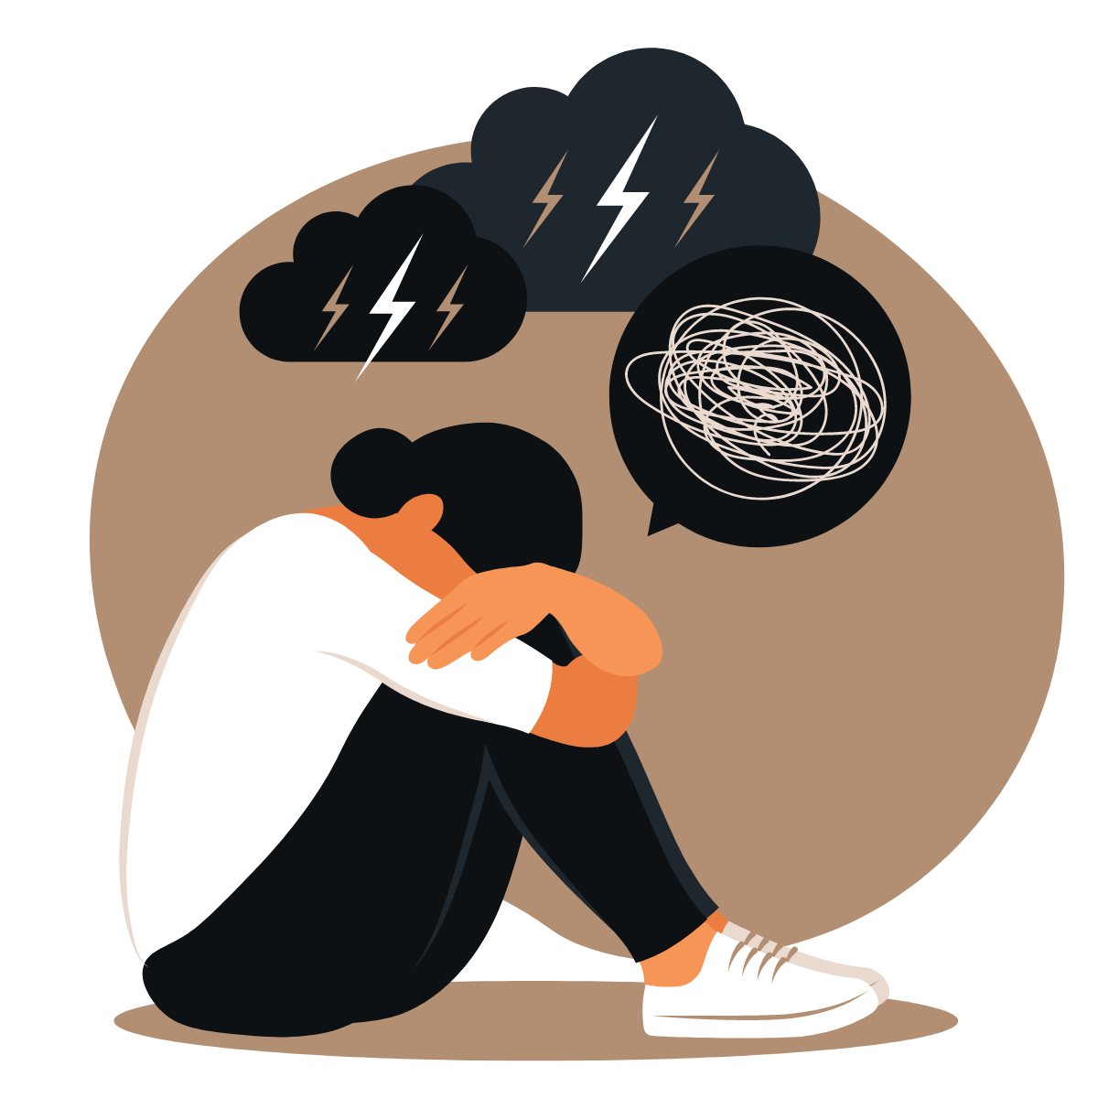
Year 6 RSHE Life skills – Family and Relationships
RSHE
Learning sequence
To understand what we mean by respect and why it is important
To understand that respect is two-way and how we treat others is how we can expect to be treated
To explore other people’s attitudes and ideas and to begin to challenge these
To understand stereotypes and be able to share information on them
To resolve disputes and conflict through negotiation and compromise.
To begin to understand the process and emotions relating to grief.
Vocabulary
friendship
respect
stereotype
authority
conflict
resolve
earn respect
expectation
grief

