Slide 1
RSHE
RSHE Life skills Learning Scaffolds

Slide 2
RSHE
Year 1

Slide 3
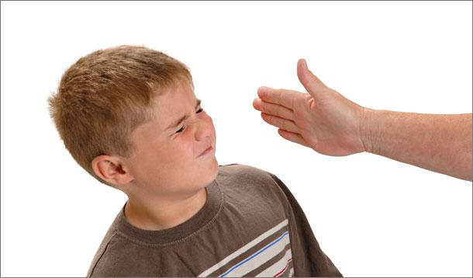
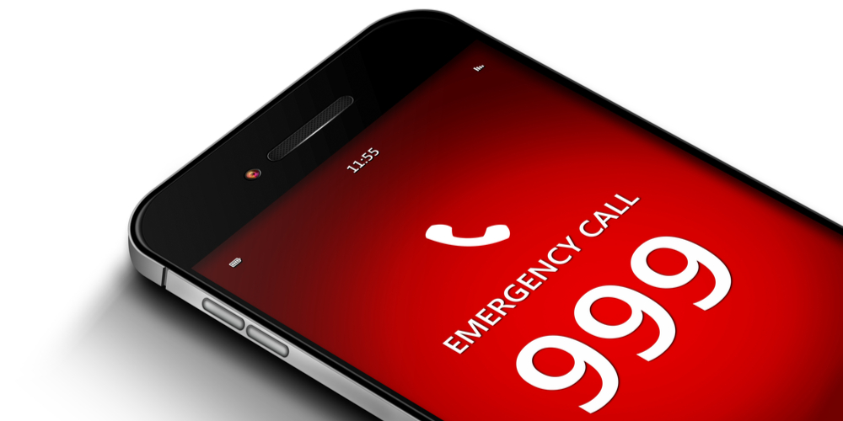
Year 1 RSHE Life skills- Safety and the changing body
RSHE
adult
job
manners
polite
visitor
stranger
worry
police
fire
ambulance
emergency
999
Physical contact
permission
acceptable/unacceptable
medicine
consent
Vocabulary:
Learning Sequence:
To know how to respond to adults in a safe and familiar context.
To understand how to respond to adults in a range of situations.
To know what an emergency is and how to make a phone call if needed.
To begin to understand the difference between acceptable and unacceptable physical contact.
To begin to understand what is safe to put into or onto our bodies.
To learn what it means to ask for permission.
Who are the adults who work in school? Where do children talk to adults outside school?
Who are the adults we meet outside school? How do we talk to the adults in these different situations? Who do we know well? What is a stranger? Why should we be cautious around strangers? What should I do if an adult makes me unhappy or hurts me?
What are the three emergency services? What is an emergency? What number do I call in an emergency? What information do I need to give? What number do I call in an emergency? What can I do to help if it isn’t an emergency?
What is physical contact? Have I had physical contact with someone today? What physical contact do I like? What physical contact don’t I like? What kinds of physical contact are never acceptable? (Examples include: hitting, smacking). What should I do if I feel uncomfortable or upset by unacceptable physical contact? (Always tell someone such as an adult, friend or someone you trust). What should I do if someone hurts me? When should I ask permission? How do I ask someone to stop? What should I do if the person carries on?
What can our bodies do? What goes into our bodies? What goes onto our body? What should I do if I am unsure about something? Where is a safe place to keep medicines or potentially dangerous substances?
6) When do we need to ask for permission? How do we ask for permission? How do we say no when someone asks for our permission?
Key Questions:

Slide 4
RSHE
Year 2

Slide 5
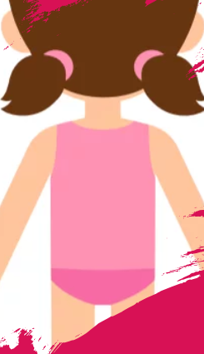
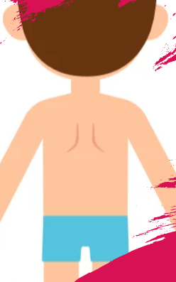
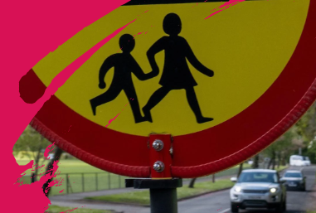
Year 2 RSHE Life skills- Safety and the changing body
RSHE
surprise
safe touch
unsafe touch
PANTS rule
private parts
vulva
Penis
testicles
secret
Report
pedestrian
pavement
car park
traffic
Vocabulary:
To begin to understand the difference between secrets and surprises.
To begin to understand the concept of privacy and the correct vocabulary for body parts.
To stay safe on and near roads.
To begin to understand how to stay safe with medicines.
To learn what it means to ask for permission
Learning Sequence:
What is a surprise? How do surprises make us feel? What is a secret? What is the difference between a secret and a surprise? What should children do if they are asked to keep something secret? Who can I report things to at school or at home?
What are the names of some of the parts of our body? What does private mean? What are our private parts called? Who should I talk to about my private parts if I have a problem? What is the PANTS rule? Who will I speak to if I ever feel uncomfortable or upset? What should I do if I see inappropriate behaviour in school?
How did I travel to school today? How did I stay safe? Where should I walk to keep safe? How else can I keep safe when there is traffic around? Which poster is the most effective at helping people to understand road safety?
What can I do to keep safe on the way to school? What are safe crossing places? What rules do I need to cross the road safely? What are the rules for crossing the road?
How do we feel when we are ill? What can make us feel better? What is a medicine?
From where do we get medicines? How can we be safe with medicines? What should I do if my friend offers me medicine?
6) When do we need to ask for permission? How do we ask for permission? How do we say no when someone asks for our permission?
Key Questions:

Slide 6
RSHE
Year 3

Slide 7
Year 3 RSHE Life skills- Safety and the changing body
RSHE
emergency
hazard
999 / 112
emergency services
emergency operator
location
Injuries
intended
cyberbullying
content
report
influencer
Gaming
influence
Decision
distraction
Vocabulary:
To understand the role I can take in an emergency situation.
To understand that cyberbullying involves being unkind online.
To begin to recognise who and what can influence our decisions.
To develop an understanding of safety on or near roads.
To learn about giving and asking for permission (consent). To learn about personal boundaries. To learn about appropriate and inappropriate touch
Learning Sequence:
What should you always do first when faced with an emergency situation? In an emergency, what hazards might you be faced with? Why shouldn’t you immediately approach when there is an emergency? What information is important to convey to the emergency services?
What is cyberbullying? Who can help if we have problems online?
What choices do I make myself? What choices do other people make for me? Who influences my choices? How can I make good choices? How can I resist pressure to make bad decisions?
What are the rules for keeping safe near the roads? When might you forget these rules? What rules do we need to remember around roads? What helps us to share a safety message effectively?
Key Questions:

Slide 8
RSHE
Year 4

Slide 9
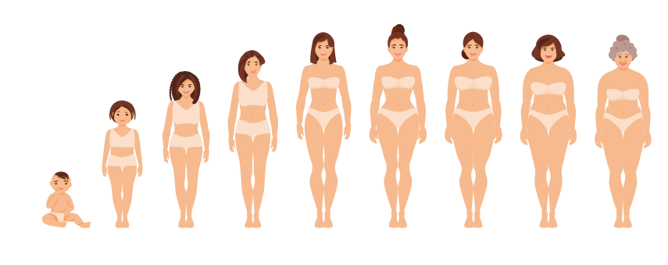
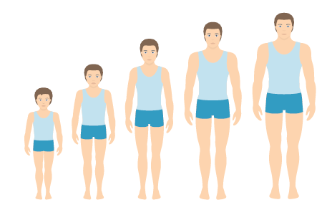
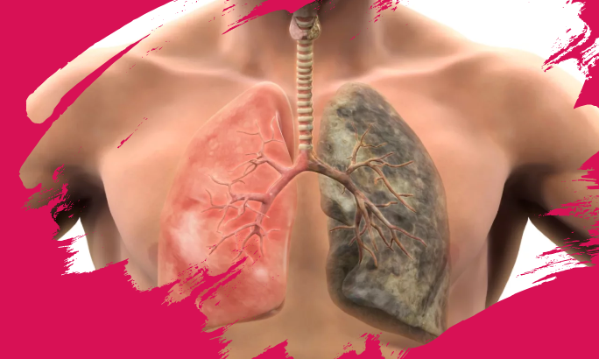
Year 4 RSHE Life skills- Safety and the changing body
RSHE
Learning Sequence:
Lessons 1 and 2 Internet safety ???
To understand how to help someone with asthma.
To develop understanding of privacy and the difference between secrets and surprises.
To recognise that change is part of growing up.
To recognise the physical differences between children and adults
To begin to understand the risks of smoking and the benefits of being a non-smoker.
To learn about giving and asking for permission (consent). To learn about personal boundaries. To learn about appropriate and inappropriate touch
airways
trachea
triggers
inhaler
lungs
medicine
Larynx
inhale
exhale
inflate
Deflate
Uncomfortable
private
public
surprise
Vocabulary:
develop
physical changes
physical
breasts
genitals
Penis
testicles
chest hair
puberty
Hygiene
non-smoker
tobacco
risks
Key Questions:
3) What is private? What is public? What is the difference between secrets and surprises? What should you do if you ever feel worried about someone? What should I do if an adult makes me feel uncomfortable? Can you remember the PANTS rule?
4) How have I changed physically? What can I do now that I couldn’t when I was younger? What will I look like as an adult? What will I be able to do when I am an adult? How do I feel about growing up?
5) What excites me about growing up? What might I be worried about? Who can I talk to? How will my body change as I grow up? Why is good personal hygiene important as I grow and change? How will I change emotionally? Do you understand the changes which are going to happen as you grow up?
6) What good things go into our bodies? What bad things go into our bodies? Why do some people smoke tobacco? What are the risks of smoking? What are the benefits of being a non-smoker? What can I do if someone I care about smokes?

Slide 10
RSHE
Year 5

Slide 11
Year 5 RSHE Life skills- Safety and the changing body
RSHE
puberty
cervix
ovary
fallopian tube
uterus
vagina
Vulva
clitoris
urethra
vaginal opening
labia
Online Friendships & Internet Safety
To understand physical changes during puberty.
To understand the menstrual cycle.
To understand emotional changes during puberty.
To understand how to help someone who is bleeding or who has suffered a head injury.
To begin to understand the influence others have on us and how we can make our own decisions.
To learn about giving and asking for permission (consent). To learn about personal boundaries. To learn about appropriate and inappropriate touch
Vocabulary:
Learning Sequence:
menstruation/period
egg
ova
Ovaries
Womb
bleeding
lining
sanitary products
towels
tampons
reusable products (period pants, cups)
wet dreams
Ejaculation
attraction
puberty
change
Feelings
voice breaking
erections
2) What do we know about growing up? What are the correct names for parts of the body?
3) What is a period? How do you deal with periods? What changes do boys go through during puberty? Who can you go to if you have questions about growing up?
4) What do we know about puberty? What other changes happen during puberty? Who can help with problems? What do I know now about puberty that I didn’t at the start of these lessons?
5) Vocab – arteries, heart, severe, minor, veins, positioning, shock, oxygen, red blood cells, reassuring, circulating, white blood cells, infection, bandaging, safety, head injury, concussion, calm, report, emergency
6) What choices do we make? How have the choices changed as we have got older? Who and what influences our decisions? What do we need to think about before making a decision? What can I do to make my opinion clear to my friends?
Key Questions:
pressure
peer pressure
peer acceptance
influence
choice

Slide 12
RSHE
Year 6

Slide 13
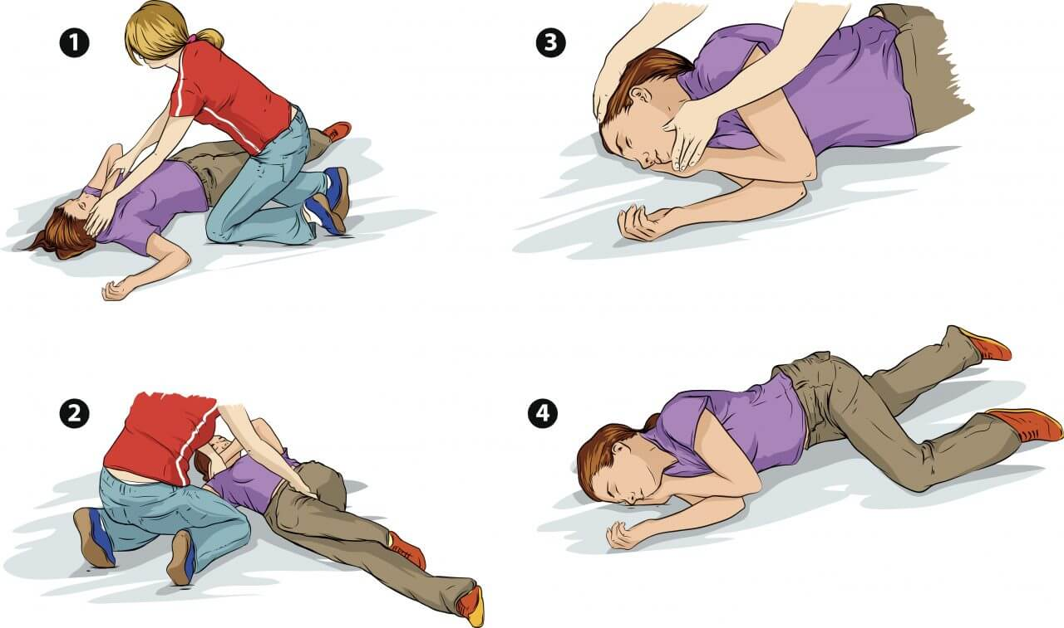
Year 6 RSHE Life skills- Safety and the changing body
RSHE
To begin to understand the risks of alcohol.
??? To understand that online relationships should be treated in the same way as face to face relationships.
To understand the changes that happen during puberty.
To understand the biology of conception.
To understand the development of the baby during pregnancy.
To understand how to help someone who is unresponsive.
To learn about giving and asking for permission (consent). To learn about personal boundaries. To learn about appropriate and inappropriate touch
Learning Sequence:
Please add relevant vocabulary to your lesson slides
Vocabulary:
What alcoholic drinks do we know about? Where have you seen people drinking alcoholic drinks? Why do some adults choose to drink alcohol? Why do some adults choose not to drink alcohol? What are the risks of drinking alcohol? Who can help if we have any worries about alcohol?
Why do people pretend to be someone they are not online? What happens when a report is made against someone? Why do people say things online they wouldn’t in real life? What can we do about bullying online? How can we deal with negativity online?
What happens during puberty? What are the correct names for the parts of the body? What problems might people have during puberty and how can I help?
What happens during the menstrual cycle? How is a baby made? At what age can people legally have intercourse?
What happens during pregnancy? How does a baby develop? What does a baby need in the first months of life? What do we know about how babies develop during pregnancy?
What do we know about babies’ needs in the first months of life?
7) What is a primary survey? How do I conduct a primary survey? How do you place a casualty who is unresponsive and breathing normally into the recovery position? How do I seek medical help?
Key Questions:

