Slide 1
Computing
Learning Scaffolds

Slide 2
EYFS

Slide 3
EYFS – Going online
Digital Literacy
Learning sequence
Engage with rules
Explore different ways to communicate
Explore kind behaviour
Explore how to find and add information online
Explore personal information
Express how to communicate kindly online
Unit overview
We will be learning about the different rules we have in different places including at home, at school and online. We will find out how to be safe and happy online, and we will use role play to share what we have learnt!
Key questions
What rules do you have at school and at home? Why do you have rules?
How do you communicate with each other?
Can unkind behaviour occur on the computer?
What do you like to look at online?
What is personal information?
Vocabulary
online
offline
communication
internet
personal information

Slide 4
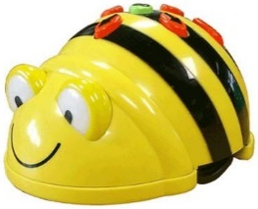
EYFS – Introducing technology
Computer Science
Learning activities
Explore controlling games on a digital device
Explore controlling a digital floor robot
Explore controlling a floor robot
Explore creating a sequence of commands
Unit overview
We will be learning how to use different forms of technology including tablets, computers, Chromebooks and floor robots. We will learn by trying things out and then sharing with our friends.
Key questions
How do you play?
What type of technology are you using today?
How do you make the character (sprite) … ?
What do you think will happen if you press … ?
How do you make the floor robot move?
How can you start a new game / program?
Can you program more than one instruction?
Vocabulary
technology
tablet
instructions
robot
predict

Slide 5
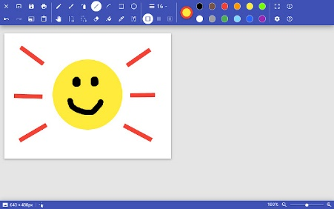
EYFS – Content creators
Information Technology
Learning sequence
Explore using the keyboard to type your name
Explore using the keyboard to perform a computer search
Explore using a drawing application on a tablet
Explore using a drawing application on a computer
Unit overview
We will be learning write text on a computer to communicate and to search for things we like. We will also be learning to create pictures online using a range of tools, and then print our pictures to display!
Key questions
How can you write letters on the keyboard?
How can you write words into a search engine? How can you create a space? How can you start the search?
How can you change the colour? How can you add a shape to your picture? How can you delete a mistake? How can you print your work?
Vocabulary
keyboard
text
keys
space
touchscreen
colours
shapes
erase
share

Slide 6
Year 1

Slide 7
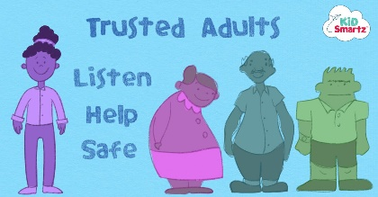
Year 1 – Online behaviour
Digital Literacy
Learning sequence
Engage with different types of behaviour
Explore the importance of trusted adults
Explore search engines
Explore passwords
Explore privacy online, and saving our work
Express good behaviour online, and what to do when you are upset
Unit overview
We will be learning about what good behaviour looks like online, and how to use trusted adults when something upsets us. We will share our learning in a clear and interesting way such as a comic book or poster.
Key questions
Is this person showing good behaviour?
What should you do if your are worried online? Who is a trusted adult?
How do you search the internet? What do you do if something worries or upsets you?
Why do we have codes and passwords?
Who does this belong to? Why is a good filename important?
Vocabulary
offline
online
communicate
internet
personal information
trusted adult
permission
search engine
voice activated
passwords

Slide 8
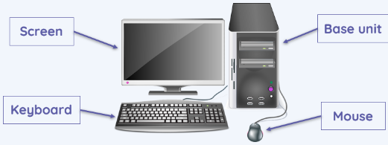
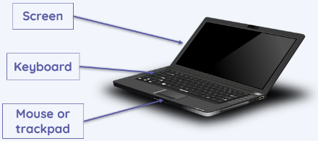
Year 1 – Using computers
Computer Science
Learning sequence
Locate examples of technology and explain how they help us
Explore the main parts of a computer
Explore how to use a mouse / trackpad
Explore how to save work
Explore how to use a keyboard
Create a project
Unit overview
We will be learning about what technology is and how we can use it to help us. We will also explore the parts of a computer, and develop our keyboard and mouse skills to create a project about our family!
Key questions
What is technology?
How can technology help us?
What are the different parts of a computer?
How does a mouse, trackpad and keyboard work?
How can you keep work to add to on another day?
How can we ensure we are open the correct file?
Vocabulary
technology
tablet
computer
screen
mouse
trackpad
keyboard

Slide 9
Year 1 – Creating algorithms
Computer Science
Learning sequence
Enquire into how a floor robot works
Explore an follow instructions
Explore forward and backward commands
Explore left and right commands
Explore command sequences
Create a series of algorithms
Unit overview
We will be learning how to program a floor robot, that a series of instructions is called an algorithm, and that we need to change our algorithm if it doesn’t work. We will express our learning by planning, programming and running algorithms with our floor robots!
Key questions
How does a floor robot work?
Why should we always start the robot from the same position?
What happens when the left/right button is pressed? Does it move to another square?
What is an algorithm?
What did you have to do if it didn’t work?
Vocabulary
instructions
robot
predict
command
device
program
run
algorithm

Slide 10
Year 1 – Digital writing
Information Technology
Learning sequence
Enquire into how a keyboard works
Explore the functions of keys on a keyboard
Explore using capital letters
Explore selecting and dragging text
Explore the impact of changing text
Express and evaluate the differences between typing and writing
Unit overview
We will be learning how to use a keyboard to type our ideas, and then compare writing with typing. We will express our learning by creating a poster with different fonts and text features.
Key questions
What could word processors be used for?
How do you type numbers? How do you start a new line?
What do these keys do?
How do you select text? What is the cursor?
Which tool did you use? Why did you use this tool?
What’s the same? What’s different?
Vocabulary
keyboard
text
keys
space
shift
space
backspace
cursor

Slide 11
Year 1 – Digital painting
Information Technology
Learning sequence
Try out making different kinds of marks on a screen
Explore using shape and line tools
Explore changing the colour of shapes
Explore using different paint tools
Explore colour and brush sizes
Create and compare digital artwork with traditional artwork
Unit overview
We will be learning how to emulate different artists using a computer art application. We will use various tools including line, shape, paintbrush and fill tools to create a range of pieces of art. We will then compare electronic art to practical art.
Key questions
How can you find out how a program works?
What does the shape tool do? What does the line tool do?
What is the advantage and disadvantage of different tools?
Which tools did you use and why?
Which method did you prefer and why?
Vocabulary
touchscreen
colours
shapes
erase
share
freehand
tools
fill
undo

Slide 12
Year 2

Slide 13
Year 2 – Who are you online?
Digital Literacy
Learning sequence
Engage with the idea of behaving differently in different situations
Explore different behaviours online
Explore rules for using the internet
Explore privacy online
Explore ownership online
Express how to behave with different people online
Unit overview
We will be learning about how our behaviour can be different with different people, but should always be kind and safe. We will demonstrate our learning in a poster!
Key questions
Do you behave the same for everybody?
Should you sign up to something online without asking an adult? Can you trust everything online?
How long is information online for? Should you post something online without asking an adult?
Who do these images belong to? Can you use them without asking?
Vocabulary
online
personal information
trusted adult
search engine
passwords
online bullying
accept
webpage
untruthful
private

Slide 14
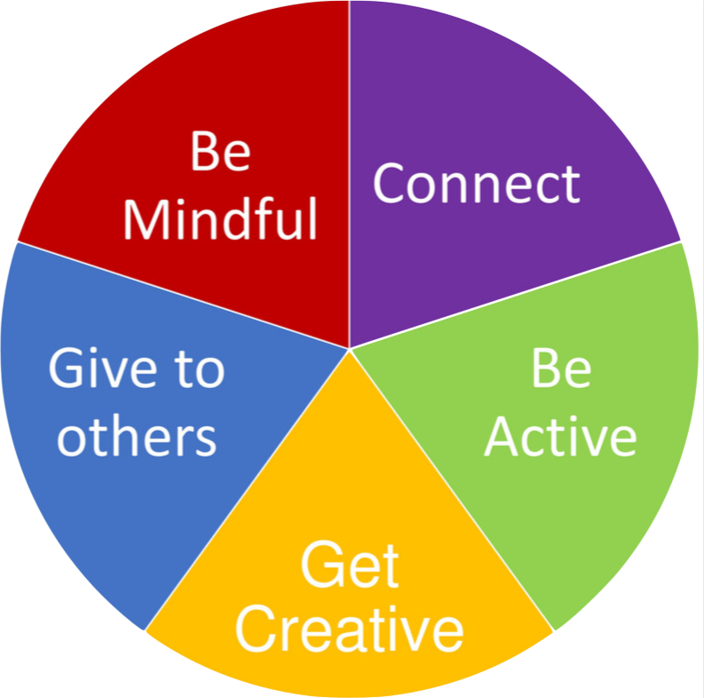
Year 2 – Information technology
Computer Science
Learning sequence
Identify and describe the uses of computers
Explore information technology in school
Explore information technology around us
Explore how technology works together and helps us
Explore how IT can be used for different types of activities
Communicate how IT can help us
Unit overview
We will be learning about information technology around us and how it makes our lives easier. We will also learn about having a digital 5 a day, and we will create a poster to help others know how information technology can help them.
Key questions
What activities can we use computers / information technology for?
What would life be like without…? Would you miss…? What would you use instead of…?
Where are you likely to find information technology?
How does information technology help us?
Vocabulary
technology
computer
mouse
trackpad
keyboard
information technology (IT)

Slide 15
Year 2 – Sequencing instructions
Computer Science
Learning sequence
Engage with a programming application
Explore joining blocks to create a program
Explore how coding blocks can be modified
Explore using multiple elements (sprites)
Plan a project
Create an animation using algorithms
Unit overview
We will be building upon our learning in Year 1 using floor robots, by creating algorithms within a programming application. We will be selecting backgrounds, designing sprites and writing algorithms to create an effective space animation!
Key questions
How do you make the sprite move? How is this similar to using floor robots?
Can you add a background? Can you add a program to each sprite?
Does your code work the way you want it to? How can you debug your code?
Vocabulary
instructions
command
program
run
algorithm
tinkering
sequence
debug
coding
sprite

Slide 16
Year 2 – Word processing
Information Technology
Learning sequence
Enquire into how a word processor works
Explore how the enter key works
Explore saving and sharing a document
Explore changing the appearance of a piece of text
Create a piece of writing
Edit, improve and print a piece of writing
Unit overview
We will be building upon our word processing in Year 1 to type a text, make appropriate selections in appearance, and edit and improve our work using the cursor. We will also learn how to save and print our work.
Key questions
Why do we use word processors?
What dos the enter key do? Why might I need to start a new line?
Why might I save a document? How can I select an appropriate title?
How can I change the appearance? Why might I change the appearance?
How can I undo a change?
Vocabulary
text
shift
space
backspace
cursor
select
bold
italic
underline
font

Slide 17
Year 2 – Pictograms
Information Technology
Learning sequence
Record and represent data
Explore entering and viewing data in a computer
Use tally charts to create pictograms
Explore creating pictograms to arrange objects by an attribute
Plan, collect and represent data to answer a question
Present information in different ways
Unit overview
We will be learning about collect data using tally charts and then recording this in pictograms and block charts using an online application. We will express what we have learnt by creating pictograms about our class.
Key questions
What is data?
What is a pictogram? How do computers help us?
What can you tell from your pictogram?
What is an attribute?
Is it safe to share?
Vocabulary
tools
undo
application
data
present
pictograms

Slide 18
Year 3

Slide 19
Year 3 – Online identity
Digital Literacy
Learning sequence
Engage with the idea of identity
Explore the difference between knowing someone online and offline
Explore finding information online
Explore well-being online
Explore privacy and rights
Express how to create a positive online identity
Unit overview
We will be learning about how we can build a positive online identity by behaving with kindness and respect. We will also be learning about how to be check online information careful, and to protect our own information. Finally, we will express our learning with a short presentation on online identity!
Key questions
What is your identity? Is your online identity the same as your offline identity?
Can you know someone you have never met? Should you treat them the same as people you’ve met?
Can you trust everything you see on the internet?
How much time should you spend online?
How can you protect your information online?
Vocabulary
passwords
search engine
untruthful
private
webpage
identity
avatar
social media
autocomplete
permission

Slide 20
Year 3 – Computing networks
Computer Science
Learning sequence
Find out about how digital devices work
Explore inputs, processes and outputs
Explore how digital devices change the way we work
Explore different connections including a network switch
Explore how information is passed between devices
Show how our school network works
Unit overview
We will be learning about how digital devices connect together, and we will draw a diagram to show how our school network works.
Tablet computers
Wireless access point
Switch
Laptop computer
Printer
Server
Desktop computers
Key questions
What is a digital device?
What is the input, process and output?
What is a network switch?
What is a server?
What is a Wireless Access Point (WAP)?
What is the benefits of having a network?
Vocabulary
technology
tablet
computer
information technology (IT)
network
switch
server
wireless access point (WAP)

Slide 21
Year 3 – Events and actions
Computer Science
Learning sequence
Engage with a programming application
Explore selecting a modifying a sprite for a purpose
Explore designing a maze
Explore adding additional features to a program
Explore debugging movement
Code a maze project
Unit overview
We will be building upon our learning in Year 2 using Scratch Jr, by using a new programming application to program a game. We will be creating movement, exploring the pen tool, and learn how to debug a program. We will then use everything we have learnt to create a maze game.
Key questions
How do you control movement in computer games?
What considerations do we need to make for our sprite?
What does ‘pen down’ mean?
Which coding blocks have been used?
What does debugging mean? What is wrong with this project? How can I fix the code?
Vocabulary
algorithm
tinkering
debug
coding
sprite
input(s)
output(s)
process
coding block
decomposition

Slide 22
Year 3 – Desktop publishing
Information Technology
Learning sequence
Enquire how to communicate with text and images
Change and edit text for a given purpose
Explore placeholders
Explore making choices about a cover
Explore different layouts for different purposes
Express how desktop publishing is useful
Unit overview
We will be building upon our word processing in Year 1 and 2, to explore how text and images can be used together using desktop publishing (DTP). We will express our learning by creating magazine covers and posters.
Key questions
What does it mean? Which is more effective?
Can you edit it? What would you change?
What is a placeholder? What does a good front cover look like?
What’s the purpose?
Where is desktop publishing used in the real world? What are the benefits of desktop publishing?
Vocabulary
text
cursor
select
font
portrait
landscape
layout
place holders
resize
insert

Slide 23
Year 3 – Animation
Information Technology
Learning sequence
Enquire into animation and flip books
Explore why little changes are needed for each frame
Explore stories in animations
Explore using ‘onion skinning’ to make small changes between frames
Evaluate and improve an animation
Explore adding other media to an animation
Unit overview
We will be learning about how animations are created using frames and a series of images to create the illusion of movement. We will express our learning with a class themed animation.
Note: due to storage requirements on the iPad, lessons 4 to 6 would benefit from being on the same day or week.
Key questions
Can a picture move? What is an animation?
Can you predict what will happen? Can you create your own stop-frame animation?
How does a storyboard work?
Why do you need to keep an animation consistent?
What is the impact?
Vocabulary
share
tools
undo
application
animation
capture
frames
media
export

Slide 24
Year 4

Slide 25
Year 4 – Positives and negatives
Digital Literacy
Learning sequence
Engage with the positives and negatives of technology
Explore online bullying
Explore people’s agendas online
Explore positives and negative of being online
Explore privacy and rights
Express ideas on the positives and negatives of technology
Unit overview
We will be learning the positives and negatives of technology so we can get the best out of the opportunities it presents, but also know how to protects ourselves online. We will express our learning by writing a balanced argument.
Key questions
What are the positives and negative of going online?
Is everything you read online true?
Can you spend too much time on technology?
What does the internet know about me?
Vocabulary
passwords
online bullying
private
permission
personal information
livestreaming
in-app purchases
pop-ups
bots
fake news

Slide 26
Year 4 – The internet
Computer Science
Learning sequence
Find out how the internet is a network of networks
Explore how the internet and World Wide Web (WWW) work
Explore where websites are stored
Explore how content can be added and accessed
Explore who owns content on the web
Explore the consequences of unreliable content
Unit overview
We will be learning about the internet and World Wide Web, the role of a router, and the advantages and disadvantages of everyone being able to add content.
Key questions
What is the internet?
What is the role of a router?
What is the World Wide Web, and how does it work?
What are the advantages and disadvantages of being able to add your own content?
Who owns content on the web?
Is everything on the internet true?
Vocabulary
information technology (IT)
network
switch
server
World Wide Web
internet
fake news

Slide 27
Year 4 – Repetition in games
Computer Science
Learning sequence
Predict what a code will do
Explore different types of loop
Explore animations using loops
Explore how to change a loop
Develop an animation
Build a program (animation with loops)
Unit overview
We will be building upon our learning in Year 3 using Scratch by starting to introduce count controlled and indefinite loops into our programming to create animations and games. We will express our learning with a catching game!
Key questions
What is a loop? Which loop would you use?
How effective was your animation? How could you improve it?
How does the wait block change how your game works?
What code could you use? What will you copy? What will you change?
How will you debug your code?
Vocabulary
tinkering
debug
sprite
coding blocks
decomposition
repeat
loop
indefinite
count-controlled
concurrency

Slide 28
Year 4 – Spreadsheets
Information Technology
Learning sequence
Collect and structure data
Explore cell format
Explore formulas in a spreadsheet
Explore creating formula which us a range of cells
Explore organising data
Use a chart to answer a question
Unit overview
We will be building upon our work in Year 2 in entering information into a computer, but focussing on numerical data. We will learn how to create formulas and sort our data, and will express our learning by creating a spreadsheet for a party!
Key questions
Why use a spreadsheet?
What is a data item? Why apply formatting?
Which formula was used?
Why would you use a spreadsheet to complete calculations?
Why should data be organised?
What does this chart tell you?
Vocabulary
keys
shift
cursor
select
spreadsheet
data
cells
formula

Slide 29
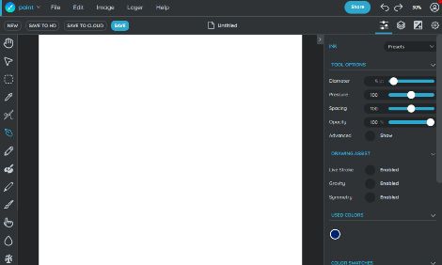
Year 4 – Photo editing
Information Technology
Learning sequence
Enquire as to why images might be cropped
Explore recolouring images
Explore adding and removing parts of an image
Explore using a range of tools to copy between images
Explore creating an image for a specific purpose
Review an image
Unit overview
We will be building on the work we have done in Year 1 creating images, to modify and combine existing images to create composite images. We will express our learning by creating a magical forest composite image.
Key questions
What is photo editing? How have these images been edited? Why might I crop this image?
Which image is most relevant?
Why do people change images? Is retouching an image obvious?
Is it okay to edit images?
Is this image real or made up?
Vocabulary
tools
undo
capture
media
export
digital image
cropping
filters
clone
copy and paste

Slide 30
Year 5

Slide 31
Year 5 – Digital citizenship
Digital Literacy
Learning sequence
Engage with being a good citizen
Explore online identity
Explore search technologies
Explore how technology can impact health and well-being
Explore risks of using different websites
Express how to be a good digital citizen
Unit overview
We will be learning what being a good digital citizen means, and how to develop a positive online identity that will remain online until adulthood. We will explore how to be safe online, and express our learning by creating the perfect digital citizen!
Key questions
What does it mean to be a good citizen?
What does it mean to have an online identity?
How can you report concerns and block users?
What is digital consent?
How can technology have a positive / negative impact on your life?
What does using this website cost?
Vocabulary
password
accept
private
social media
permission
emojis
memes
GIFs
collaborative
influencers

Slide 32
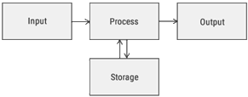
Year 5 – Systems and search engines
Computer Science
Learning sequence
Discover what a system is
Explore the different elements of a computer system
Explore how to find specific information on the internet
Explore what an index is
Explore how search engines rank results
Evaluate the limitations of search engines
Unit overview
We will be learning about how computer systems work, how a search engine computer system works, and we will create an information sheet to help others use a search engine.
Key questions
What is a system? What are the inputs and outputs? What are the processes?
What do the sensors do? How the system work? What does the system do when…?
How can you search the internet?
How does an index work?
What are the limitations of search engines?
Vocabulary
technology
network
server
World Wide Web
internet
system
search engine
indices
web crawler
ranking

Slide 33
Year 5 – Selection in quizzes
Computer Science
Learning sequence
Enquire about conditions in a program
Explore ‘if… then… else…’ statements
Explore the flow of a program that contains ‘if… then… else…’
Explore the outcome of user input in an algorithm
Implement algorithms and test the program
Identify the setup code I need and extend my program
Unit overview
We will be building upon our learning in Year 4 using Scratch by starting to introduce conditions into our coding allow our program to branch out depending on the user input. We will express our learning by creating a condition controlled quiz game!
Key questions
What is a condition? What is selection?
How are a condition and the outcome linked?
How is the flow of the program changed?
What conditions have you set?
Does your algorithm work as you planned?
How can you improve and extend your program?
Vocabulary
tinkering
decomposition
repeat
loop
concurrency
conditions
condition-controlled
if
then
else

Slide 34
Year 5 – Presentations
Information Technology
Learning sequence
Enquire about a slideshow
Explore how much content to include on a slide
Explore how pictures can make a slideshow more engaging
Explore the use of transitions and effects
Plan and create a slideshow
Improve and present a slideshow
Unit overview
We will be building on our work in previous years in using applications to present our work, to create electronic presentations. We will think of our audience as we choose how much information to include, and how to make our presentations engaging. We will express our learning with a topic presentation!
Key questions
How did the slideshow impact upon the presentation?
What makes a good slideshow?
How can we make a slideshow more engaging to the audience?
Should we always use complicated transitions?
How much content will you include on each slide?
Is your slide effective?
Vocabulary
select
font
layout
resize
insert
presentation
transition
slide
slideshow
background

Slide 35
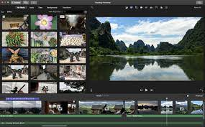
Year 5 – Video editing
Information Technology
Learning sequence
Find out about video features
Explore camera angles
Use a range of filming techniques
Outline and film material for a scene
Explore editing and reshooting
Edit, improve and evaluate a video
Unit overview
We will be learning about the different filming techniques and shorts used in online videos. We will then be creating and editing our own videos.
Note: due to storage requirements on the iPad, lessons 4 to 6 would benefit from being on the same day or week.
Key questions
What is happening? What can you see in the video?
What filming techniques can you see?
What is static camera? What is zoom? What is pan and tilt?
What filming techniques will you use?
Do you need to reshoot or edit?
Vocabulary
application
media
export
filters
clone
device
project
editing
split
trim

Slide 36
Year 6

Slide 37
Year 6 – Finding balance
Digital Literacy
Learning sequence
Engage using technology responsibly
Explore the risks of sharing online
Explore persuasive design
Explore pressures of using technology
Explore increasing privacy on apps
Express how to find balance using technology
Unit overview
We will be learning about the consideration we need to make to ensure that we embody our values of kindness, resilience, healthy and honesty when using technology. We will express our learning by creating an action plan to ensure we find balance when using technology.
Key questions
How can we socialise online in a sensible and responsible way?
What are the risks of sharing online?
How can you capture bullying online?
What is persuasive design?
How many times should you ask for help?
Why do you think apps and websites make it easier to have privacy settings low?
Vocabulary
identity
social media
permission
livestreaming
fake news
screen-grabs
persuasive design
phishing
PEGI / BBFC
terms and conditions

Slide 38
Year 6 – Online collaboration
Computer Science
Learning sequence
Enquire into how online addresses work
Explore the transfer of data over networks
Explore how to work collaboratively online
Explore how working together on the internet can be public or private
Explore different methods of communication online
Communicate how to work together online responsibly
Unit overview
We will be learning about how online networks work and transfer data, and how to choose the best way to work collaboratively online depending on the situation. We will then create a presentation to share what we have learnt collaboratively.
To:
___
From:
___
Packet no.
__
of
Total no. of packets.
__
_
_
_
_
_
_
_
_
10
7
1
1
H
e
l
l
o
!
Key questions
What is an IP address? What is a DNS?
How is data transferred between networks? What is a data packet?
How can we collaborate with others?
When might we reuse other people’s work?
What is the best way to communicate online to…?
Vocabulary
network
World Wide Web
internet
search engine
indices
DNS
protocols
packets
public
private

Slide 39
Year 6 – Variables in games
Computer Science
Learning sequence
Enquire into how a variable works
Explore how variables can change
Explore how to set a variable
Create algorithms for a project
Identify multiple variables using names
Use variables to extend a game
Unit overview
We will be building upon our learning in Year 5 using Scratch by adding variables into our projects to personalise our projects and allow them to keep score. We will express our learning by creating a catching game.
Key questions
What is a variable? What information can variables hold?
What can a variable hold?
What could be set and changed in this game?
How can you change and adapt and existing algorithm?
How can you set more than one variable? How could your game end?
Vocabulary
decomposition
repeat
loop
condition controlled
if, then, else
variable
constant
initialisation

Slide 40
Year 6 – Websites
Information Technology
Learning sequence
Enquire into what make an effective website
Explore common web page layouts
Explore copyright-free images
Add content and preview a web page
Create navigation paths using hyperlinks
Explore the implication on linking to other websites
Unit overview
We will be building on our learning in presenting information by creating websites using copyright free images and hyperlinks to navigate. We will express our learning by creating learning themed websites.
Note: permissions will need to be added to children’s Google accounts so that they can access Google Sites.
Key questions
What is a website? What is a web page? What is a browser?
What’s the purpose? How would you lay out your web page?
Why should I use copyright-free images?
How does it look? Does it look the same on different devices?
How do you navigate a website?
What are the reasons for and against linking to other websites?
Vocabulary
font
layout
resize
insert
background
navigation bars
HTML
hyperlinks
embed
preview

Slide 41
Year 6 – Audio editing
Information Technology
Learning sequence
Record audio
Explore how to edit and trim a recording
Explore how to combine audio tracks
Explore how to review and improve a soundtrack
Explore how to arrange multiple sounds
Evaluate the effectiveness of a recording
Unit overview
We will be learning how to use music editing software like Garage Band to create a soundtrack for a film. We will combine tracks to create a multi-track audio recording before combining this with video using movie editing software like iMovie.
Key questions
How can be sound used to entertain?
What impact does sound have?
How can you record and modify a soundtrack.
What effect does combining tracks have on a soundtrack?
How many layers are in the soundtrack?
How can you export and use your soundtrack?
What impact does your soundtrack have on a film?
Vocabulary
media
export
cropping
editing
trim
audio
align
layer
tracks
mp3

