Slide 1
RSHE
RSHE Life skills Knowledge and Skill Progression

Slide 2
RSHE
Year 1

Slide 3
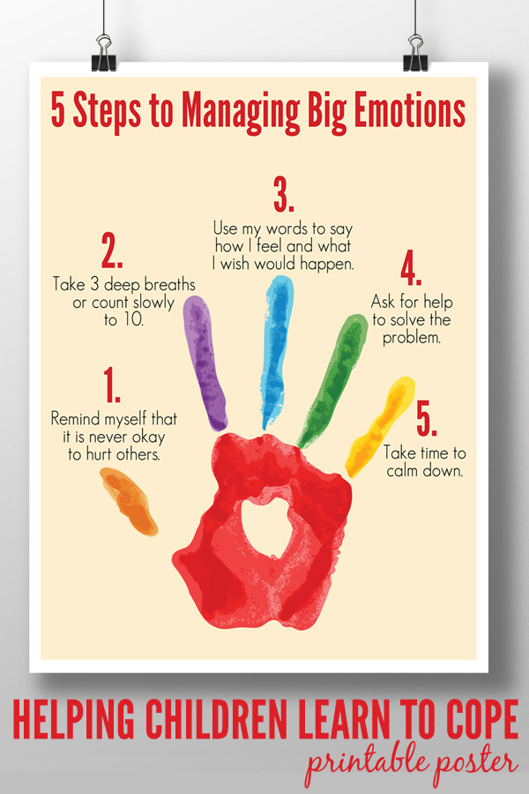
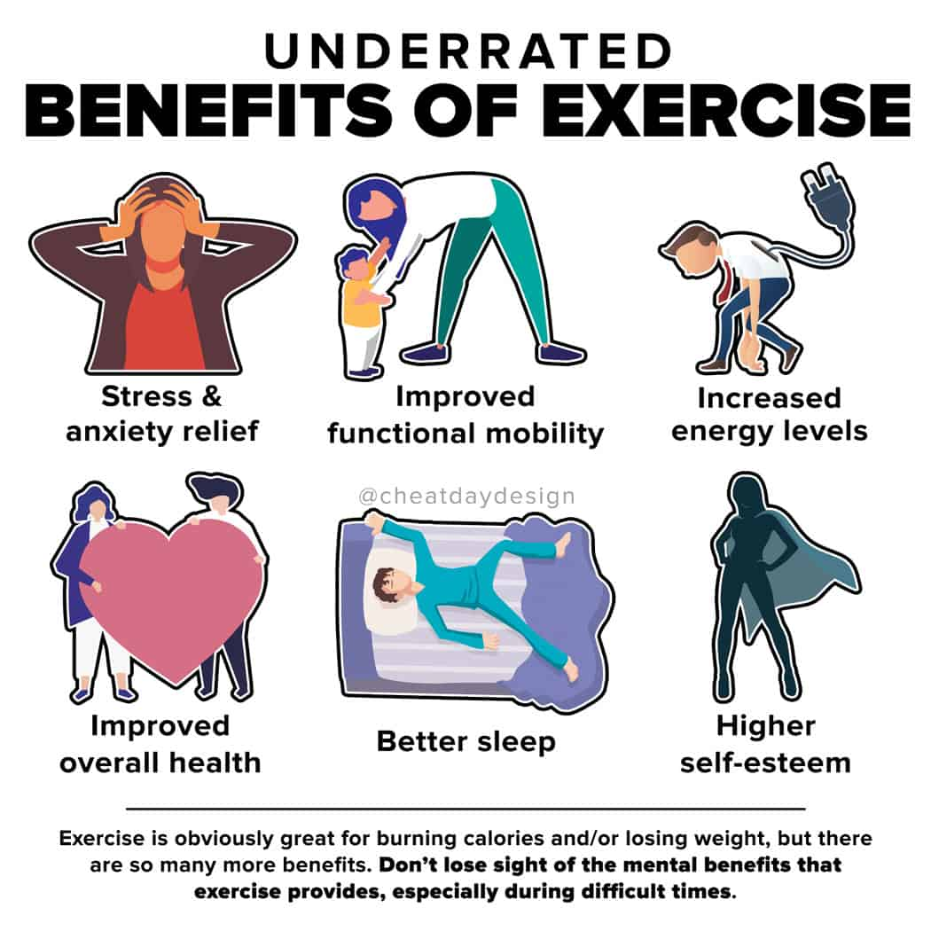
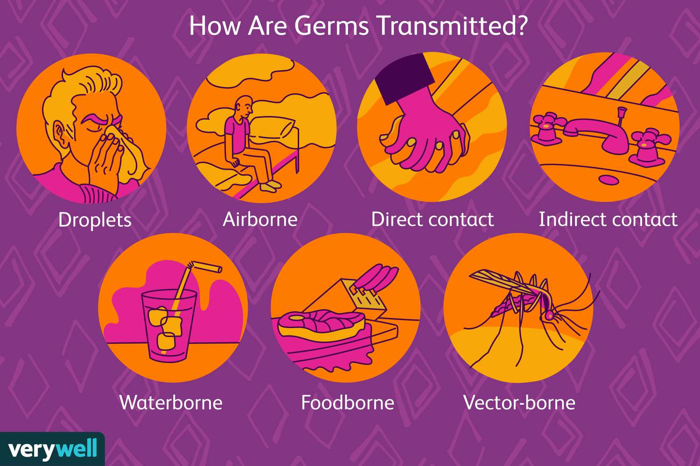
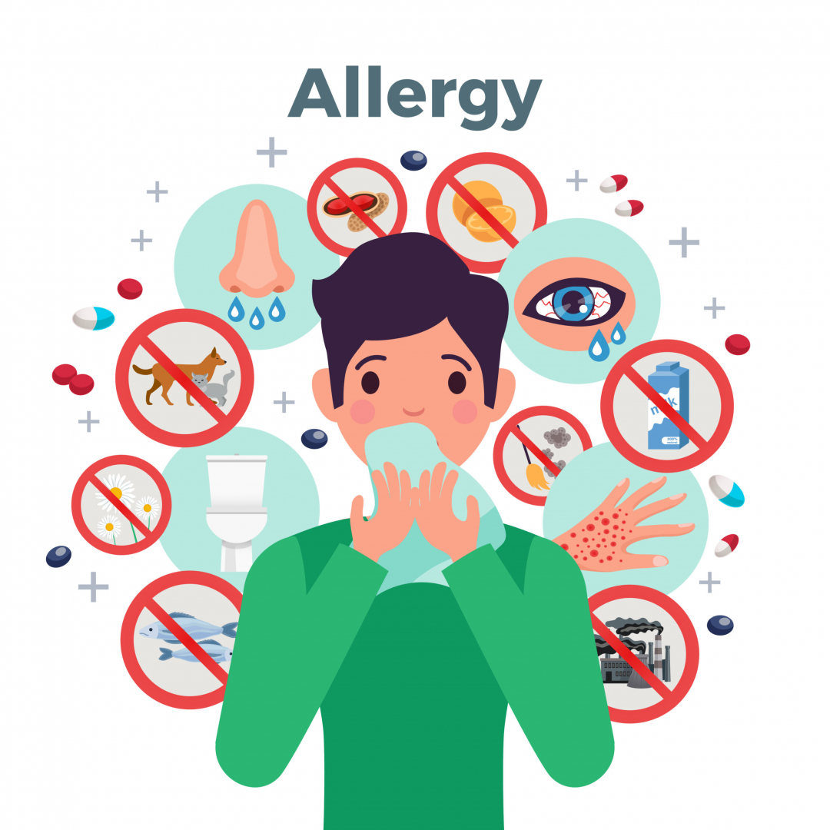
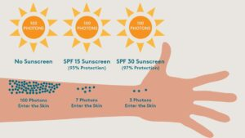
Year RSHE Life skills- Year 1
RSHE
Strategy
Routine
Relaxation
Germs
Allergy
Allergen
Food allergy
Allergic reaction
Vocabulary:
To describe and understand my feelings and develop simple strategies for managing them.
To understand the benefits of physical activity and rest
To begin to understand how germs are spread and how we can stop them spreading
To begin to understand the risks associated with the sun
To begin to understand allergies
Learning Sequence:

Slide 4
RSHE
Year 2

Slide 5
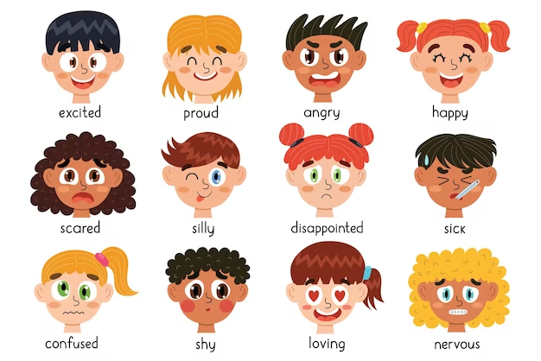
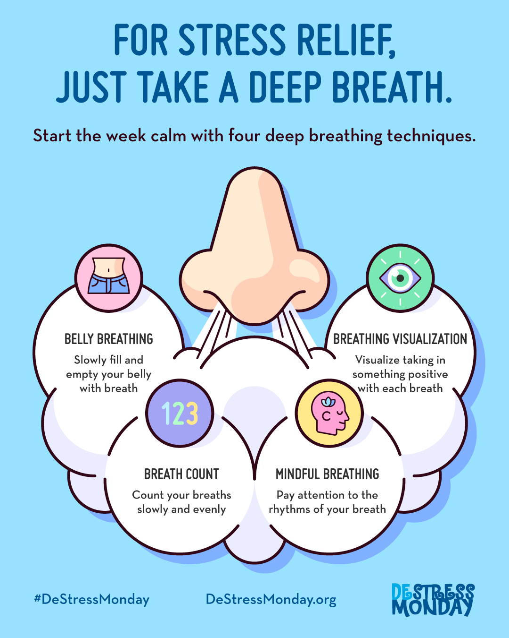
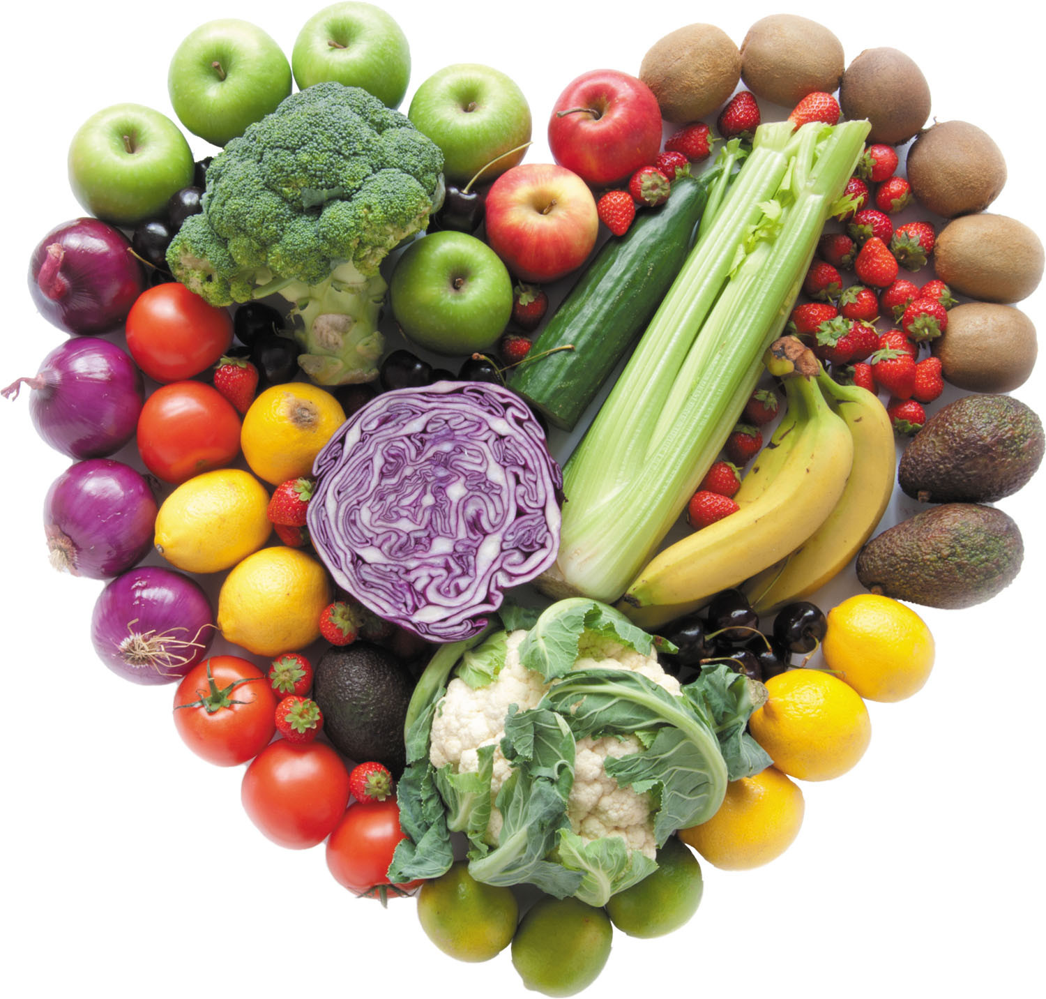
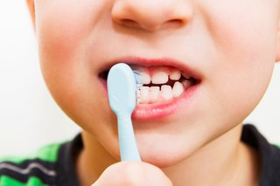
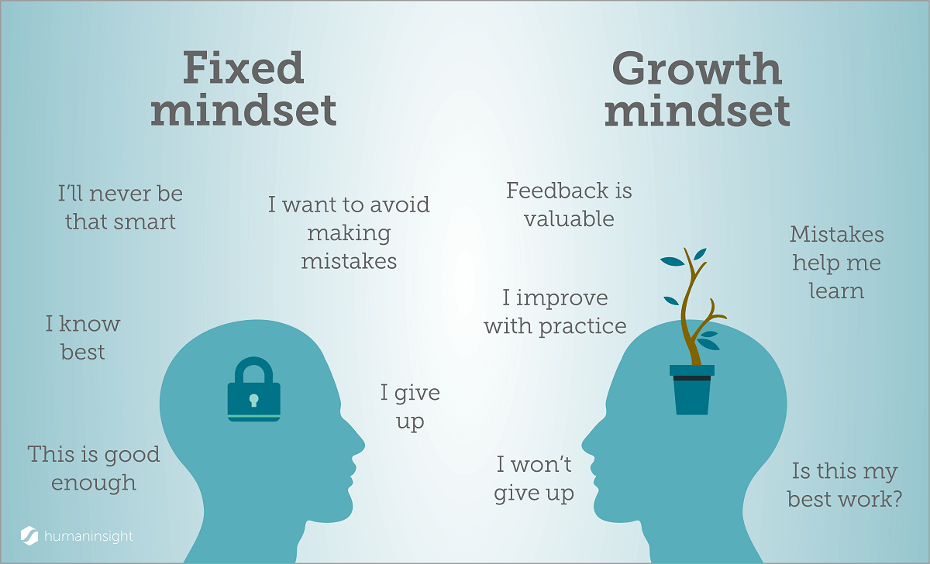
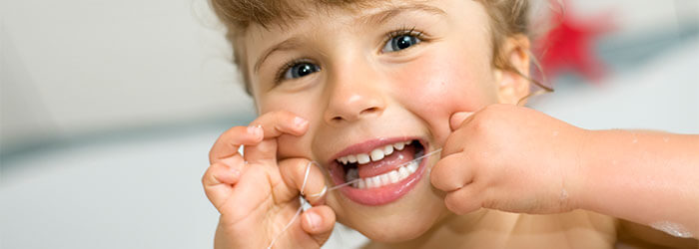
Year RSHE Life skills- 2
RSHE
Frustrated
Self-awareness
Feeling
Emotion
Frustrating
Growth mindset
Immune system
Healthy diet
Portion
Nutrients
Weight
Tooth decay
Vocabulary:
Learning Sequence:
Experiencing different emotions
Relaxation breathing exercises
Developing a growth mindset
Healthy diet
Looking after our teeth

Slide 6
RSHE
Year 3

Slide 7
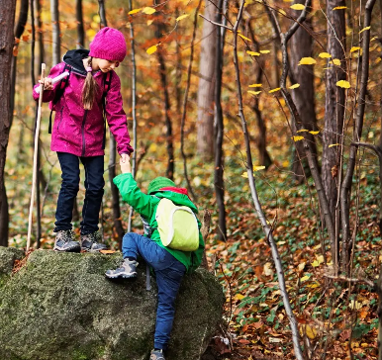
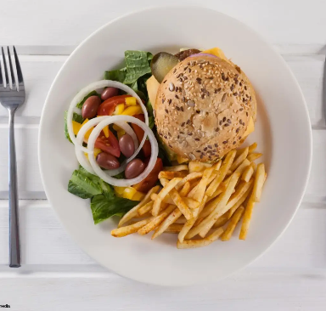
Year 3 RSHE Life skills- Health and Wellbeing
RSHE
alone
balance
barriers
belonging
diet
healthy
identity
lonely
relax
resilience
stretch
My healthy diary
Resilience: breaking down barriers
Diet and dental health
Vocabulary:
Learning Sequence:
What food gives us energy? Why is it important to have the correct amount of food for our bodies? What else keeps us healthy?
What are we good at? How can a problem be broken down into smaller goals so that it can be achieved? What is the purpose of this? How else can we use this strategy? How can we solve problems or overcome challenges?
What do we like to eat? What is healthy? What is a balanced diet? Why do we need different types of food? Why do we need to look after our teeth?
Key Questions:

Slide 8
RSHE
Year 4

Slide 9
Year 4 RSHE Life skills- Health and Wellbeing
RSHE
To understand how we can look after our teeth.
To understand what relaxation feels like.
To develop a growth mindset and understand that mistakes are useful.
To identify my own strengths and begin to see how they can affect others.
To identify what’s important to me and to take responsibility for my own happiness.
To understand a range of emotions.
To begin to understand what mental health is and who can help if they need it.
tooth
teeth
sugary drink
healthy
brush
dentist
fluoride
toothpaste
Learning Sequence:
Vocabulary:
nervous
anxious
shocked
positive emotions
excited
joyful
astonished
grateful
job
skills
role
feelings
emotions
happy
disappointed
angry
relax
place
calm
visualise
imagine
mistake
learn
resilience
enthusiastic
negative emotions
sad
worried
physical health
mental health
What key messages about dental health do we want to share? How can we share information to get a message across?
What places do we find relaxing? What does calm feel like?
How do you feel if you make a mistake? Why are mistakes useful? What can you do if you make a mistake?
4. What types of jobs are there? How do these jobs help other people?
5. What actions can you take to reach a goal? How can other people help you? Who can you talk to if you feel unhappy or are worried about something?
6. What different emotions can we experience? How can emotions change over time? What does it mean to have a problem with your mental health? Where can you get help when you have a problem with your mental health?
Key Questions:

Slide 10
RSHE
Year 5

Slide 11
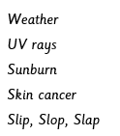
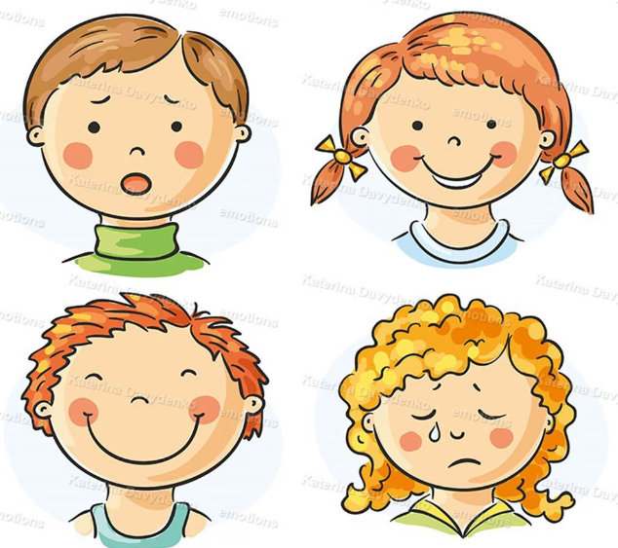
Year RSHE Life skills- Year 5
RSHE
To understand the benefits of sleep
To take responsibility for their own feelings and actions and to use vocabulary to describe these
To understand and be able to plan healthy meals
To understand risks associated with the sun and how these can be avoided, taking independence for their own sun protection
Quantity
Sleep
Rest
Relax
Quality
Destiny
Emotion
Assertive
Choice
Feeling
Responsibility
Risk
Learning Sequence:
Vocabulary:

Slide 12
RSHE
Year 6

Slide 13
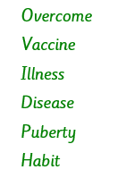
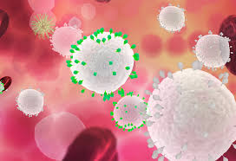
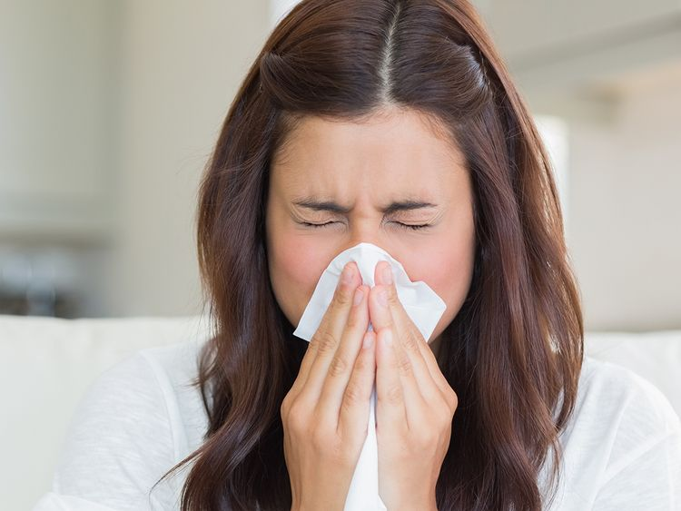
Year 6 RSHE- Health and Wellbeing
RSHE
Learning Sequence
To understand and plan for a healthy lifestyle
To understand the potential impact of technology on physical and mental health
To reflect on skills they have developed to identify and respond to difficult situations
Understand ways that we help prevent ourselves and others becoming ill
To understand what happens when we are ill and begin to understand when to seek support
Vocation
Consequence
Resilience
Immunisation
World Health Organisation
National Health Service
Future
Values
Career
Responsibility
Physical health
Mental health
Vocabulary

Slide 14
Year RSHE Life skills-
RSHE
Vocabulary:
Learning Sequence:
?
Key Questions:

