Slide 1
Geography Learning Scaffolds

Slide 2
EYFS

Slide 3
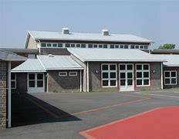
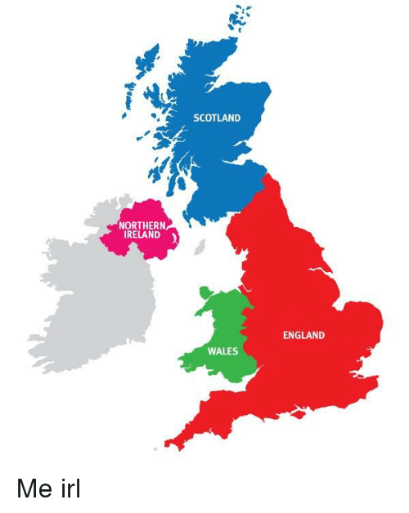
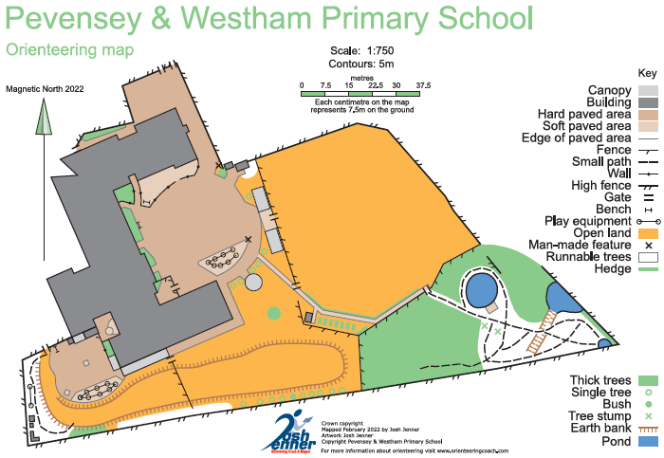
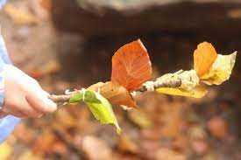
Forest School
Geography
EYFS – PaWS
What features are found around our school grounds?
Learning sequence
What can we find around the school grounds?
What features are man-made?
How can I describe a route?
How can we create a map for the school grounds?
Vocabulary
woodland
grassland
pond
playground
boundary
map
symbol
route
school
human
natural
building
Knowledge
Map

Slide 4
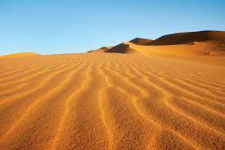
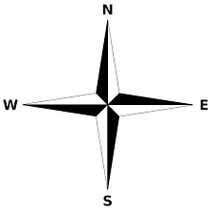
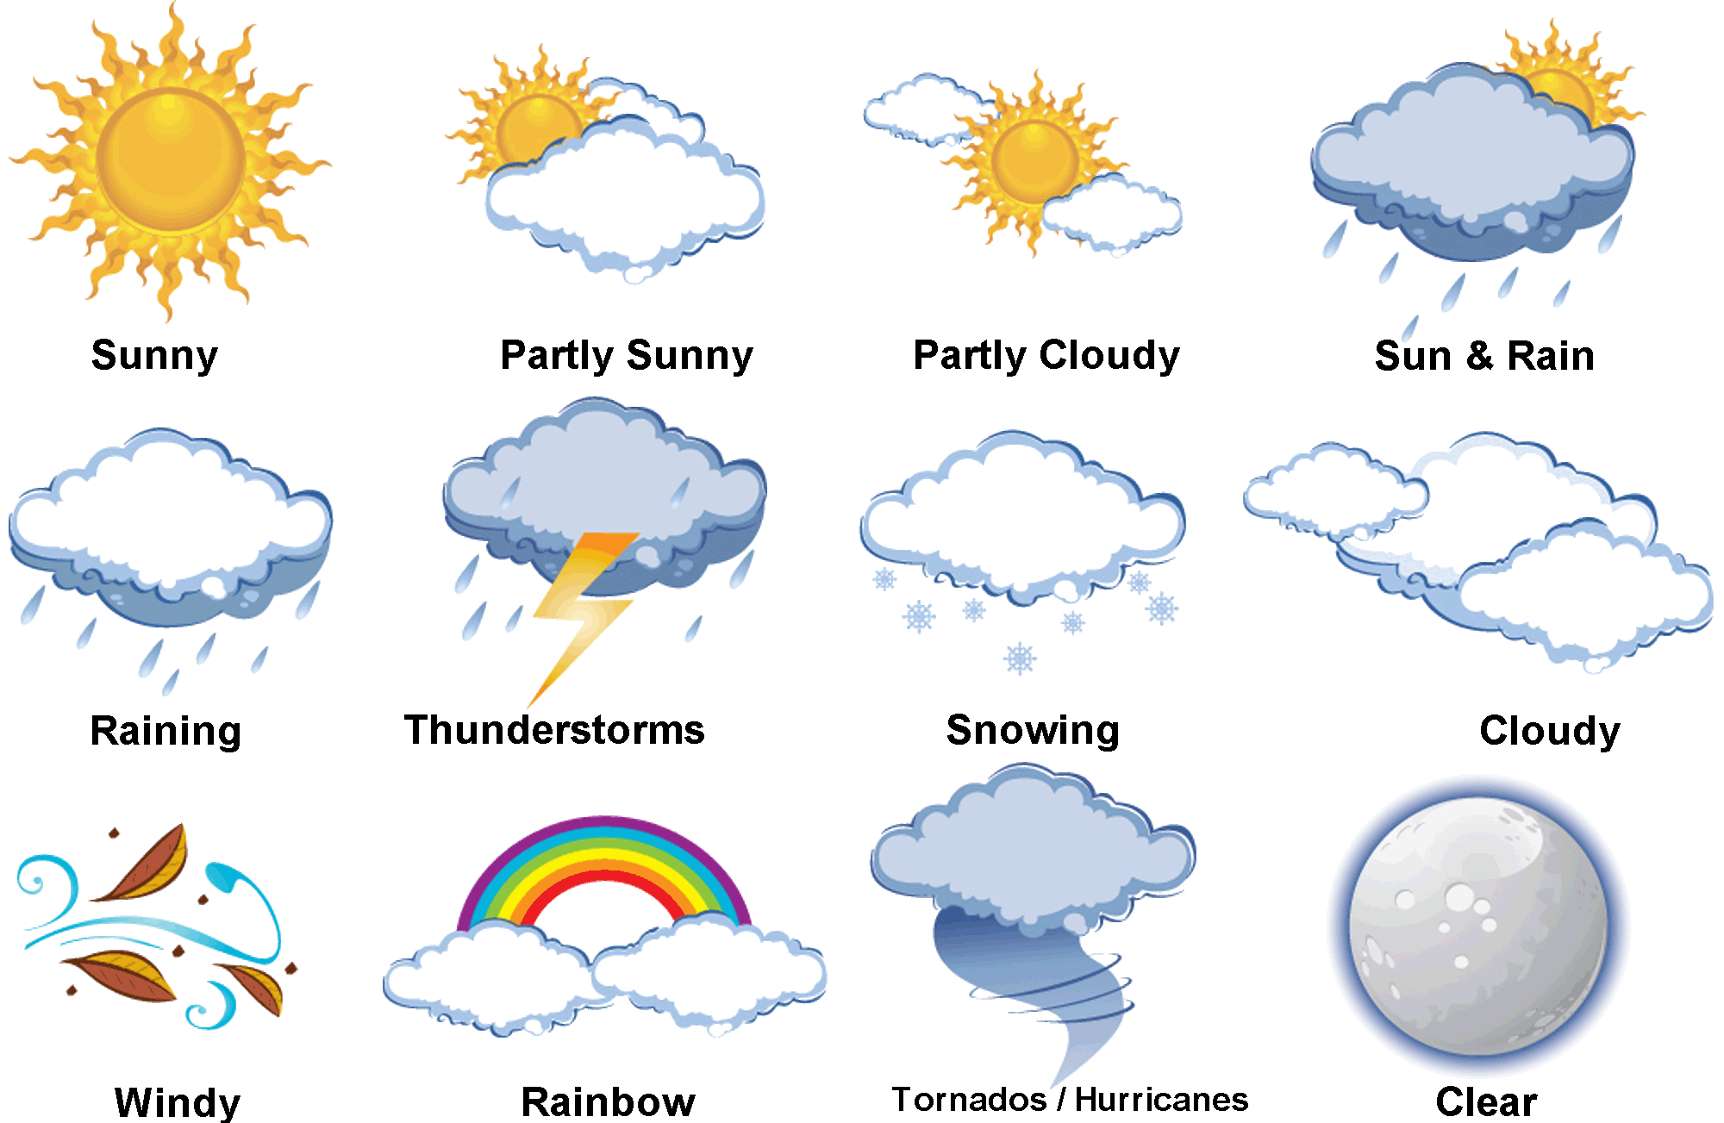
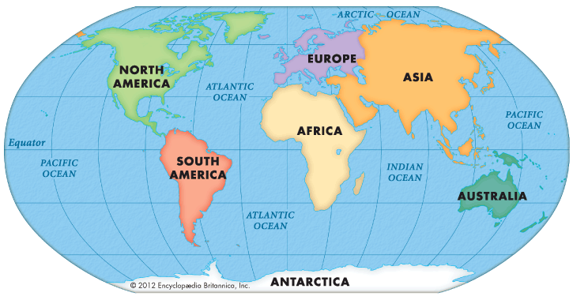
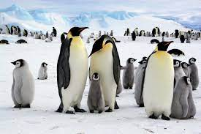
PaWS Weather Station
Geography
EYFS – The Weather
What is the weather like around the world?
Learning sequence
What is weather like today?
How does the weather affect us?
What are the 4 seasons?
Can we forecast the weather?
What is it like at the North and South Pole?
What is it like by the Equator?
Vocabulary
wet
frost
freezing
ice
Equator
North Pole
South Pole
desert
dry
weather
cold
hot
Knowledge
Map

Slide 5
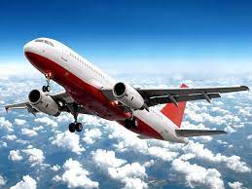
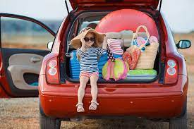
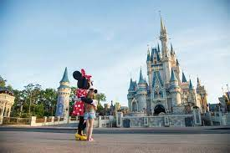
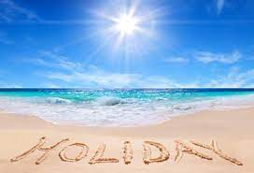
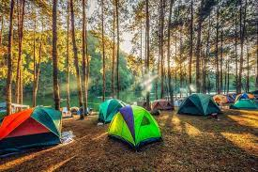
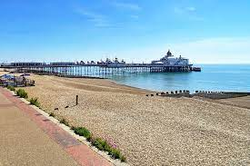
EYFS – Holidays
Geography
Where do we go on holiday? Why?
Learning sequence
Where are we going on holiday?
What are we doing on holiday?
How are we travelling to our destination?
Are all holidays the same?
Vocabulary
distance
beach
season
location
Equator
North Pole
South Pole
holiday
weather
tourist
destination
travel
Knowledge
Map

Slide 6
Year 1

Slide 7
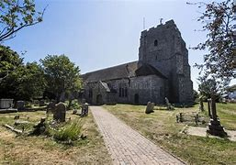
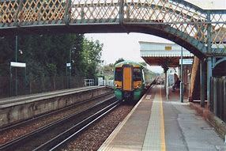
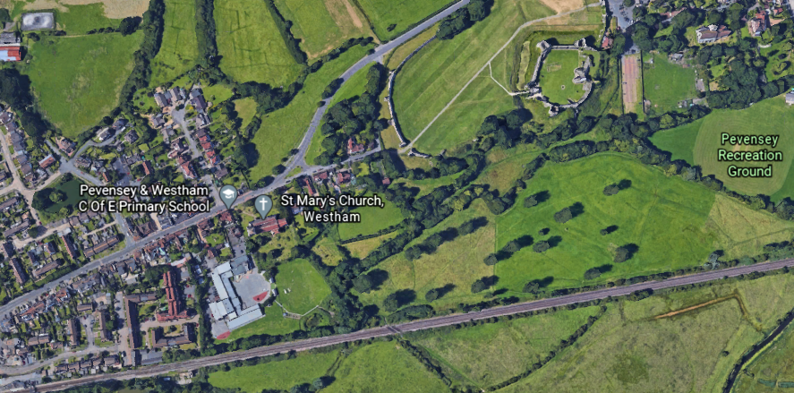
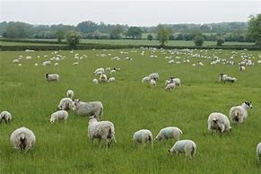
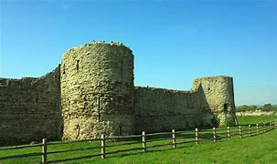
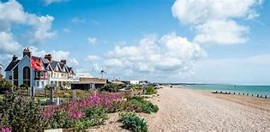
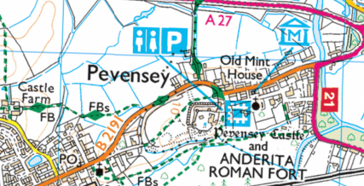
Year 1 – Pevensey and Westham
Geography
Exploring our Local Area
What is the geography of where I live?
Learning sequence
Vocabulary
UK
town
map
building
castle
city
beach
geography
symbol
human
physical
capital
country
coast
countryside
local
village
transport residential economic activity
public services
What features do you find in Pevensey and Westham?
Where are they in relation to the school?
What route would you take when going on a tour of PaW?
How is the land used around our local area?
How has Pevensey and Westham changed?
What is the United Kingdom? Where do we live?
Knowledge
Map

Slide 8
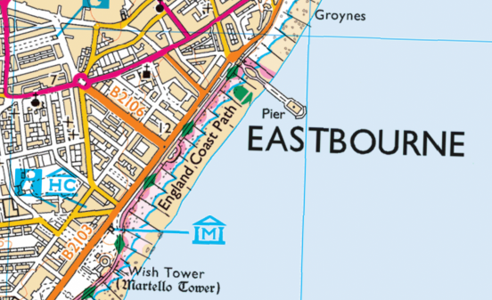
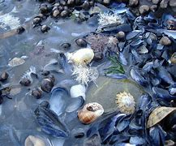
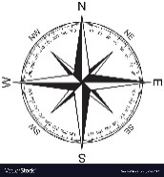
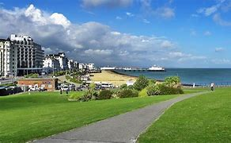
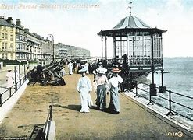
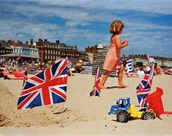
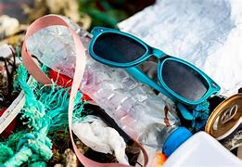
Year 1 – The Sunshine Coast
Geography
Why do we love being beside the sea so much?
Beach Trip
Learning sequence
What features are found at the seaside?
Why do people go on holiday to the seaside?
How have seaside holidays changed?
What habitats and animals are found by the seaside?
What negative impacts are people having on the seaside?
What are potential solutions to these problems?
Vocabulary
building
country
beach
coast
weather
climate
capital
countryside
shop
local
sea
town
road
seaside
season
UK
island
human
physical
recreation
pollution
leisure
urban
rural
resort
tide
habitat
tourism
Knowledge
Map

Slide 9
Year 2

Slide 10
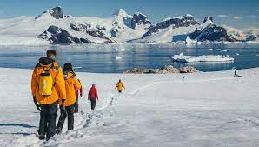
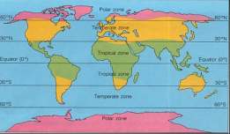
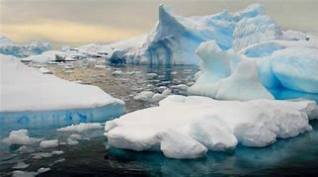
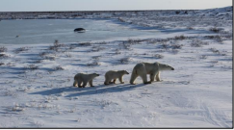
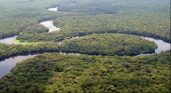
Year 2 – Welcome to our World
Geography
Drusillas
What is the weather, climate and environment like around the world?
Learning sequence
What are continents and oceans?
Where are the world’s hot and cold places?
How does Antarctica compare with the Sahara Desert?
How is the Arctic different from the Antarctic?
How have animals adapted to survive in Antarctica?
How would you plan an expedition from Canada to Antarctica?
Vocabulary
polar
adapt
atlas
continent
climate
desert
environment
tropical
globe
habitat
hemisphere
ocean
Circles
temperate
predator
seasons
temperature
weather
geography
country
human
physical
wildlife
Poles
Equator
Map
Knowledge

Slide 11
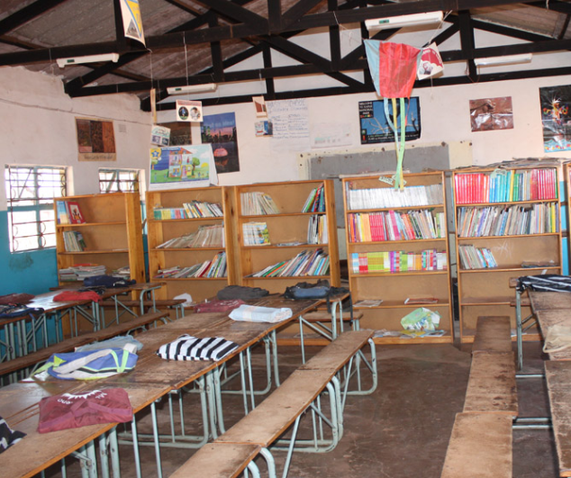
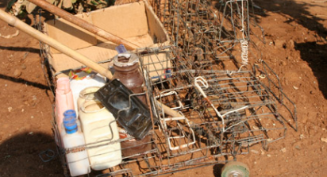
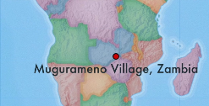
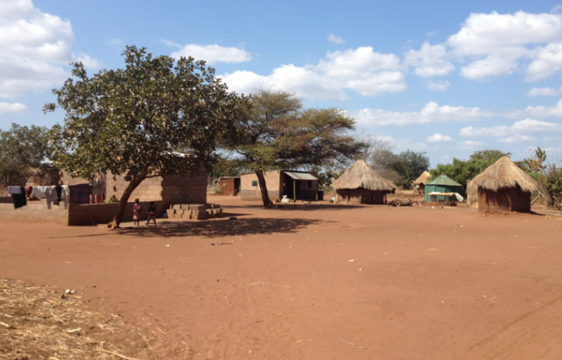
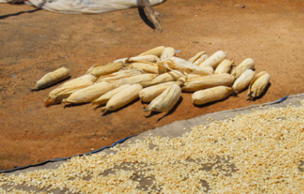
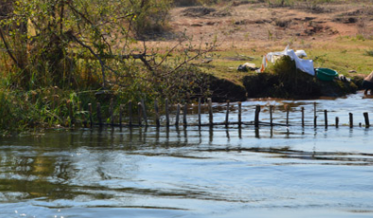
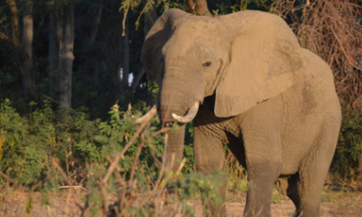
Year 2 – Off to Africa!
Geography
Where is Mugurameno Village? How does Mugurameno Village compare with where I live?
Zambia Day!
Learning sequence
Where is Zambia? Where is Mugurameno Village?
Mugurameno Village: What do I notice? What do I wonder?
How do people use the River Zambezi?
What do people eat in Mugurameno Village?
Friend or foe? Wild animals around Muguranmeno Village
Living in Muguranmeno Village
Vocabulary
seasons
temperature
weather
geography
country
farm
human
Equator
symbols
savannah
flood
physical
soil
Hemispheres
adapt
atlas
continent
crop
desert
field
National Park
habitat
recycling
market
mining
population
waterfall
wildlife
Knowledge
Map

Slide 12
Year 3

Slide 13
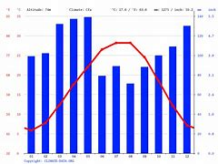
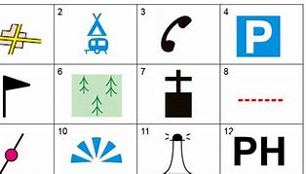
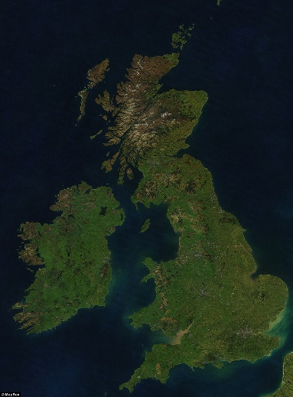
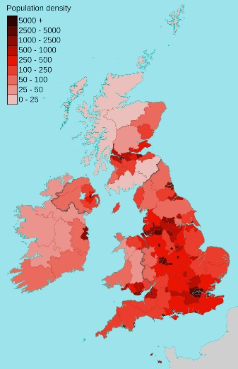
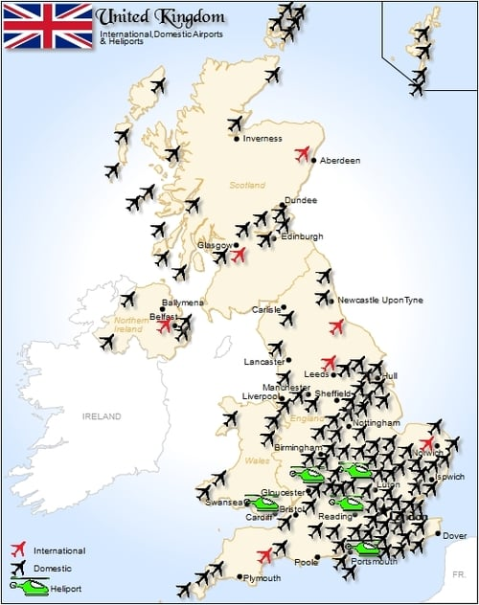
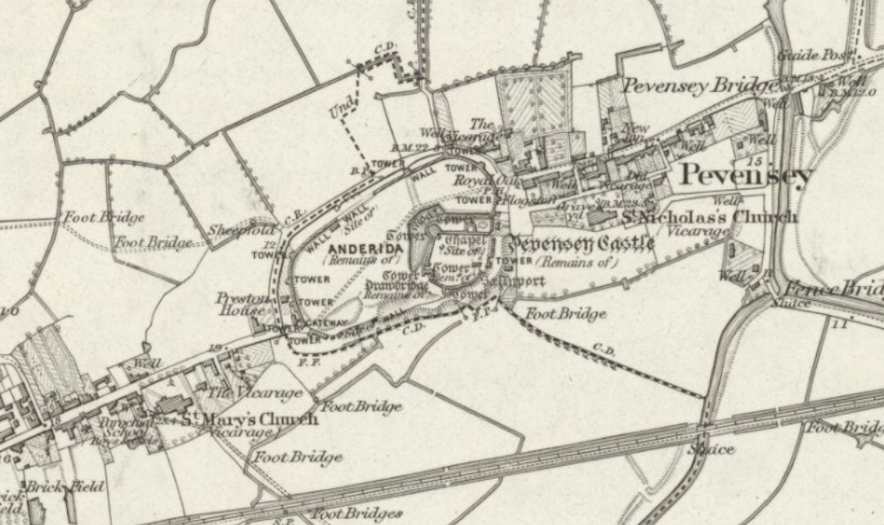
Year 3 – The United Kingdom
Geography
Why is the Southeast so heavily populated?
Learning sequence
Vocabulary
Where do I live?
How does the topography of different areas of the UK compare?
Why does the climate of different areas of the UK vary?
What transport links are found around the UK?
How does land use vary across the UK? Why?
How has the population of our local area changed? Why?
human
physical
climate
transport
symbol
UK
country
temperature
local
capital
natural
density
resources
trade
coastline
island
landmark
city
population
industry
economy
land use
settle
settlement
OS map
counties
development
topography
Knowledge
Map

Slide 14
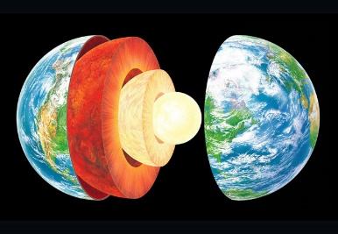
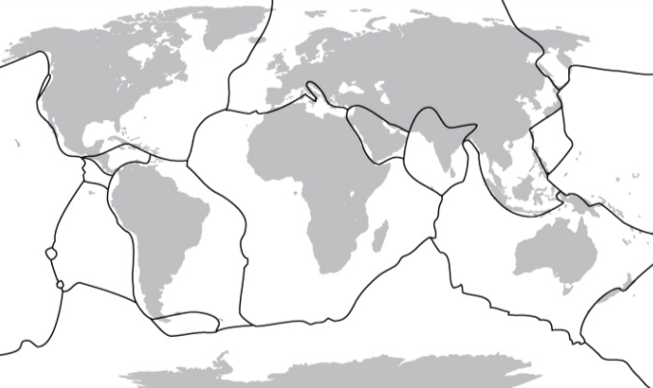
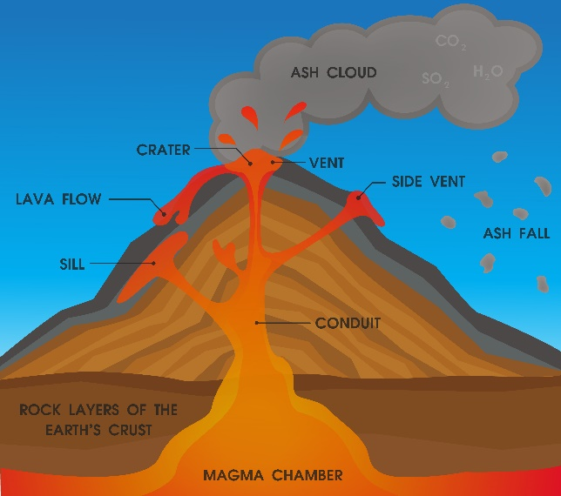
Year 3 – Extreme Earth
Geography
Model Volcanoes
Why and where do volcanoes and earthquakes occur?
Learning sequence
What is the structure of the Earth?
How are mountains formed? Where?
What occurs at the boundaries between the Earth’s plates?
What are the key features of a volcano?
Where are volcanoes? When do they erupt?
Vesuvius 79 AD: What happens when a volcano erupts?
Why do people live near volcanoes?
Vocabulary
eruption
fault-line
geothermal
landform
landslide
lava
Magma
pyroclastic
mantle
plate
Richter Scale
tectonic
tremor
tsunami
vent
epicentre
globe
physical
vegetation
Equator
hemisphere
climate
mountain
aftershock
ash
core
crater
crust
disaster
dormant
Knowledge
Map

Slide 15
Year 4

Slide 16
Year 4 – National Parks
Geography
What are National Parks for?
Orienteering
Vocabulary
Learning sequence
What is a National Park?
Where are the UK’s National Parks?
Why was the South Downs made into a National Park?
How have the South Downs changed?
What challenges are the South Downs National Park Authority facing?
What are different solutions to these challenges?
Vocabulary
adapt
atlas
continent
coral reef
Poles
desert
wildlife
globe
habitat
Equator
ocean
population
rainforest
Circles
hemisphere
climate
seasons
temperature
weather
geography
country
human
physical
island
western
eastern
northern
southern
human
physical
OS map
vegetation
nature
tourism
landscape
topography
symbol
traffic
pollution
rural
urban
aagriculture
environment
habitat
land use
National Park
conserve
sustainable
management
conflict
cultural heritage
Knowledge
Map

Slide 17
Year 4 – Water
Geography
Friend of Foe?: What challenges are coastal and river communities facing?
Sea defences at Pevensey Bay
Vocabulary
Learning sequence
What is the water cycle?
What are rivers and what are their key features?
Where are the world’s and UK’s major rivers?
How does the River Cuckmere change on its journey to the sea?
Why do people choose to live by the River Ganges in Bangladesh?
What is being done to control river flooding in Bangladesh?
How is our local area being threatened by flooding?
What is being done to control coastal flooding at Pevensey Bay?
Vocabulary
hemisphere
climate
seasons
temperature
weather
geography
country
adapt
atlas
continent
coral reef
Poles
desert
wildlife
globe
habitat
Equator
ocean
population
rainforest
Circles
estuary
course
drainage
erosion
irrigation
precipitation
evaporation
human
physical
island
western
eastern
northern
southern
human
physical
mountain
valley
OS map
coast
river
flood plain
meander
mouth
source
tributary
waterfall
lake
groundwater
condensation
transpiration
levee
longshore drift
defences
Knowledge
Map

Slide 18
Year 5

Slide 19
Year 5 – Road Trip USA!
Geography
‘A larger version of the United Kingdom?’ - How does the USA compare with the UK?
‘Seven Worlds, One Planet’
Learning sequence
From a snapshot, how does the USA compare with the UK?
How much larger is the USA?
How does the weather compare in the USA? Why?
How do the physical environments compare in the USA? Why?
How does population density compare in the USA? Why?
How do National Parks in the USA compare?
Is the USA a larger version of the UK?
Vocabulary
village
city
town
village
symbols
weather
landmark
northwest
northeast
southeast
southwest
hemisphere
human
physical
hamlet
urban
rural
tourism
urbanisation
landscape
skyline
arid
biodiversity
biome
climate
National Park
economy
industry
Knowledge
Map

Slide 20
Year 5 – Rainforests
Geography
Should people be allowed to cut down the world’s rainforests?
Forest School
Learning sequence
What do we mean by a ‘Rainforest Biome?’
Why are rainforests so biodiverse?
Why do people cut down the world’s rainforests?
What is the impact of deforestation on a local and global scale?
How are projects like Fairtrade trying to protect the rainforests and the indigenous groups who live there?
Should people be allowed to cut down the world’s rainforests?
Vocabulary
Tropics
Equator
Hemispheres
humidity
temperate
climate
biodiversity
biome
canopy
economy
industry
deforestation
temperature
agriculture
tourism
logging
indigenous
sustainable
ecosystem
emergent
environmentalist
urbanisation
understory
tropical
Knowledge
Map
Importance
Impacts
Solutions

Slide 21
Year 6

Slide 22
Year 6 – Greece
Geography
Why is tourism important in Greece? Why does Greece have an immigration crisis?
Learning sequence
Building a picture of Europe – What are the key patterns and features?
What are the key physical and human features in Greece?
Is tourism important in Greece?
Is Thessaloniki another ‘Sunshine Resort’ like Eastbourne?
Why does Greece have an immigration crisis?
?
Vocabulary
urban
urbanisation
rural
biomes
symbols
climate
landmark
trade
agriculture
migration
refugees
GMT
latitude
longitude
time zones
terrain
Mediterranean
administrative
immigration
energy
finance
tourism
human
physical
industry
economy
countries
settlement
Map
Knowledge

Slide 23
Changes in our Local Area
Year 6 – Changing World
Geography
How is climate change affecting the world? How will it impact me?
Learning sequence
What is the ‘greenhouse effect’?
Case Studies: What is the effect of global warming on different locations around the world?
Hurricanes in Florida: What is the effect of global warming?
How might climate change affect our local area?
How can we protect our planet?
Vocabulary
Tropics
ecosystem
extreme
indigenous
sustainable
temperate
physical
Equator
climate
human
temperature
Hemispheres
agriculture
habitat
pollution
management
precipitation
deforestation
environment
disaster
conserve
recycle
renewable
latitude
longitude
energy
global warming
greenhouse gas
Knowledge
Map

