Slide 1
History Learning Scaffolds

Slide 2
EYFS

Slide 3
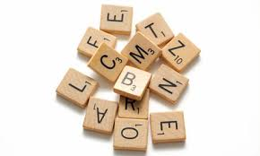
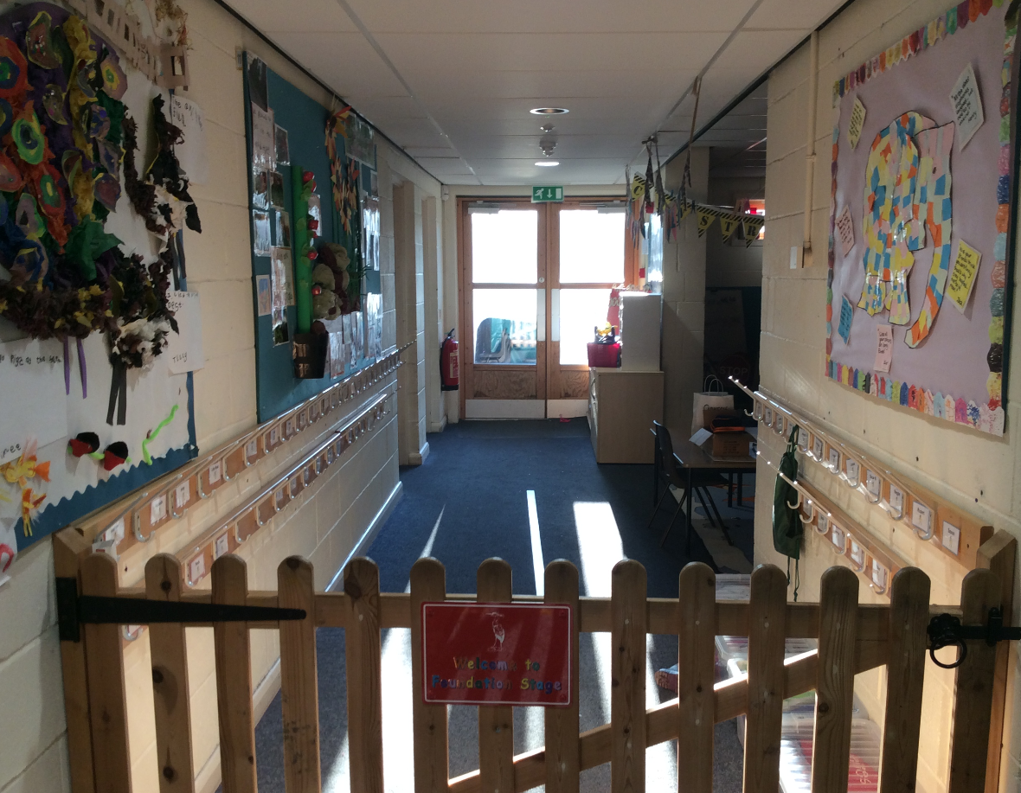
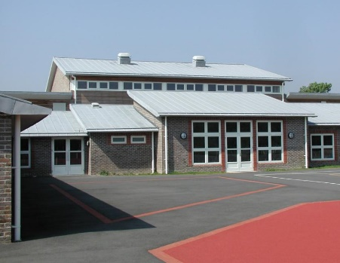
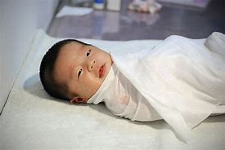
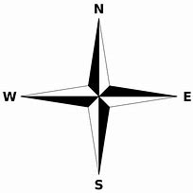
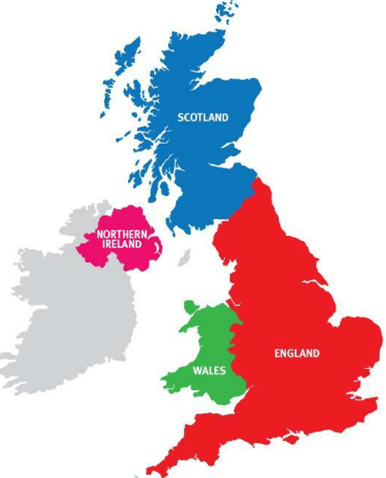
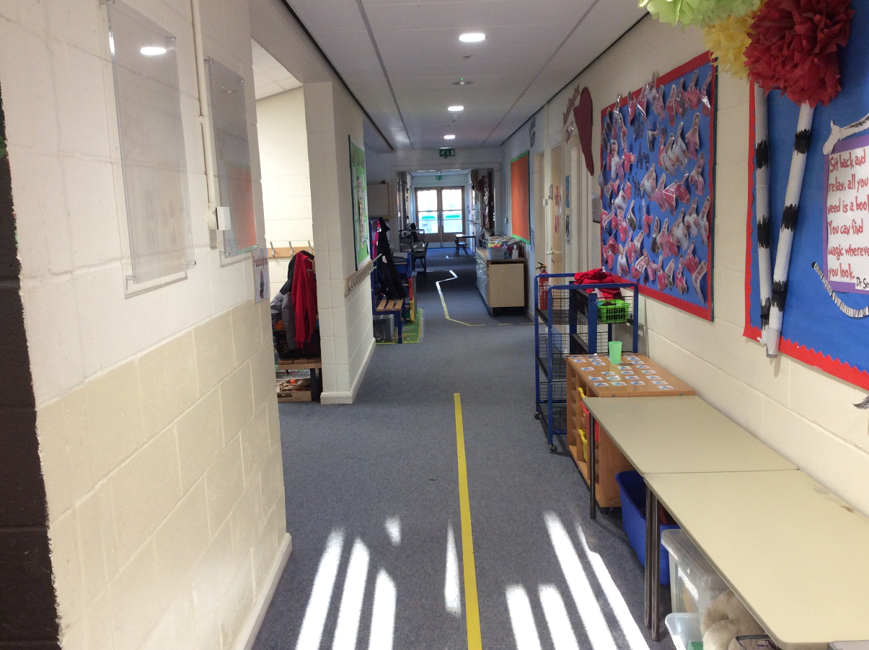
EYFS – My Story
History
What changes have occurred in my lifetime? How have I changed?
Learning sequence
To be taught throughout the year. Stories read during the pupils time in EYFS will allow all historical concepts to be introduced and discussed. There will also be opportunities for the pupils to discuss their own backgrounds, past and present.
Vocabulary
change
different
old
past
same
yesterday
today
present
born
school
nursery
year 1
photo
story
Knowledge
Map
Chronology
The past History
The present
The Future
I will go to secondary school
My parents/carers were born
I was born
Now
I will move up classes

Slide 4
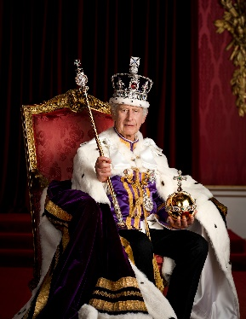
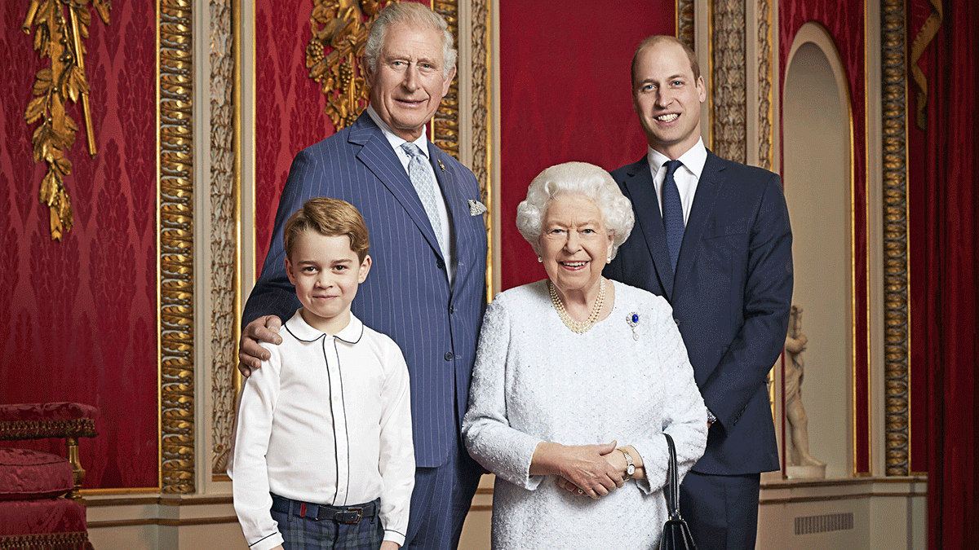
EYFS – The Royal Family
History
Who is Charles III and why is he important?
Learning sequence
Who is King Charles?
How do we know when and how Prince Charles became King?
How has life changed for the king since he became King?
What important events have happened since his birth?
What were other coronations like in the past?
How do we see the importance of King Charles all around us in our lives today?
Vocabulary
yesterday
today
present
coronation
Queen
King
British
United Kingdom
important
Monarch
past
Knowledge
Map
Chronology
The past History
The present
The Future
I will go to secondary school
My parents/carers were born
I was born
Now
I will move up classes

Slide 5
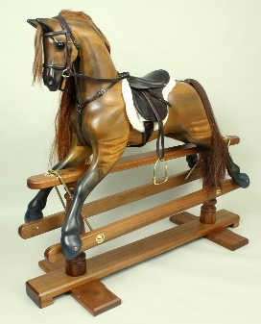
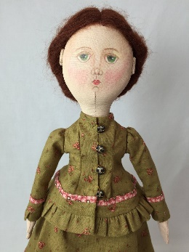
EYFS – Toys
History
Have the toys that we play with changed?
Learning sequence
What are our toys like today?
What are other people’s toys like?
How can we tell these toys are old?
What were our grandparents’ toys like and how do we know?
Who played with these toys a long time ago?
How can we set up a Toy Museum?
Vocabulary
change
different
old
past
artefact
same
yesterday
today
present
long ago museum
Knowledge
Map
Chronology
The past History
The present
The Future
I will go to secondary school
My parents/carers were born
I was born
Now
I will move up classes

Slide 6
Year 1

Slide 7
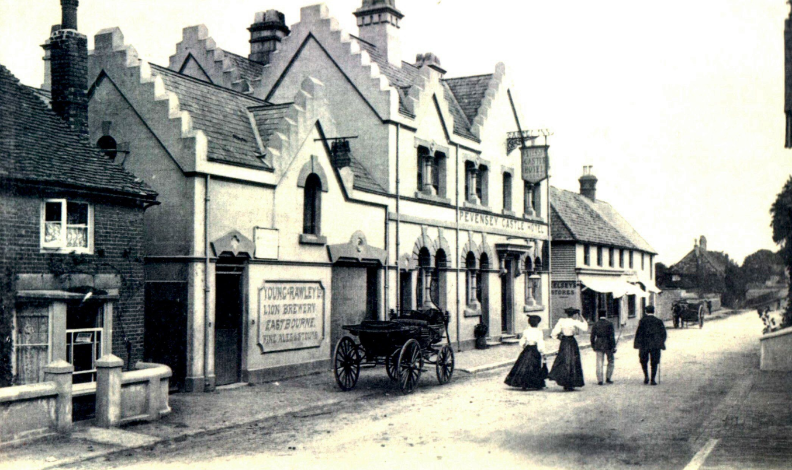
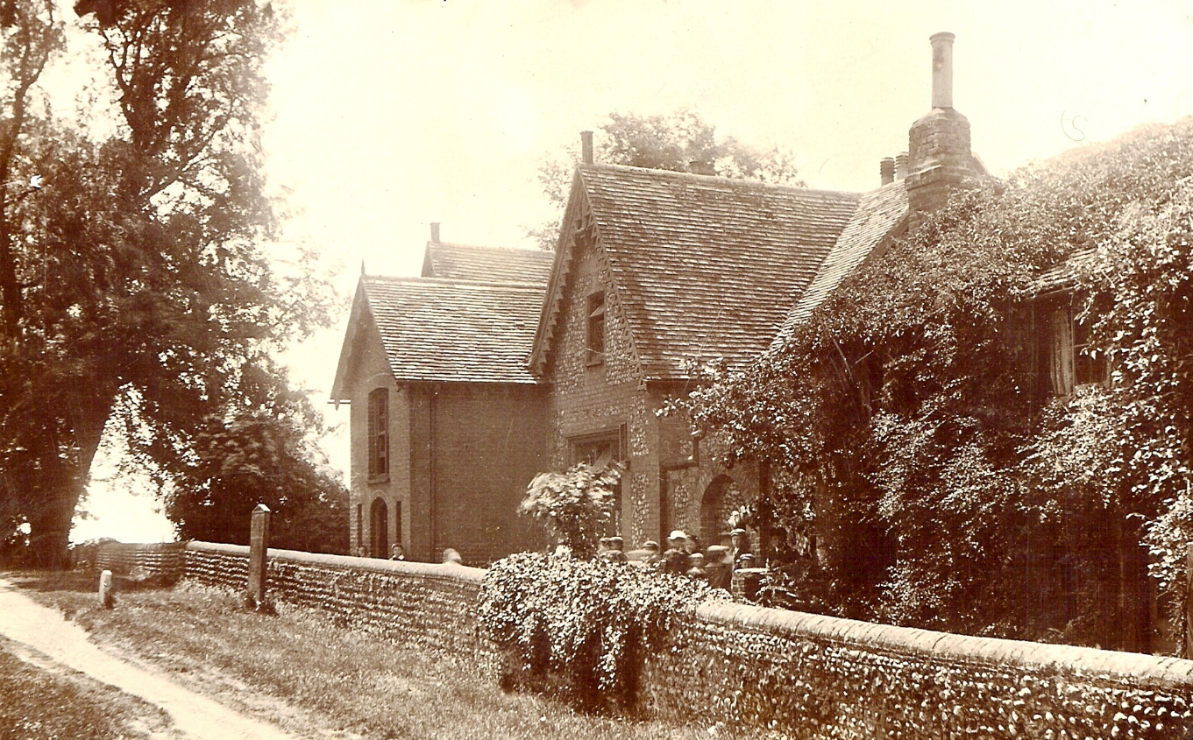
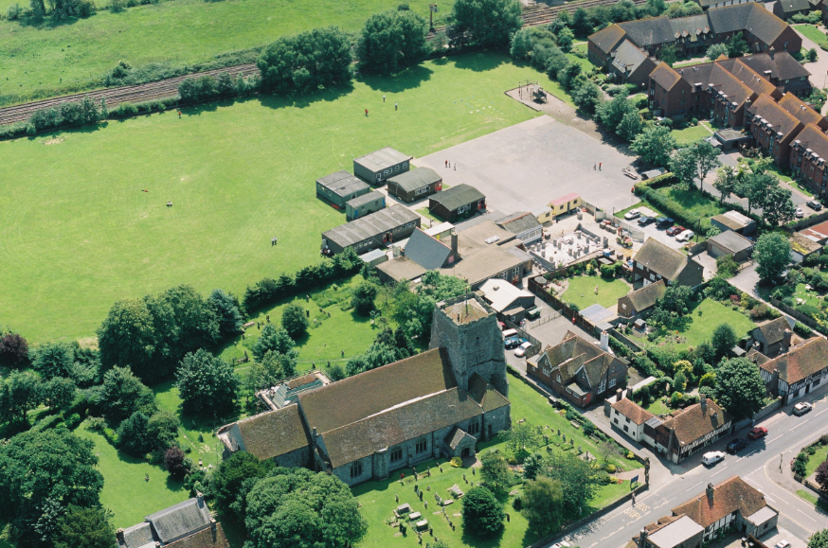
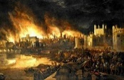
Year 1 – Our School
History
What were schools like for our parents and grandparents? How has PaWS changed?
Former Pupils!
Learning sequence
What do I notice when I look at old photographs of Pevensey and Westham and the school?
What do I discover when I ask an adult about their time at school?
The Old School Building: What was it like?
How does our present school compare with its past?
Vocabulary
technology
differences
similarities
source
long ago
local
compare
recent
artefact
change
present
old
different
UK
photos
past
school
same
Knowledge
Map
Chronology
The past History
The present
The Future
My parents/carers were born
I will go to secondary school
Long ago
I was born
Now
I will move up classes

Slide 8
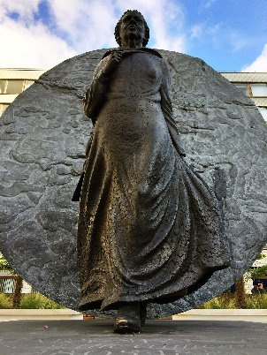
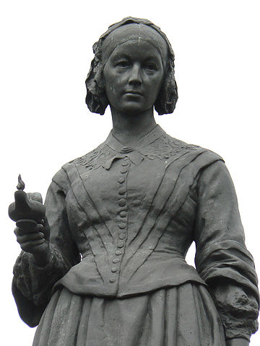
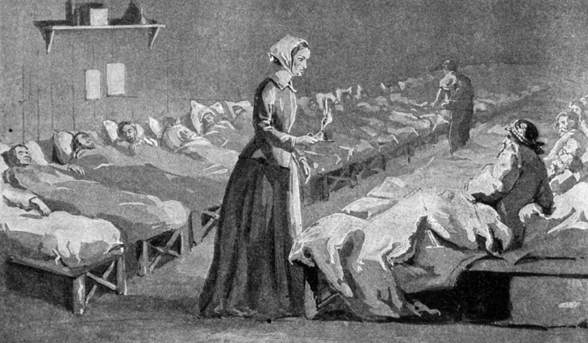
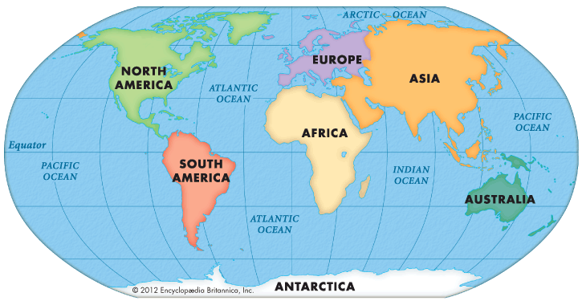
Year 1 – Florence Nightingale, Edith Cavell and Mary Seacole
History
Why do we remember Florence Nightingale, Edith Cavell Mary Seacole? How do these individuals compare?
Learning sequence
Why is Florence Nightingale remembered today and what did she do in her life?
Why do you think Florence took the brave steps to go to the Crimea and who influenced her?
What did Florence do to help the soldiers and did everyone have the same opinion of her?
What were the most important achievements of Florence’s life?
How does Edith Cavell compare to Florence Nightingale?
Why have we learnt so much about Florence and so little about Mary Seacole?
How should we remember Florence Nightingale and Mary Seacole?
Vocabulary
empire
achievement
soldier
war
nursing
remember
monument
significance
hospital
sacrifice
Victorian
Britain
conflict
long ago
history
similarities
change
differences
compare
Knowledge
Map
Chronology
The past History
The present
The Future
My parents/carers were born
I will go to secondary school
Long ago
I was born
Now
I will move up classes

Slide 9
Year 2

Slide 10
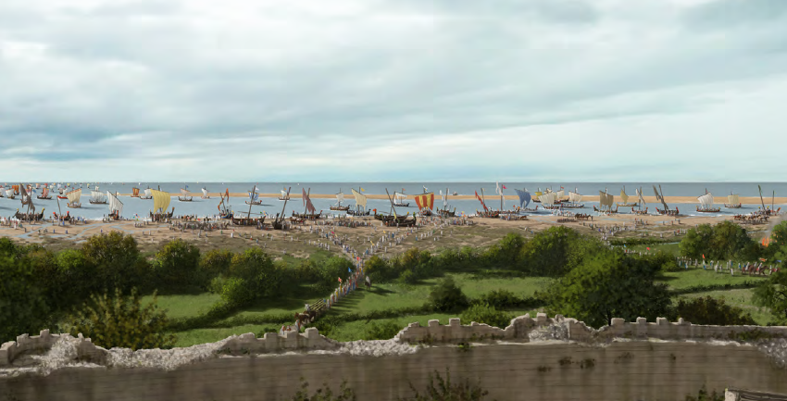
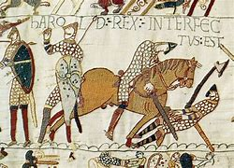
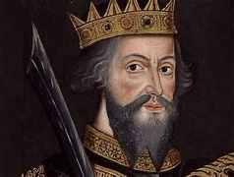
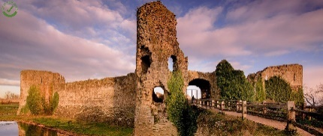
Year 2 – Pevensey Castle
History
Why is there a castle in our village? What significant event occurred in 1066?
Pevensey Castle
Learning sequence
What is a castle? Why are castles built?
Why did William invade in 1066?
Why did William land at Pevensey?
What happened at the |Battle of Hastings?
Why did William build a castle?
How has the castle been used since William had it built? Why is not used any more?
Why is there a castle in our village? How has it changed?
Vocabulary
conquest
invade
chronology
defensive
Anglo-Saxon
Norman
wealth
heir
harbour
Roman
succession
conflict
war
timeline
long ago
monarch
history
artefact
change
consequences
compare
UK
castle
local
significance
King/Queen
same
Knowledge
Map
Chronology
The past History
The present
The Future
My parents/carers were born
I will go to secondary school
Long ago
I was born
Now
I will move up classes

Slide 11
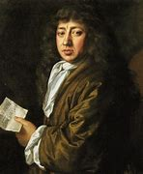
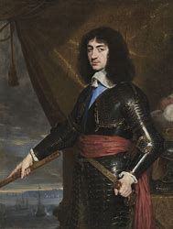
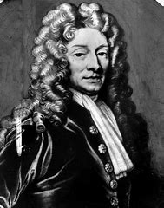
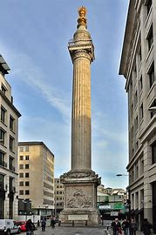
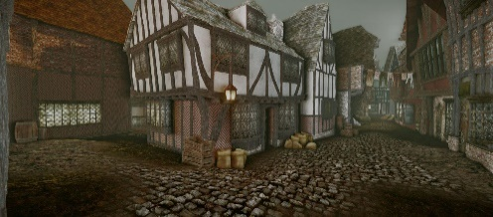
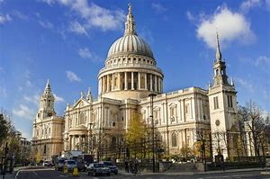
Year 2 – The Great Fire of London
History
How do we know so much about what happened in the Great Fire of London?
PaWS’ Great Fire of London!
Learning sequence
How can we work out why the Great Fire started?
What actually happened during the Great Fire and how can we know for sure 350 years later?
Why did the Great Fire burn down so many buildings?
Could more have been done to stop the Fire?
How did people manage to live through the Great Fire?
How shall we rebuild London?
Vocabulary
extinguish
consequence
cause
eyewitness
significance
diary
monument
architect
Thames
demolish
timeline
monarchy
different
past
similarities
differences
London
artefact
King
Source
long ago
Knowledge
Map
Chronology
The past History
The present
The Future
My parents/carers were born
I will go to secondary school
Long ago
I was born
Now
I will move up classes

Slide 12
Year 3

Slide 13
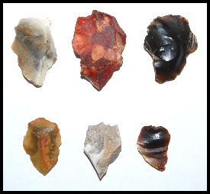
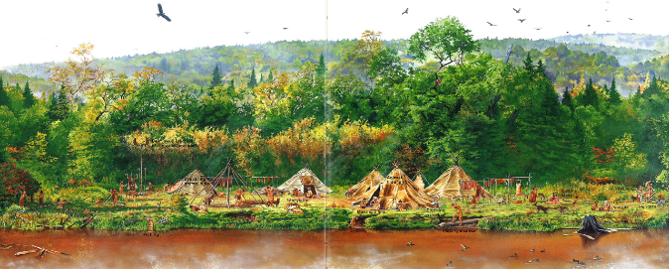
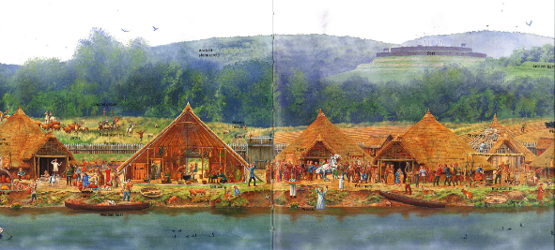
Year 3 – Prehistoric Britain
History
What was Prehistoric Britain? How did Britain change during prehistory?
Forest School
Learning sequence
What is archaeology? What is ‘prehistory’?
What was life like in Stone Age Britain?
What can we learn about life in the Stone Age from a study of Skara Brae?
Why is it so difficult to work out why Stonehenge was built?
How much did life change during the Iron Age? How do we know?
Why were 52 skeletons found at the Iron Age Hillfort, Maiden Castle?
How did Britain change during prehistory?
Vocabulary
continuity
artefact
change
chronology
conflict
timeline
agriculture
ancient
prehistory
civilisation
archaeology
burial
evidence
hunter-
gatherer
trade
invention
nomadic
differences
significance
similarities
conquest
Knowledge
Map
900
146 BC
323 BC
Chronology bbbbbb
Period of study
Mayans
First Viking Raid 793
King Henry VIII 1509
Black Death 1348
43
410
Battle of Hastings 1066
1714
Man on the Moon 1969
1485
1603
1901
First World War 1914-8
Ancient Greece
The Great Fire of London 1666
1837
Second World War 1939-45
2300 BC
800 BC
Birth of Christ 0
Christopher Columbus 1492
Coronation of Charles III 2023
Ancient Egypt
Stone Age | Bronze Age | Iron Age | Roman | Anglo-Saxon/Viking | Medieval | Tudor | Stuart | Georgian | Victorian | Modern

Slide 14
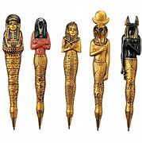
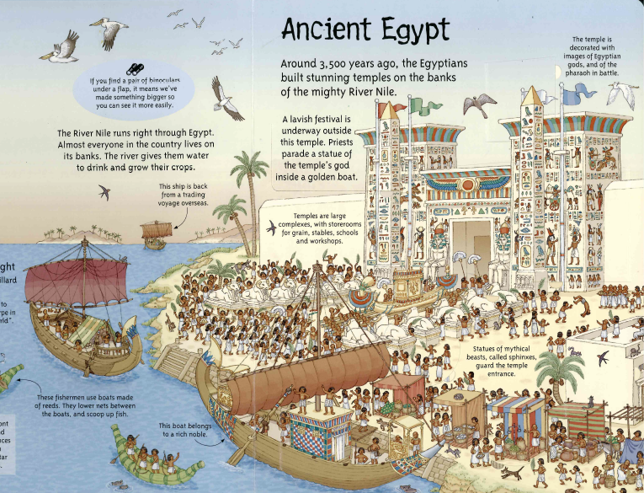
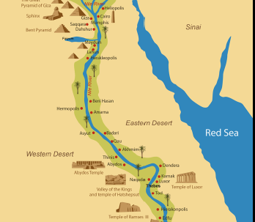
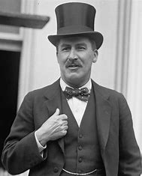
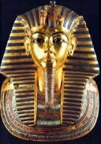
Year 3 – Ancient Egypt
History
What were the achievements of one of the early civilisations? How does it contrast to Prehistoric Britain?
Mummification!
Learning sequence
What is an ‘early civilisation’? Where were they?
What does the landscape tell us about what life might have been like in Ancient Egypt?
What do objects that have survived tell us about Ancient Egypt?
What does the evidence tell us about the everyday life for men, women and children?
What did the Ancient Egyptians believe about life after death?
Would you have preferred to live in Ancient Egypt or Prehistoric Britain? Why?
Where were other ‘early civilisations’? How do they compare?
Vocabulary
burial
achievement
empire
artefact
differences
significance
similarities
agriculture
ancient
prehistory
civilisation
archaeology
slave
irrigate
fertile
Pharaoh
hieroglyphics
tomb
mummification
hierarchy
gods/goddesses
Knowledge
Map
900
146 BC
323 BC
Chronology bbbbbb
Period of study
Mayans
First Viking Raid 793
King Henry VIII 1509
Black Death 1348
43
410
Battle of Hastings 1066
1714
Man on the Moon 1969
1485
1603
1901
First World War 1914-8
800 BC
Birth of Christ 0
1837
Second World War 1939-45
2300 BC
Ancient Greece
Christopher Columbus 1492
The Great Fire of London 1666
Coronation of Charles III 2023
Ancient Egypt
Stone Age | Bronze Age | Iron Age | Roman | Anglo-Saxon/Viking | Medieval | Tudor | Stuart | Georgian | Victorian | Modern

Slide 15
Year 4

Slide 16
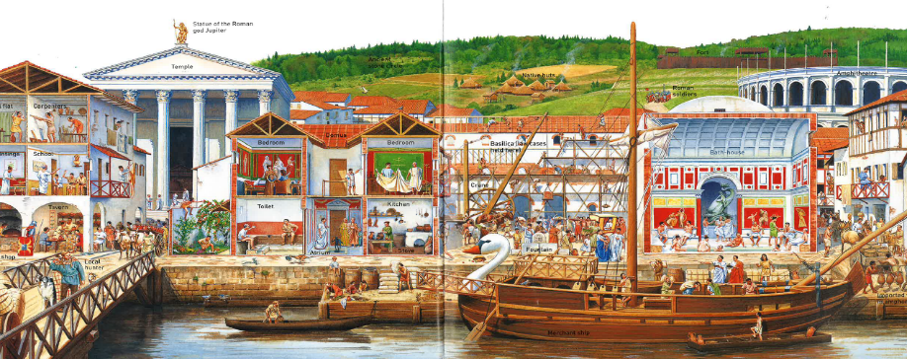
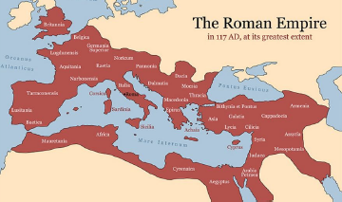
Year 4 – Roman Britain
History
Pevensey Castle
How did the arrival of the Romans change Britain?
Learning sequence
Why did the Romans leave sunny Italy to invade this cold island on the edge of the empire?
Why did Boudica stand up to the Romans and what image do we have of her today?
How were the Romans able to keep control over such a vast empire?
How did the Roman way of life contrast with the Celtic lifestyle they found when they arrived? How do we know?
How can we solve the mystery of why this great empire came to an end?
How much of our lives today are influenced by the Romans who lived here 2,000 years ago?
Vocabulary
agriculture
evidence
emperor
achievement
chronology
conquest
change
trade
differences
significance
similarities
artefact
empire
ancient
rebel
AD
BC
Christianity
gladiator
taxation
technology
civilisation
invention
slave
archaeology
invade
Knowledge
Map
900
146 BC
323 BC
Chronology bbbbbb
Period of study
Mayans
First Viking Raid 793
King Henry VIII 1509
Black Death 1348
43
410
Battle of Hastings 1066
1714
Man on the Moon 1969
1485
1603
1901
First World War 1914-8
800 BC
Birth of Christ 0
1837
Second World War 1939-45
2300 BC
Ancient Greece
Christopher Columbus 1492
The Great Fire of London 1666
Coronation of Charles III 2023
Ancient Egypt
Stone Age | Bronze Age | Iron Age | Roman | Anglo-Saxon/Viking | Medieval | Tudor | Stuart | Georgian | Victorian | Modern

Slide 17
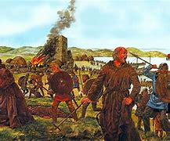
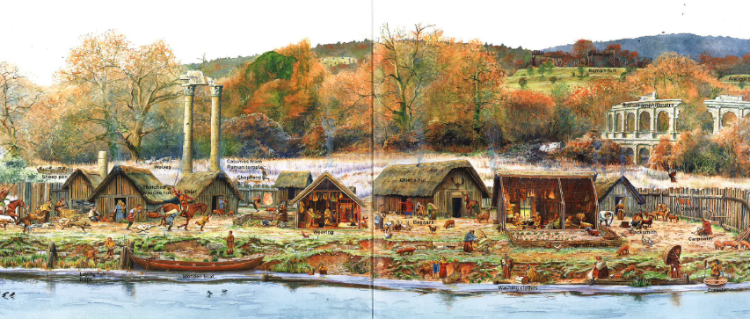
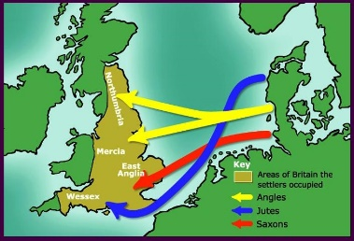
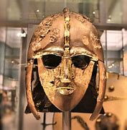
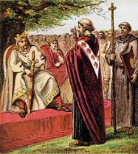
Year 4 – Saxons and Vikings
History
Should this period of time be called the ‘Dark Ages’? How well did the Saxons and Vikings get on with each other?
Learning sequence
Why did the Anglo-Saxons invade and how can we possibly know where they settled?
What does the mystery of the empty grave tell us about Saxon Britain?
How did people’s lives change when Christianity came to Britain and how can we be sure?
How were the Saxons able the see off the Viking threat?
How ‘great’ was King Alfred?
How effective was Saxon justice?
Why do some historians call this period of time the ‘Dark Ages’? Is that fair?
Vocabulary
Dark Age
AD
BC
Christianity
crime
pagan
peasant
progress
carpenter
convert
settle
civilisation
invasion
trade
agriculture
continuity
achievement
archaeology
conflict
fertile
differences
significance
similarities
artefact
Knowledge
Map
900
146 BC
323 BC
Chronology bbbbbb
Period of study
Mayans
First Viking Raid 793
King Henry VIII 1509
Black Death 1348
410
Battle of Hastings 1066
Man on the Moon 1969
43
1485
1603
1714
1901
First World War 1914-8
800 BC
Birth of Christ 0
1837
Second World War 1939-45
2300 BC
Ancient Greece
Christopher Columbus 1492
The Great Fire of London 1666
Coronation of Charles III 2023
Ancient Egypt
Stone Age | Bronze Age | Iron Age | Roman | Anglo-Saxon/Viking | Medieval | Tudor | Stuart | Georgian | Victorian | Modern

Slide 18
Year 5

Slide 19
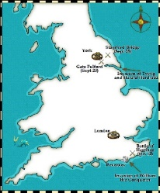
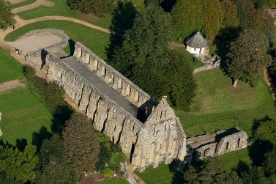
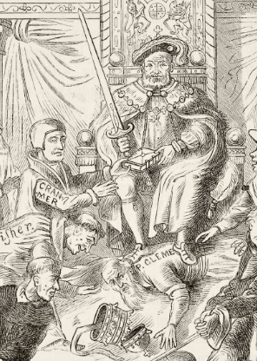
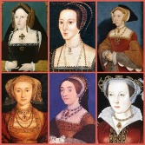
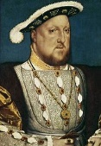
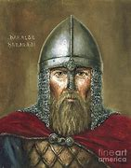
Year 5 – A Battle and an Abbey
History
Why is there an Abbey at Battle? Why was the Abbey destroyed?
Pevensey Castle Battle Abbey and Murder Mystery!
Learning sequence
What is the story leading to and including the Battle of Hastings?
Why was there a crisis in 1066? Who were the candidates for the throne?
Why did the Normans win the Battle of Hastings?
How accurate is the Bayeux Tapestry?
Why is 1066 such a significant date? Why was an Abbey built?
What is the story of Henry VIII, his six wives and the Reformation?
Who was Henry VIII? What kind of character was he?
What problems did Catholic Church face in the 1500s?
What is the Church of England? Why was the Abbey destroyed?
Vocabulary
Protestant
Catholic
Reformation
Pope
monastery
dissolution
execution
tyrant
perspective
divorce
treason
traitor
reliability
feudal
hierarchy
conquest
church
Christianity
chronology
peasant
heir
timeline
invasion
significance
monarch
AD
BC
succession
Knowledge
Map
900
146 BC
323 BC
Chronology bbbbbb
Period of study
Mayans
First Viking Raid 793
King Henry VIII 1509
43
Black Death 1348
1714
Man on the Moon 1969
410
1485
1901
1603
Second World War 1939-45
Ancient Greece
Christopher Columbus 1492
1837
First World War 1914-8
800 BC
The Great Fire of London 1666
Coronation of Charles III 2023
2300 BC
Birth of Christ 0
Ancient Egypt
Battle of Hastings 1066
Stone Age | Bronze Age | Iron Age | Roman | Anglo-Saxon/Viking | Medieval | Tudor | Stuart | Georgian | Victorian | Modern

Slide 20
Year 5 – The Mayans
History
Why should we study the Mayans? Manmade or Natural Disaster – which best explains the disappearance of the Mayans around AD 900?
Learning sequence
What was significant about the Mayans?
How did the Mayans manage to become so important?
How do we know what life was like for the Mayan people 1,000 years ago?
If the Mayans were so civilized, why then did they believe in human sacrifice?
How do the Mayans compare to the Ancient Egyptians and Anglo-Saxons?
What happened to the Mayans?
Vocabulary
city-state
sacrifice
achievement
agriculture
invention
slave
emperor
hierarchy
nomadic
AD
BC
artefact
archaeology
chronology
cause
calendar
civilisation
trade
hieroglyphics
significance
gods/goddesses
prehistory
ancient
Knowledge
Map
900
146 BC
323 BC
Chronology bbbbbb
Period of study
Mayans
First Viking Raid 793
King Henry VIII 1509
Black Death 1348
43
410
Battle of Hastings 1066
1714
Man on the Moon 1969
1485
1603
1901
First World War 1914-8
800 BC
Birth of Christ 0
1837
Second World War 1939-45
2300 BC
Ancient Greece
Christopher Columbus 1492
The Great Fire of London 1666
Coronation of Charles III 2023
Ancient Egypt
Stone Age | Bronze Age | Iron Age | Roman | Anglo-Saxon/Viking | Medieval | Tudor | Stuart | Georgian | Victorian | Modern

Slide 21
Year 6

Slide 22
Year 6 – The Second World War
History
Home Front 1939-45: What was life like in Britain during the Second World War?
PaWS VE Day!
ration
Holocaust
censorship
Parliament
consequences
empire
invasion
war
evidence
significance
artefact
interpretation
chronology
source
Learning sequence
Why did Britain have to go to war in 1939?
Why was it necessary for children to be evacuated and what was evacuation really like?
How was Britain able to stand firm against the German threat?
How did people manage to carry on normal life during the war and how do we know?
Why is it so difficult to be sure what life on the Home Front was really like?
What was VE day really like?
Vocabulary
propaganda
government
democracy
autocracy
blitz
international
allies
atrocities
morale
primary
secondary
global
dictator
evacuate
Knowledge
Map
900
146 BC
323 BC
Chronology bbbbbb
Period of study
Mayans
First Viking Raid 793
King Henry VIII 1509
Black Death 1348
43
410
Battle of Hastings 1066
1714
Man on the Moon 1969
1485
1603
1901
800 BC
Birth of Christ 0
1837
First World War 1914-8
2300 BC
Ancient Greece
Christopher Columbus 1492
The Great Fire of London 1666
Coronation of Charles III 2023
Ancient Egypt
Second World War 1939-45
Stone Age | Bronze Age | Iron Age | Roman | Anglo-Saxon/Viking | Medieval | Tudor | Stuart | Georgian | Victorian | Modern

Slide 23
Murder Mystery!
Year 6 – Ancient Greece
History
What was so special about Ancient Greece? The story of the Trojan Horse – fact, myth or legend?
Learning sequence
How do know so much about the Ancient Greeks who lived over 2,500 years ago?
Theseus and the Minotaur: Is there any evidence for the legend?
What was so special about the Ancient Greeks? In what ways have the Ancient Greeks influenced our lives today?
Why did Sparta and Troy go to war?
What is the story of the Trojan Horse?
What is the difference between fact, myth and legend? Where does the story of the Trojan Horse fit?
Vocabulary
evidence
gods/goddesses
civilisation
significance
hierarchy
city-state
artefact
myth
legend
government
democracy
autocracy
citizen
legacy
architecture
philosophy
achievement
agriculture
interpretation
AD
BC
archaeology
chronology
ancient
consequences
Knowledge
Map
900
146 BC
323 BC
Chronology bbbbbb
Period of study
Mayans
First Viking Raid 793
King Henry VIII 1509
Black Death 1348
43
410
Battle of Hastings 1066
1714
Man on the Moon 1969
1485
1603
1901
First World War 1914-8
Birth of Christ 0
1837
Second World War 1939-45
Ancient Greece
2300 BC
800 BC
Christopher Columbus 1492
The Great Fire of London 1666
Coronation of Charles III 2023
Ancient Egypt
Stone Age | Bronze Age | Iron Age | Roman | Anglo-Saxon/Viking | Medieval | Tudor | Stuart | Georgian | Victorian | Modern

