Slide 1
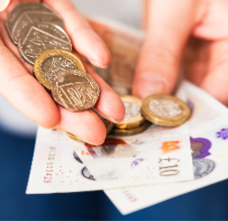
Year 1 RSHE Life skills – Economic Wellbeing
RSHE
Learning sequence
To discover what money is and how it helps us.
To begin to understand the differences between spending and saving money.
Transition
Vocabulary
bank
cash
earn
job
money
notes
pocket money
safe
save
skill
spend
value

Slide 2
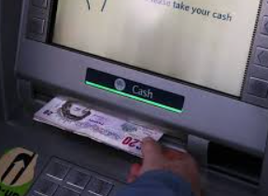
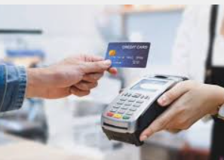
Year 2 RSHE Life skills - Economic Wellbeing
RSHE
Learning sequence
To explore the ways people receive money.
To identify my skills and talents.
Transition
Vocabulary
bank
money
earn
save
value
skill
prioritise
want
transaction
wages
diversity
equality

Slide 3
Year 3 RSHE Life skills - Economic Wellbeing
RSHE
Learning sequence
To understand how to put together a budget
To understand that there are a range of jobs available and to think about what job they might want to do
Transition
Vocabulary
bank account
wages
prioritise
electronic
jobs
account
assumption
budget
career
digital trade
fair trade
profession
stereotype

Slide 4
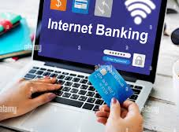
Year 4 RSHE Life skills - Economic Wellbeing
RSHE
Learning sequence
To recognise factors influencing value for money.
To describe different ways of keeping money safe.
Transition
Vocabulary
bank account
wages
career
profession
stereotype
income
expenditure
bank statement
password
security
value for money
career satisfaction
influence
perspective

Slide 5
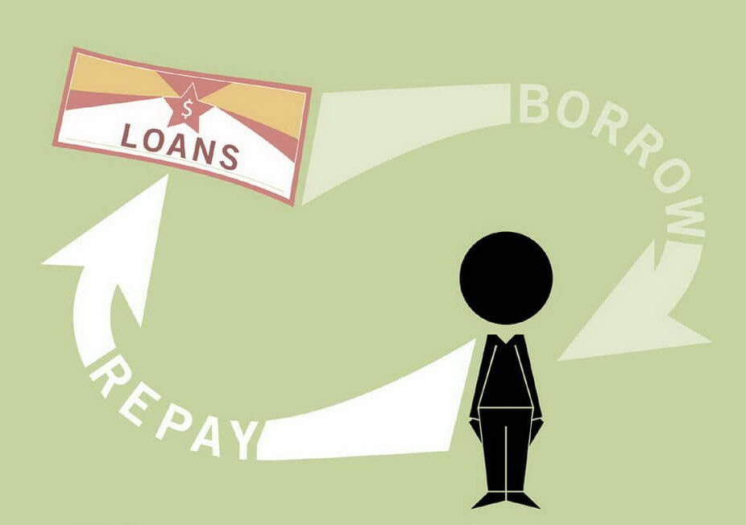
Year 5 RSHE Life skills - Economic Wellbeing
RSHE
Learning sequence
To examine the risks associated with handling money online.
Transition
Vocabulary
priortise
bank account
wages
career
stereotype
influence
budget
borrow
commitment
expenditure
impact
income
loan
repayment
risk

Slide 6
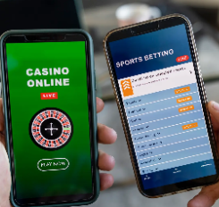
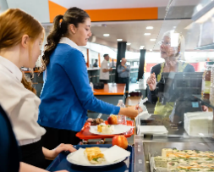
Year 6 RSHE Life skills - Economic Wellbeing
RSHE
Learning sequence
Explore different career routes and their requirements.
Transition
Vocabulary
priortise
career
budget
commitment
borrow
loan
risk
earnings
expenses
responsibilities
gambling
safeguard
workplace
qualifications
university
valuables

