Slide 1
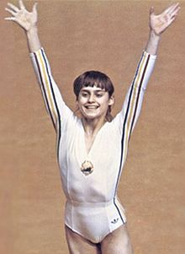
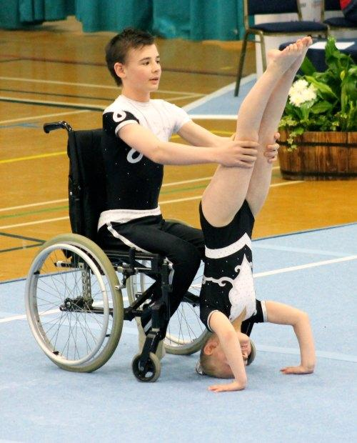
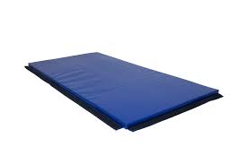
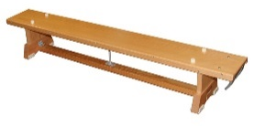
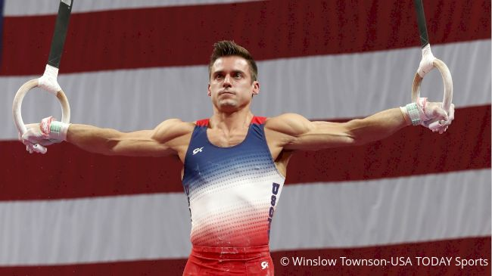
EYFS – Jumps, Rolling, Balances – Gymnastics
PE
Learning sequence
Engage and Enquire: Talking Points: Introduction of Gymnastics.
Develop body control, simple actions alone and using relevant language for actions.
Progress further using and finding space, using different body parts/body shapes, changing shape/ levels/directions.
Vocabulary
shapes | travel | space
tuck | balance | roll
healthy | movement | curled
Equipment
Athletes
Nadia
Comaneci
Disability Gymnastics
Simone Biles
Hoops
Spot markers
Gym mat
Sam Mikulak
Bench
iPad

Slide 2
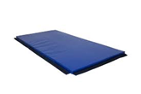
Year 1 – Stillness, Turns, Combinations – Gymnastics
PE
Learning sequence
Engage and Enquire: Talking Points: Building on EYFS Gymnastics
Develop travelling, stillness, balance, turning, rolling, weight on hands, jumping – (with more control, combinations, contrast, complex, actions – requiring continuity and co-ordination of body parts).
Demonstrate body control, planning/practicing simple actions alone using correct language for actions/apparatus.
Vocabulary
shapes | travel | space
tuck | balance | roll
healthy | movement | curled
stillness | turning | weight
planning | equipment | actions
support | jumping | curled
Equipment
Athletes
Nadia
Comaneci
Disability Gymnastics
Gym mat
Markers
Bench
Simone Biles
Sam Mikulak
iPad
Whiteboards

Slide 3
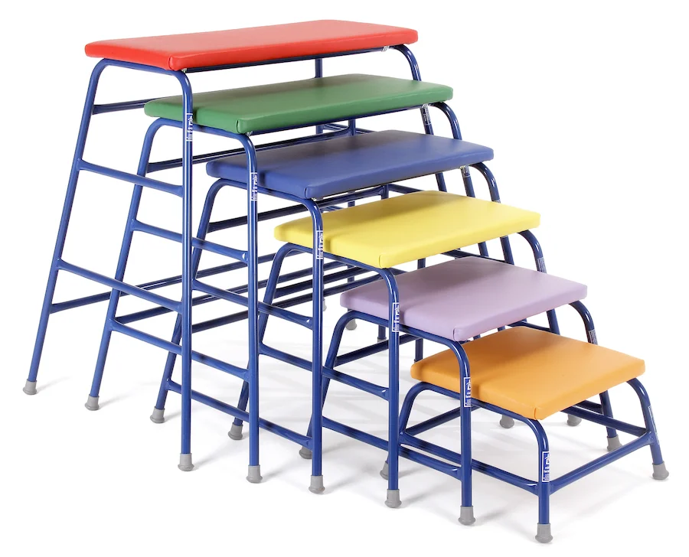
Year 2 – Rolling, Climbing, Jumping – Gymnastics
PE
Learning sequence
Engage and Enquire: Talking Points: Building on Year 1 Gymnastics.
Demonstrate further skills of travelling, stillness, balance, turning, rolling, climbing, weight on hands, placing apparatus, jumping.
Perform and demonstrate choreographed sequences of movements. Consolidating work identified in Year 1.
Vocabulary
stillness | turning | weight
planning | equipment | actions
support | jumping | curled
climbing | travelling | placing
developing | apparatus | skills
counter | landing | link
Equipment
Athletes
Nadia
Comaneci
Disability Gymnastics
Gym mat
Bench
Markers
Simone Biles
Whiteboards
iPad
Sam Mikulak
Table
tops
Springboard

Slide 4
Year 3 – Shapes, Levels, Combinations – Gymnastics
PE
Learning sequence
Engage and Enquire: Talking Points: Building on Year 2 Gymnastics.
Progress and develop skills of travelling rolling, jumping, balancing, taking weight on hands, changing speed, direction, and shape levels.
Demonstrate improvement in using different combinations of floor and apparatus, working alone/ with partner.
Vocabulary
climbing | travelling | placing
developing | apparatus | skills
counter | landing | link
levels | transition | spot
demonstrate | resources | ability
gravity | combination | symmetrical
Equipment
Athletes
Nadia
Comaneci
Disability Gymnastics
Gym mat
Bench
Markers
Simone Biles
Whiteboards
iPad
Sam Mikulak
Table
tops
Springboard

Slide 5
Year 4 – Direction, Sequences, Performances – Gymnastics
PE
Learning sequence
Engage and Enquire: Talking Points: Building on Year 3 Gymnastics.
Progress skills of rolling, travelling jumping, swinging, balancing, taking weight on hands; changing speed, direction changes, shape, levels; using different combinations of floor and apparatus, working alone/with partner.
Perform and refine actions; perform with whole/part body control.
Demonstrate actions that are developed within sequences. Practised and repeated through gymnastic actions.
Vocabulary
levels | transition | spot
demonstrate | resources | ability
gravity | combination | symmetrical
swinging | alteration | critique
refine | manoeuvre | power
centre | pattern | mastery
Equipment
Athletes
Nadia
Comaneci
Disability Gymnastics
Gym mat
Bench
Markers
Simone Biles
Whiteboards
iPad
Sam Mikulak
Table
tops
Springboard

Slide 6
Year 5 – Floor exercise, refined actions – Gymnastics
PE
Learning sequence
Engage and Enquire: Talking Points: Building on Year 4 Gymnastics.
Demonstrate improved skills of rolling, travelling jumping, swinging, balancing, taking weight on hands; changing speed, direction, shape, levels; using different combinations of floor and apparatus, working alone/with partner.
Perform and demonstrate, adapted and refined actions; performed with whole/part body control.
Vocabulary
swinging | alteration | critique
refine | manoeuvre | power
centre | pattern | mastery
dynamics | suppleness | elements
contrasting | rotation | assessment
evaluate | refinements | take-off
Equipment
Athletes
Nadia
Comaneci
Disability Gymnastics
Gym mat
Bench
Markers
Simone Biles
Whiteboards
iPad
Sam Mikulak
Table
tops
Springboard

Slide 7
Year 6 – Whole body control, Refined actions – Gymnastics
PE
Learning sequence
Engage and Enquire: Talking Points: Building on Year 5 Gymnastics.
Perform improved skills of rolling, jumping, swinging, balancing, taking weight on hands; changing speed, direction, shape, levels; using different combinations of floor and apparatus, working alone/with partner.
Demonstrate refined actions; perform with whole/part body control; develop selected actions.
Vocabulary
dynamics | suppleness | elements
contrasting | rotation | assessment
evaluate | refinements | take-off
audience | judgement | tension
aesthetically | creativity | competition
criteria | extension | inverted
Equipment
Athletes
Nadia
Comaneci
Disability Gymnastics
Gym mat
Bench
Markers
Simone Biles
Whiteboards
iPad
Sam Mikulak
Table
tops
Springboard

