Slide 1
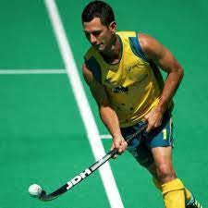
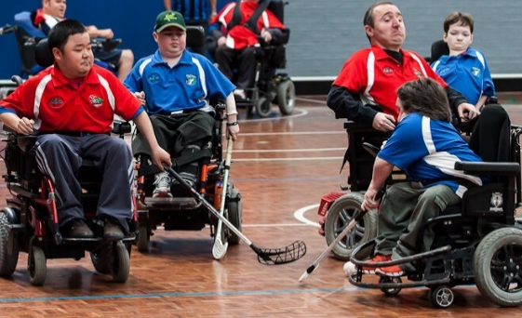
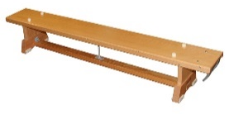
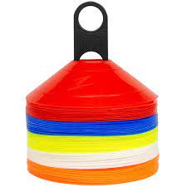
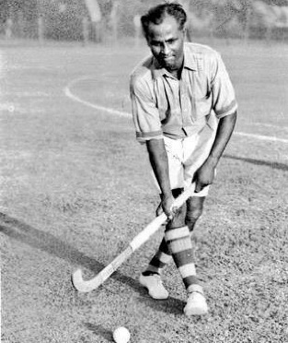
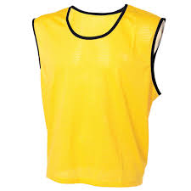
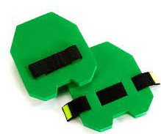
EYFS – Travel, Receive, Control – Exploring Multi-skills
PE
Learning sequence
Engage and Enquire: Talking Points: introduction of Multi-skills.
Begin: The skills of travel, send , chase, receive, avoid and control.
Demonstrate: Good control and co-ordination in large and small movements.
Demonstrate: Awareness of space and individual actions.
Explore: Simple games, playing alone and in pairs.
Vocabulary
Team | Passing | Follow
Speed | Rolling
Equipment
Athletes
Athletes
Jamie Dwyer
Electric Wheelchair Hockey
Spot markers
Dhyan Chand
Hoops
Soft balls
Bench
Cones
Luciana Aymar
Bibs
Hand pads
Basketballs

Slide 2
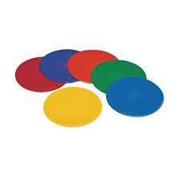
Year 1 – Dribble, Pass, Strike – Exploring Hockey
PE
Learning sequence
Engage and Enquire: Talking Points: introduction of Hockey.
Begin: To hold the hockey stick correctly.
Explore: Dribbling in different directions and into different areas.
Begin: Striking in different directions and into different areas.
Perform: The push pass technique.
Evaluate: Striking the ball to a specific target.
Vocabulary
Team | Passing | Follow
Speed | Rolling
Tracking | Opposite | Direction
Avoiding | Rebound
Athletes
Equipment
Athletes
Jamie Dwyer
Electric Wheelchair Hockey
Dhyan Chand
Spot markers
Hockey sticks
Balls
Luciana Aymar
Bibs
Cones

Slide 3
Year 2 – Passing, Avoiding, Coordination – Exploring Hockey
PE
Learning sequence
Engage and Enquire: Talking Points: introduction of Hockey.
Begin: To understand some rules and when to use skills within small-sided games.
Perform: Different types of ball passes with accuracy.
Evaluate: Decisions on how and when to use space to avoid opponents using the push technique.
Vocabulary
Tracking | Opposite | Direction
Avoiding | Rebound
Possession | Receive | Tactics
Cover
Athletes
Equipment
Athletes
Jamie Dwyer
Electric Wheelchair Hockey
Dhyan Chand
Spot markers
Hockey sticks
Balls
Luciana Aymar
Bibs
Cones

Slide 4
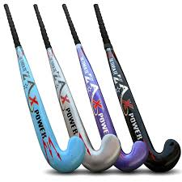
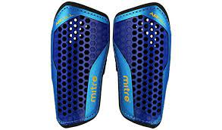
Year 3 – Direction, Space, Shooting – Exploring Hockey
PE
Learning sequence
Engage and Enquire: Talking Points: introduction of Hockey.
Begin: Rotating the stick to change direction.
Explore: Finding and using space to keep the ball and push pass over different distances.
Evaluate: Understanding of all rules and apply to modified games.
Vocabulary
Possession | Receive | Tactics
Cover
Stance | Marking | Support
Defending
Equipment
Athletes
Jamie Dwyer
Electric Wheelchair Hockey
Dhyan Chand
Spot markers
Balls
Hockey sticks
Luciana Aymar
Shin pads
Bibs
Cones

Slide 5
Year 4 – Tactics, Fluency, Attacking – Exploring Hockey
PE
Learning sequence
Engage and Enquire: Talking Points: introduction of Hockey.
Explore: Simple attacking and defending tactics.
Begin: Using a range of skills and organising themselves in formations.
Develop: Playing in competitive games, modified appropriately.
Vocabulary
Stance | Marking | Support
Defending
Shield | Width | Depth
Team Play
Athletes
Equipment
Athletes
Jamie Dwyer
Electric Wheelchair Hockey
Dhyan Chand
Spot markers
Balls
Hockey sticks
Luciana Aymar
Shin pads
Bibs
Cones

Slide 6
Year 5 – Officiating, Competition, Tactics – Exploring Hockey
PE
Learning sequence
Engage and Enquire: Talking Points: introduction of Hockey.
Explore: Tactics on how to work well as a team when attacking, and explore a range of ways to defend.
Develop: Skilful attacking and team play, including the use of referees.
Demonstrate: A greater awareness of good sportsmanship, fairness and respect whilst playing.
Perform: Good positional play to find space to be in the right position to send and receive passes in competitive game situations.
Vocabulary
Shield | Width | Depth
Team Play
Obstruction | Offside | Turnover
Concede
Athletes
Equipment
Athletes
Jamie Dwyer
Electric Wheelchair Hockey
Dhyan Chand
Spot markers
Balls
Hockey sticks
Luciana Aymar
Shin pads
Bibs
Cones

Slide 7
Year 6 – Combination, Isolation, Consistency – Exploring Hockey
PE
Learning sequence
Engage and Enquire: Talking Points: introduction of Hockey.
Begin: To play even-sided mini-versions of different skill based games.
Apply: All skills learnt and provide skill stations to peers in lower year groups.
Evaluate: How to improve defending territory and attacking play in modified games/matches.
Vocabulary
Obstruction | Offside | Turnover
Concede
Channel | Hacking | Hooking
Long Corner | Penalty Corner | Green Card
Athletes
Equipment
Athletes
Jamie Dwyer
Electric Wheelchair Hockey
Dhyan Chand
Spot markers
Balls
Hockey sticks
Luciana Aymar
Shin pads
Bibs
Cones

