Slide 1
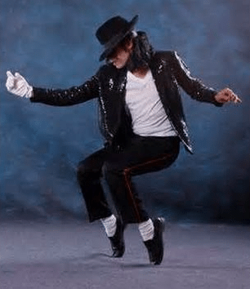
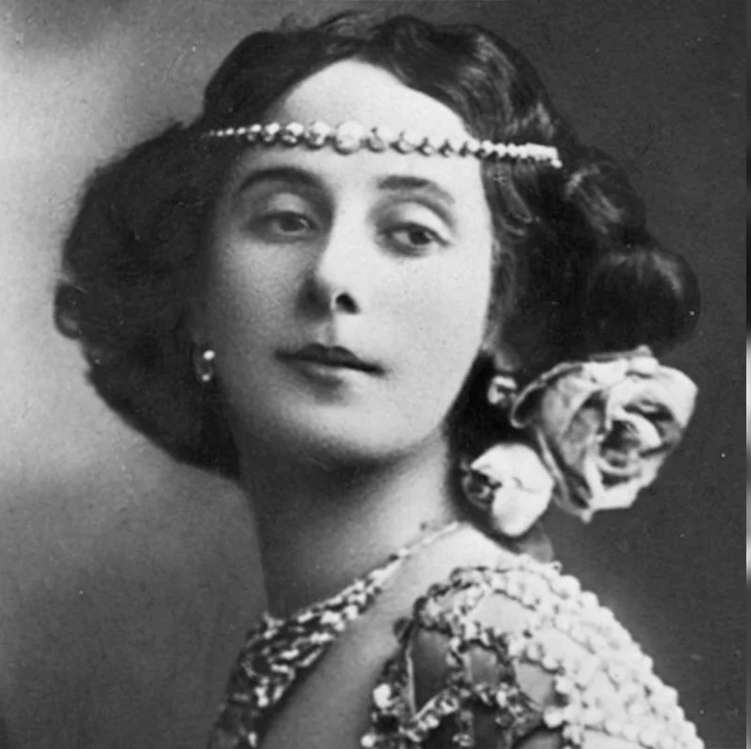
EYFS – Agility, Balance, Routines – Exploring Dance
PE
Learning sequence
Engage and Enquire: Talking Points: introduction of Dance.
Begin: to navigate space and obstacles safely, with consideration for themselves and others.
Demonstrate strength, balance and coordination when performing simple tasks.
Explore moving energetically, such as running, jumping, dancing, hopping, skipping and climbing.
Vocabulary
travel stillness
direction space
beginning middle
end feelings
Equipment
Athletes
Michael Jackson
Michael Flatley
Anna Pavlova
Spot markers
Music
Hoops
Whiteboards
Mirrors
Video

Slide 2
Year 1 – Rhythm, Express, Combine – Exploring Dance
PE
Learning sequence
Engage and Enquire: Talking Points: introduction of Dance.
Develop spatial awareness and confidently move safely in space and basic agility, balance and coordination skills.
Create and repeat a variety of short dance routines inspired by a range of stimuli on tutting.
Begin to work individually, in pairs, small groups and as a whole class.
Explore awareness of different tutting dances.
Vocabulary
travel
stillness
direction
space
feelings
body parts
levels
directions
pathways
speed
rhythm
Equipment
Athletes
Michael Jackson
Michael Flatley
Anna Pavlova
Spot markers
Music
Hoops
Whiteboards
Mirrors
Video

Slide 3
Year 2 – Link, Express, Tension – Exploring Dance
PE
Learning sequence
Engage and Enquire: Talking Points: introduction of Dance.
Explore, remember, repeat and link a range of tutting actions with coordination and control.
Perform short dances that express and communicate moods, ideas and feelings.
Develop simple routines and improve the quality of their movement, e.g. stretching fingers and pointing toes, to help produce tension and extension.
Vocabulary
body parts
levels
directions
pathways
speed
rhythm
space
repeat
dance phrase
improvisation
Equipment
Athletes
Michael Jackson
Michael Flatley
Anna Pavlova
Spot markers
Music
Hoops
Whiteboards
Mirrors
Video

Slide 4
Year 3 – Gestures, Actions, Repetition – Exploring Dance
PE
Learning sequence
Engage and Enquire: Talking Points: introduction of Dance.
Perform dances using a range of movement patterns gaining inspiration from a range of stimuli on tutting.
Perform intricate finger movements accurately and with control.
Develop sequences that include changes of level and speed, and focus on using different geometric shapes.
Evaluate own and others performance.
Vocabulary
space
repeat
dance phrase
improvisation
character
gesture
repetition
action
reaction
Equipment
Athletes
Michael Jackson
Michael Flatley
Anna Pavlova
Spot markers
Music
Hoops
Whiteboards
Mirrors
Video

Slide 5
Year 4 – Patterns, Routines, Sequences – Exploring Dance
PE
Learning sequence
Engage and Enquire: Talking Points: introduction of Dance.
Demonstrate rhythm & spatial awareness.
Begin to build complex dance routines in small groups.
Copy, remember, explore simple actions, and link & vary ideas with control & coordination.
Create sequences that include changes of level and speed, and focus on using different body shapes.
Vocabulary
character
gesture
repetition
action
reaction
myth
legend
costume
prop
pattern
Equipment
Athletes
Michael Jackson
Michael Flatley
Anna Pavlova
Spot markers
Music
Hoops
Whiteboards
Mirrors
Video

Slide 6
Year 5 – Formations, Techniques, Performances – Exploring Dance
PE
Learning sequence
Engage and Enquire: Talking Points: introduction of Dance.
Create longer sequences to perform for an audience.
Develop a wider range of actions and explore other formations to perform.
Evaluate own performance.
Develop increasing flexibility, strength of movement, technique, control and balance.
Vocabulary
myth
legend
costume
prop
pattern
style
technique
formation
pattern
Equipment
Athletes
Michael Jackson
Michael Flatley
Anna Pavlova
Spot markers
Music
Hoops
Whiteboards
Mirrors
Video

Slide 7
Year 6 – Compositional, Improvisation, Dynamics – Exploring Dance
PE
Learning sequence
Engage and Enquire: Talking Points: introduction of Dance.
Explore with more advanced moves that show dynamics.
Develop knowledge of compositional principles (different levels, change of direction, how to combine and link actions).
Perform and create movement sequences with some complex moves. Display consistent strength of movement and dynamics.
Vocabulary
Style
Technique
Formation
Pattern
Rhythm
Variation
Improvisation
Compositional
Dynamics
Equipment
Athletes
Michael Jackson
Michael Flatley
Anna Pavlova
Spot markers
Music
Hoops
Whiteboards
Mirrors
Video

