Slide 1
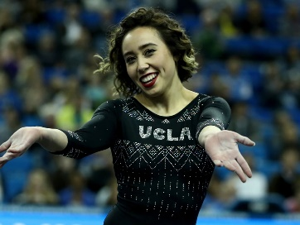
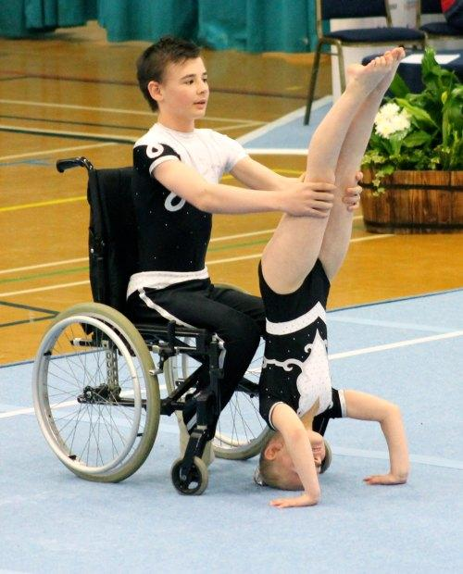
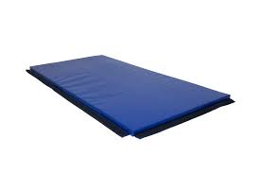
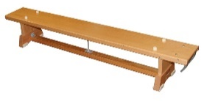
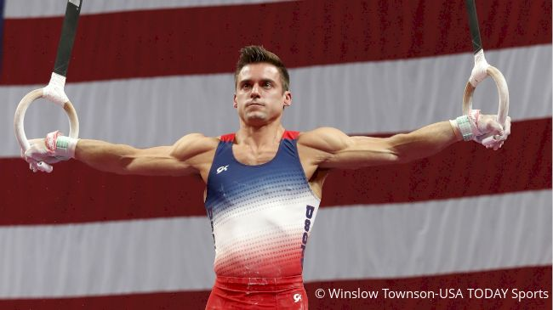
EYFS – Jumps, Rolling, Balances – Building on Gymnastics
PE
Learning sequence
Engage and Enquire: Talking Points: building on Term 1 Gymnastics.
Develop body control, simple actions alone and using relevant language for actions.
Progress further using and finding space, using different body parts/body shapes, changing shape/ levels/directions.
Vocabulary
shapes | travel | space
tuck | balance | roll
healthy | movement | curled
Katelyn Ohashi
Equipment
Athletes
Disability Gymnastics
Simone Biles
Hoops
Spot markers
Gym mat
Sam Mikulak
iPad
Bench

Slide 2
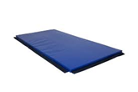
Year 1 – Stillness, Turns, Combinations – Building on Gymnastics
PE
Learning sequence
Engage and Enquire: Talking Points: Developing and building on Term 1 Gymnastics
Develop travelling, stillness, balance, turning, rolling, weight on hands, jumping – (with more control, combinations, contrast, complex, actions – requiring continuity and co-ordination of body parts).
Demonstrate body control, planning/practicing simple actions alone using correct language for actions/apparatus.
Vocabulary
shapes | travel | space
tuck | balance | roll
healthy | movement | curled
stillness | turning | weight
planning | equipment | actions
support | jumping | curled
Katelyn Ohashi
Equipment
Athletes
Disability Gymnastics
Gym mat
Markers
Bench
Simone Biles
Sam Mikulak
iPad
Whiteboards

Slide 3
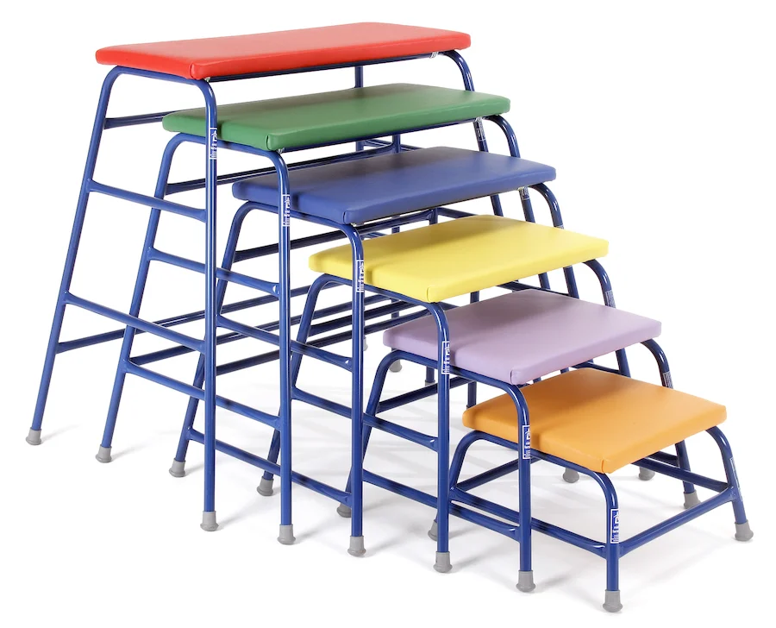
Year 2 – Rolling, Climbing, Jumping – Building on Gymnastics
PE
Learning sequence
Engage and Enquire: Talking Points: Developing and building on Term 1 Gymnastics.
Demonstrate further skills of travelling, stillness, balance, turning, rolling, climbing, weight on hands, placing apparatus, jumping.
Perform and demonstrate choreographed sequences of movements. Consolidating work identified in this section from Term 1.
Vocabulary
stillness | turning | weight
planning | equipment | actions
support | jumping | curled
climbing | travelling | placing
developing | apparatus | skills
counter | landing | link
Katelyn Ohashi
Equipment
Athletes
Markers
Disability Gymnastics
Bench
Gym mat
Simone Biles
Whiteboards
Sam Mikulak
iPad
Table tops

Slide 4
Year 3 – Shapes, Levels, Combinations – Building on Gymnastics
PE
Learning sequence
Engage and Enquire: Talking Points: Developing and building on Term 1 Gymnastics.
Progress and develop skills of travelling rolling, jumping, balancing, taking weight on hands, changing speed, direction, and shape levels.
Demonstrate improvement in using different combinations of floor and apparatus, working alone/ with partner.
Vocabulary
climbing | travelling | placing
developing | apparatus | skills
counter | landing | link
levels | transition | spot
demonstrate | resources | ability
gravity | combination | symmetrical
Katelyn Ohashi
Equipment
Athletes
Disability Gymnastics
Gym mat
Bench
Markers
Simone Biles
Whiteboards
iPad
Sam Mikulak
Table tops
Springboard

Slide 5
Year 4 – Direction, Sequences, Performances – Building on Gymnastics
PE
Learning sequence
Engage and Enquire: Talking Points: Developing and building on Term 1 Gymnastics.
Progress skills of rolling, travelling jumping, swinging, balancing, taking weight on hands; changing speed, direction changes, shape, levels; using different combinations of floor and apparatus, working alone/with partner.
Perform and refine actions; perform with whole/part body control.
Demonstrate actions that are developed within sequences. Practised and repeated through gymnastic actions.
Vocabulary
levels | transition | spot
demonstrate | resources | ability
gravity | combination | symmetrical
swinging | alteration | critique
refine | manoeuvre | power
centre | pattern | mastery
Katelyn Ohashi
Equipment
Athletes
Disability Gymnastics
Gym mat
Bench
Markers
Simone Biles
Whiteboards
iPad
Sam Mikulak
Table tops
Springboard

Slide 6
Year 5 – Floor exercise, refined actions – Building on Gymnastics
PE
Learning sequence
Engage and Enquire: Talking Points: Developing and building on Term 1 Gymnastics.
Demonstrate improved skills of rolling, travelling jumping, swinging, balancing, taking weight on hands; changing speed, direction, shape, levels; using different combinations of floor and apparatus, working alone/with partner.
Perform and demonstrate, adapted and refined actions; performed with whole/part body control.
Vocabulary
swinging | alteration | critique
refine | manoeuvre | power
centre | pattern | mastery
dynamics | suppleness | elements
contrasting | rotation | assessment
evaluate | refinements | take-off
Katelyn Ohashi
Equipment
Athletes
Disability Gymnastics
Gym mat
Bench
Markers
Simone Biles
Whiteboards
iPad
Sam Mikulak
Table tops
Springboard

Slide 7
Year 6 – Whole body control, Refined actions – Building on Gymnastics
PE
Learning sequence
Engage and Enquire: Talking Points: Developing and building on Term 1 Gymnastics.
Perform improved skills of rolling, jumping, swinging, balancing, taking weight on hands; changing speed, direction, shape, levels; using different combinations of floor and apparatus, working alone/with partner.
Demonstrate refined actions; perform with whole/part body control; develop selected actions.
Vocabulary
dynamics | suppleness | elements
contrasting | rotation | assessment
evaluate | refinements | take-off
audience | judgement | tension
aesthetically | creativity | competition
criteria | extension | inverted
Katelyn Ohashi
Equipment
Athletes
Disability Gymnastics
Gym mat
Bench
Markers
Simone Biles
Whiteboards
iPad
Sam Mikulak
Table tops
Springboard

