Slide 1
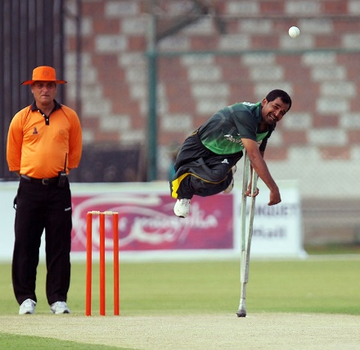
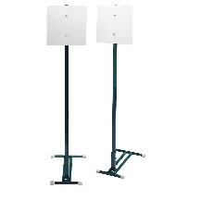
EYFS – Bowl, Bat, Throw & Catch – Exploring Striking & Fielding
PE
Learning sequence
Engage and Enquire: Talking Points: introduction of Stoolball.
Demonstrate: Avoiding, control; awareness of space and individual actions.
Experience: A variety of game(s) equipment, practising alone, competition, simple rules, indoor/outdoor areas.
Evaluate: Present and reflect on learning during the unit.
Vocabulary
rolling | striking | overarm
bouncing | catching | underarm
base | bowling | fielding
Equipment
Athletes
Brian Lara
Hoops
Bat(s)
Ellyse Perry
Spot markers
Freddie Flintoff
Ball(s)
Whiteboard
Farhan Saeed
Posts
Athletes

Slide 2
Year 1 – Bowl, Bat, Throw & Catch – Exploring Striking & Fielding
PE
Learning sequence
Engage and Enquire: Talking Points: introduction of Stoolball.
Develop: travel, chasing, avoiding, dodging, control; awareness of space.
Experience: A variety of game(s) equipment, practising alone, competition, simple rules, indoor/outdoor areas.
Develop: simple games (striking, scoring), playing these games – alone/with a partner.
Evaluate: Present and reflect on learning during the unit.
Vocabulary
rolling | striking | overarm
bouncing | catching | underarm
base | bowling | fielding
wicket | boundary | innings
support | marking | covering
anticipate | drive | umpire
Equipment
Athletes
Brian Lara
Hoops
Bat(s)
Ellyse Perry
Spot markers
Freddie Flintoff
Ball(s)
Whiteboard
Farhan Saeed
Posts

Slide 3
Year 2 – Bowl, Bat, Throw & Catch – Exploring Striking & Fielding
PE
Learning sequence
Engage and Enquire: Talking Points: introduction of Stoolball.
Develop: travel, sending, chasing, receiving, avoiding, dodging, control; awareness of space and partner.
Experience: A variety of game(s) equipment, practising alone, competition, simple rules, indoor/outdoor areas.
Develop: simple games (striking, scoring), playing these games – alone/with a partner.
Evaluate: Present and reflect on learning during the unit.
Vocabulary
wicket | boundary | innings
support | marking | covering
anticipate | drive | umpire
aiming | contact | distance
controlling | receiving | actions
stump | technique | retrieving
Equipment
Athletes
Brian Lara
Hoops
Bat(s)
Ellyse Perry
Spot markers
Freddie Flintoff
Ball(s)
Whiteboard
Farhan Saeed
Posts

Slide 4
Year 3 – Bowl, Bat, Throw & Catch – Exploring Striking & Fielding
PE
Learning sequence
Engage and Enquire: Talking Points: introduction of Stoolball.
Develop: Skills of travel, send chase, receive, dodge, avoid, attack, defend, control accuracy; movement into/out of space.
Experience: Small sided and simplified versions of different types of games, (i.e. Stoolball); a variety of common skills and game principles; team work; working towards tasks set by themselves and the teacher.
Develop: simple games (striking, scoring), playing these games – alone/with a partner.
Evaluate: Present and reflect on learning during the unit.
Vocabulary
aiming | contact | distance
controlling | receiving | actions
stump | technique | retrieving
avoiding | opposite | tracking
rebound | connection | scoring
eliminate | process | recover
Equipment
Athletes
Brian Lara
Hoops
Bat(s)
Ellyse Perry
Spot markers
Freddie Flintoff
Ball(s)
Whiteboard
Farhan Saeed
Posts

Slide 5
Year 4 – Bowl, Bat, Throw & Catch – Exploring Striking & Fielding
PE
Learning sequence
Engage and Enquire: Talking Points: introduction of Stoolball.
Develop: Skills of travel, send chase, receive, dodge, avoid, attack, defend, control accuracy; movement into/out of space
Experience: Small sided and simplified versions of different types of games, (i.e. stoolball); a variety of common skills and game principles; team work; working towards tasks set by themselves and the teacher.
Develop: Team games, making up games, own game practices, understanding of game principles.
Evaluate: Present and reflect on learning during the unit.
Vocabulary
avoiding | opposite | tracking
rebound | connection | scoring
eliminate | process | recover
elude | barrier | pinpoint
glance | target | attain
Equipment
Athletes
Brian Lara
Hoops
Bat(s)
Ellyse Perry
Spot markers
Freddie Flintoff
Ball(s)
Whiteboard
Farhan Saeed
Posts

Slide 6
Year 5 – Bowl, Bat, Throw & Catch – Exploring Striking & Fielding
PE
Learning sequence
Engage and Enquire: Talking Points: introduction of Stoolball.
Develop: Skills of travel, send chase, receive, dodge, avoid, attack, defend, control accuracy; movement into/out of space
Experience: Small sided and modified competitive versions of different types games, (i.e. stoolball); a variety of common skills and game principles linked to attacking & defending play; team wok; refining their own games.
Develop team games – working within prescribed areas, considering and developing rules, roles and scoring systems, understanding of game principles.
Evaluate: Present and reflect on learning during the unit.
Vocabulary
elude | barrier | pinpoint
glance | target | attain
eradicate | procedure | redeem
navigate | implement | coordinate
Equipment
Athletes
Brian Lara
Hoops
Bat(s)
Ellyse Perry
Spot markers
Freddie Flintoff
Ball(s)
Whiteboard
Farhan Saeed
Posts

Slide 7
Year 6 – Bowl, Bat, Throw & Catch – Exploring Striking & Fielding
PE
Learning sequence
Engage and Enquire: Talking Points: introduction of Stoolball.
Develop: Skills of travel, send chase, receive, dodge, avoid, attack, defend, control accuracy; movement into/out of space.
Experience small sided and modified competitive versions of different types games, (i.e. Stoolball); a variety of common skills and game principles linked to team wok; refining their own games, competitions.
Develop team games – working within prescribed areas, considering and developing rules, roles and scoring systems, understanding of game principles.
Evaluate: Present and reflect on learning during the unit.
Vocabulary
eradicate | procedure | redeem
navigate | implement | coordinate
umpire | signals | outstretch
dimension | competence | maximise
Equipment
Athletes
Brian Lara
Hoops
Bat(s)
Ellyse Perry
Spot markers
Freddie Flintoff
Ball(s)
Whiteboard
Farhan Saeed
Posts

