Slide 1
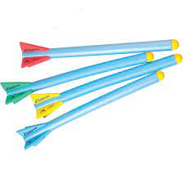
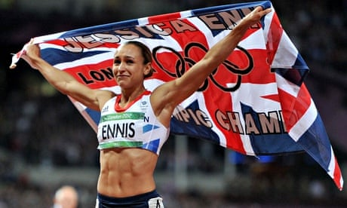
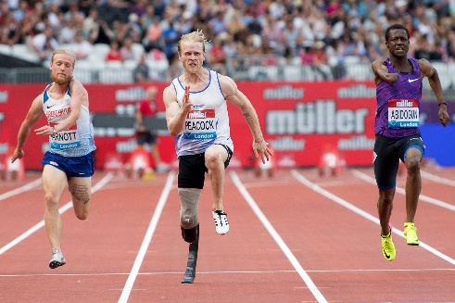
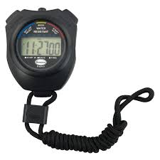
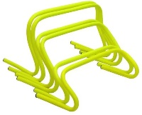
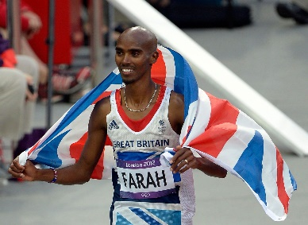
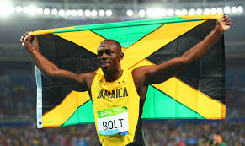
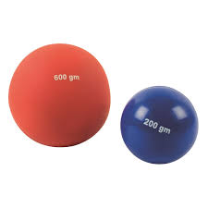
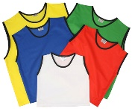
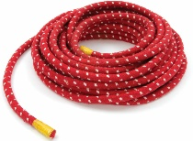
EYFS – Run, Jump, Throw – Exploring Athletics
PE
Learning sequence
Engage and Enquire: Talking Points: introduction of Athletics.
Demonstrate: Good control and co-ordination in large and small movements.
Explore: How using the body changes the speed and effect of movement (e.g. using arms when running).
Evaluate: Present and reflect on learning during the unit.
Vocabulary
far | hop | aim
fast | slow | bend
improve | direction | travel
Equipment
Athletes
Jessica Ennis-Hill
Jonnie Peacock
Hoops
Javelins
Spot markers
Mo Farrah
Hurdles
Stopwatch
Shots
Usain Bolt
Bibs
Rope

Slide 2
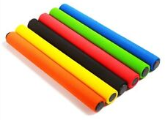
Year 1 – Run, Jump, Throw – Exploring Athletics
PE
Learning sequence
Engage and Enquire: Talking Points: introduction of Athletics.
Explore: Running, jumping and throwing activities, and take part in simple challenges and competitions.
Develop: Different ways of travelling, throwing and jumping, increasing their awareness of speed and distance.
Begin: Practising field events and different race types, in preparation for Year 1 Sports Day.
Evaluate: Present and reflect on learning during the unit.
Vocabulary
far | hop | aim
fast | slow | bend
improve | direction | travel
sprint | jog | distance
height | take off | landing
flight | overarm | underarm
Equipment
Athletes
Jessica Ennis-Hill
Jonnie Peacock
Hoops
Javelins
Spot markers
Mo Farrah
Hurdles
Stopwatch
Shots
Usain Bolt
Batons
Bibs
Rope

Slide 3
Year 2 – Run, Jump, Throw – Exploring Athletics
PE
Learning sequence
Engage and Enquire: Talking Points: introduction of Athletics.
Explore: Running, jumping and throwing activities, and take part in simple challenges and competitions.
Develop: Different ways of travelling, throwing and jumping, increasing their awareness of speed and distance.
Develop: Practising field events and different race types, in preparation for Year 2 Sports Day.
Evaluate: Present and reflect on learning during the unit.
Vocabulary
sprint | jog | distance
height | take off | landing
flight | overarm | underarm
speed | power | strength
accurately | higher | pace
control | faster | further
Equipment
Athletes
Jessica Ennis-Hill
Jonnie Peacock
Hoops
Javelins
Spot markers
Mo Farrah
Hurdles
Stopwatch
Shots
Usain Bolt
Batons
Bibs
Rope

Slide 4
Year 3 – Run, Jump, Throw – Exploring Athletics
PE
Learning sequence
Engage and Enquire: Talking Points: introduction of Athletics.
Develop: Good basic running, jumping and throwing techniques.
Explore: Setting challenges for distance and time that involve using different styles and combinations of running, jumping and throwing.
Develop: Practising field events and different race types, in preparation for Year 3 Sports Day.
Evaluate: present and reflect on learning during the unit.
Vocabulary
speed | power | strength
accurately | higher | pace
control | faster | further
power | stamina | officiate
perseverance | determination | accuracy
personal best | changeover | signal
Equipment
Athletes
Jessica Ennis-Hill
Jonnie Peacock
Hoops
Javelins
Spot markers
Mo Farrah
Hurdles
Stopwatch
Shots
Usain Bolt
Batons
Bibs
Rope

Slide 5
Year 4 – Run, Jump, Throw – Exploring Athletics
PE
Learning sequence
Engage and Enquire: Talking Points: introduction of Athletics.
Demonstrate: Good basic running, jumping and throwing techniques.
Explore: Setting challenges for distance and time that involve using different styles and combinations of running, jumping and throwing.
Develop: Practising field events and different race types, specific to Year 4 in preparation for Sports Day.
Evaluate: present and reflect on learning during the unit.
Vocabulary
power | stamina | officiate
perseverance | determination | accuracy
personal best | changeover | signal
technique | down sweep | up sweep
seconds | stride | rhythm
heave | energy | weight
Equipment
Athletes
Jessica Ennis-Hill
Jonnie Peacock
Hoops
Javelins
Spot markers
Mo Farrah
Hurdles
Stopwatch
Shots
Usain Bolt
Batons
Bibs
Rope

Slide 6
Year 5 – Run, Jump, Throw – Exploring Athletics
PE
Learning sequence
Engage and Enquire: Talking Points: introduction of Athletics.
Demonstrate: Technical understanding of athletic activity.
Explore: How to set targets and improve their performance in a range of running, jumping and throwing activities.
Develop: Practising field events and different race types, specific to Year 5 in preparation for Sports Day.
Evaluate: present and reflect on learning during the unit.
Vocabulary
technique | down sweep | up sweep
seconds | stride | rhythm
heave | energy | weight
rotation | force | compete
trajectory | angle | acceleration
phase | millisecond | extension
Equipment
Athletes
Jessica Ennis-Hill
Jonnie Peacock
Hoops
Javelins
Spot markers
Mo Farrah
Hurdles
Stopwatch
Shots
Usain Bolt
Batons
Bibs
Rope

Slide 7
Year 6 – Run, Jump, Throw – Exploring Athletics
PE
Learning sequence
Engage and Enquire: Talking Points: introduction of Athletics.
Develop: Their technical understanding of athletic activity.
Develop: Setting targets and improve their performance in a range of running, jumping and throwing activities.
Develop: Practising field events and different race types, specific to Year 6 in preparation for Sports Day.
Evaluate: present and reflect on learning during the unit.
Vocabulary
rotation | force | compete
trajectory | angle | acceleration
phase | millisecond | extension
momentum | continuous | pace
transfer | stamina | Athlon (Greek for athletics)
Equipment
Athletes
Jessica Ennis-Hill
Jonnie Peacock
Hoops
Javelins
Spot markers
Mo Farrah
Hurdles
Stopwatch
Shots
Usain Bolt
Batons
Bibs
Rope

