Slide 1
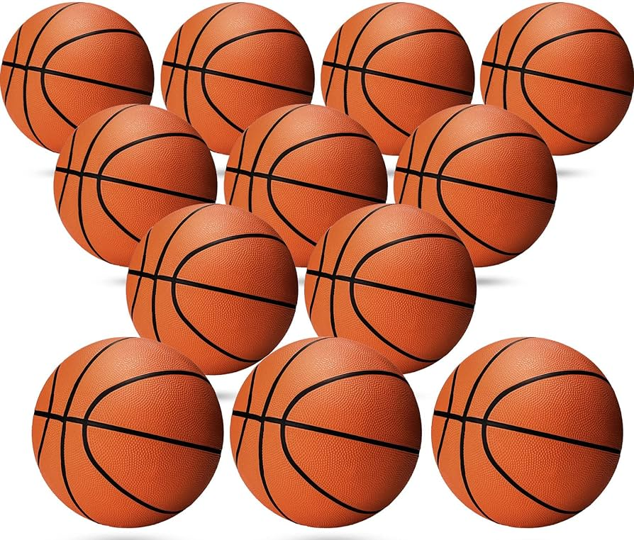
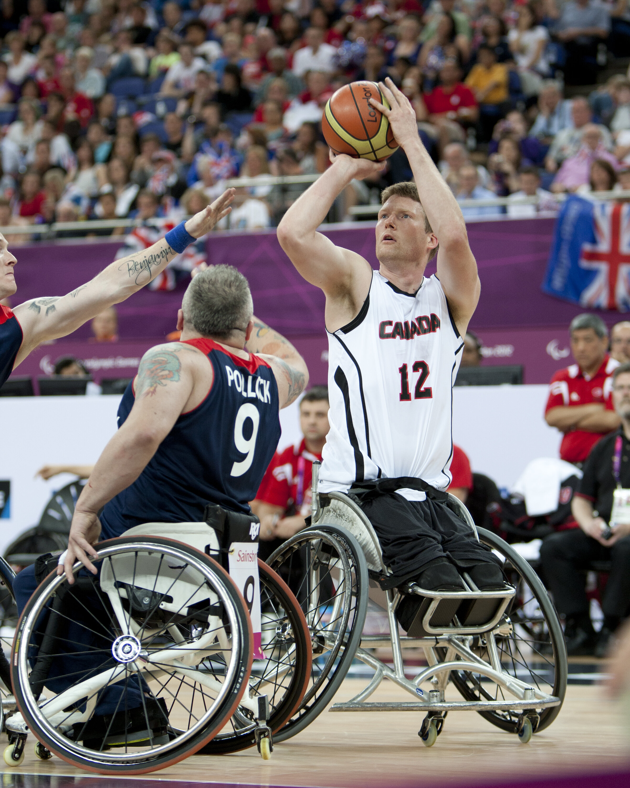
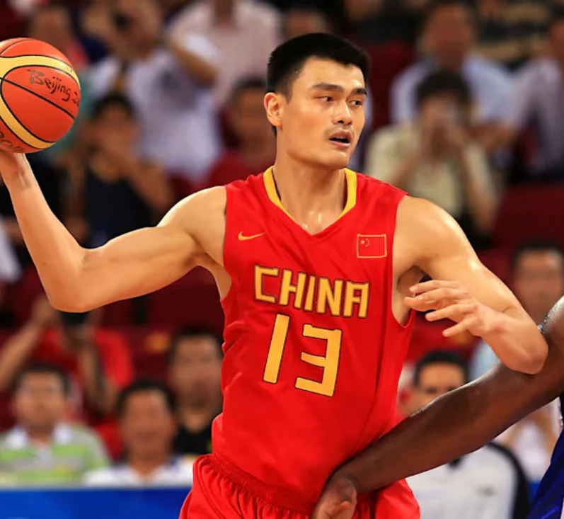
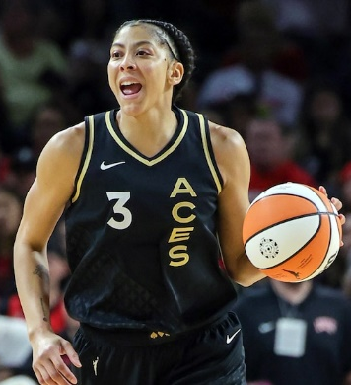
EYFS – Handle, Pass, Control – Exploring Basketball
PE
Learning sequence
Engage and Enquire: Talking Points: introduction of Basketball.
Develop: skills of travel, send, receive, avoid, and control, awareness of space and individual actions.
Develop: simple games, modified games alone and in pairs.
Explore: a variety of competition, simple rules, indoor/outdoor areas.
Evaluate: Present and reflect on learning during the unit.
Vocabulary
grip | stance | aim
elbow | flick | target
explore | control | send
Equipment
Athletes
Patrick Anderson
Yao Ming
Michael Jordan
Hoops
Basketballs
Spot markers
Bibs
Floor net
Candace Parker

Slide 2
Year 1 – Pass, Dribble, Shoot – Exploring Basketball
PE
Learning sequence
Engage and Enquire: Talking Points: introduction of Basketball.
Begin: To handle a basketball with control.
Explore: Dribbling in different directions and into different areas.
Begin: Passing in different directions and into different areas.
Perform: Throwing towards a target with increasing accuracy.
Evaluate: Watch and describe performances, to say how they could improve.
Vocabulary
grip | stance | aim
elbow | flick | target
explore | control | send
handle | footwork | scoring
extend | follow | chest
bounce | technique | trio
Equipment
Athletes
Yao Ming
Patrick Anderson
Michael Jordan
Hoops
Basketballs
Spot markers
Bibs
Basketball Net
Candace Parker

Slide 3
Year 2 – Shoot, Avoid, Coordination – Exploring Basketball
PE
Learning sequence
Engage and Enquire: Talking Points: introduction of Basketball.
Begin: To understand some rules and when to use skills within small-sided games.
Perform: Different types of passes with increasing accuracy.
Evaluate: Decisions on how and when to use space to avoid opponents using a variety of dribble types.
Vocabulary
handle | footwork | scoring
extend | follow | chest
bounce | technique | trio
possession | pivot | field goal
follow through | opponent | travel
backboard | shift | block
Athletes
Equipment
Athletes
Yao Ming
Patrick Anderson
Michael Jordan
Hoops
Basketballs
Spot markers
Bibs
Basketball Net
Candace Parker

Slide 4
Year 3 – Direction, Space, Shooting – Exploring Basketball
PE
Learning sequence
Engage and Enquire: Talking Points: introduction of Basketball.
Begin: Throwing, catching in a variety of ways and in different situations.
Explore: Finding useful space and getting into it to support teammates.
Evaluate: Understanding of all rules and apply to modified games.
Vocabulary
possession | pivot | field goal
follow through | opponent | travel
backboard | shift | block
turnover | double dribble | free throw
key | triangle | box out
rebound | outlet | lay up
Athletes
Equipment
Athletes
Yao Ming
Patrick Anderson
Michael Jordan
Hoops
Basketballs
Spot markers
Bibs
Basketball Net
Candace Parker

Slide 5
Year 4 – Tactics, Fluency, Attacking – Exploring Basketball
PE
Learning sequence
Engage and Enquire: Talking Points: introduction of Basketball.
Explore: Simple attacking and defending tactics.
Begin: Using a range of skills and organising themselves in formations.
Develop: Playing in competitive games, modified appropriately.
Vocabulary
turnover | double dribble | free throw
key | triangle | box out
rebound | outlet | lay up
timeout | screen | tip-off
shot clock | gather | tactics
zone | weak side | strong side
Athletes
Equipment
Athletes
Yao Ming
Patrick Anderson
Michael Jordan
Hoops
Basketballs
Spot markers
Bibs
Basketball Net
Candace Parker

Slide 6
Year 5 –Officiating, Competition, Tactics – Exploring Basketball
PE
Learning sequence
Engage and Enquire: Talking Points: introduction of Basketball.
Explore: Tactics on how to work well as a team when attacking, and explore a range of ways to defend.
Develop: Skilful attacking and team play, including the use of referees.
Demonstrate: A greater awareness of good sportsmanship, fairness and respect whilst playing.
Perform: Good positional play to find space to be in the right position to send and receive passes in competitive game situations.
Vocabulary
timeout | screen | tip-off
shot clock | gather | tactics
zone | weak side | strong side
cross over | carry | centre circle
side-line | perimeter
free-throw line | half-court line
Athletes
Equipment
Athletes
Yao Ming
Patrick Anderson
Michael Jordan
Hoops
Basketballs
Spot markers
Bibs
Basketball Net
Candace Parker

Slide 7
Year 6 – Combination, Isolation, Consistency – Exploring Basketball
PE
Learning sequence
Engage and Enquire: Talking Points: introduction of Basketball.
Begin: To play even-sided mini-versions of skill based games.
Apply: All skills learnt and provide skill stations to peers in lower year groups.
Evaluate: How to improve defending territory and attacking play in modified games/matches.
Vocabulary
cross over | carry | centre circle
side-line | perimeter
free-throw line | half-court line
baseline | technical foul | personnel foul
point guard | power forward | small forward
center | assist | Shooting guard
Athletes
Equipment
Athletes
Yao Ming
Patrick Anderson
Michael Jordan
Hoops
Basketballs
Spot markers
Bibs
Basketball Net
Candace Parker

