Slide 1
French
Learning
Scaffolds

Slide 2
Year 3

Slide 3
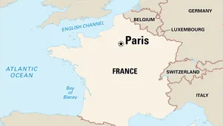
Year 3 – I’m learning French

Slide 4
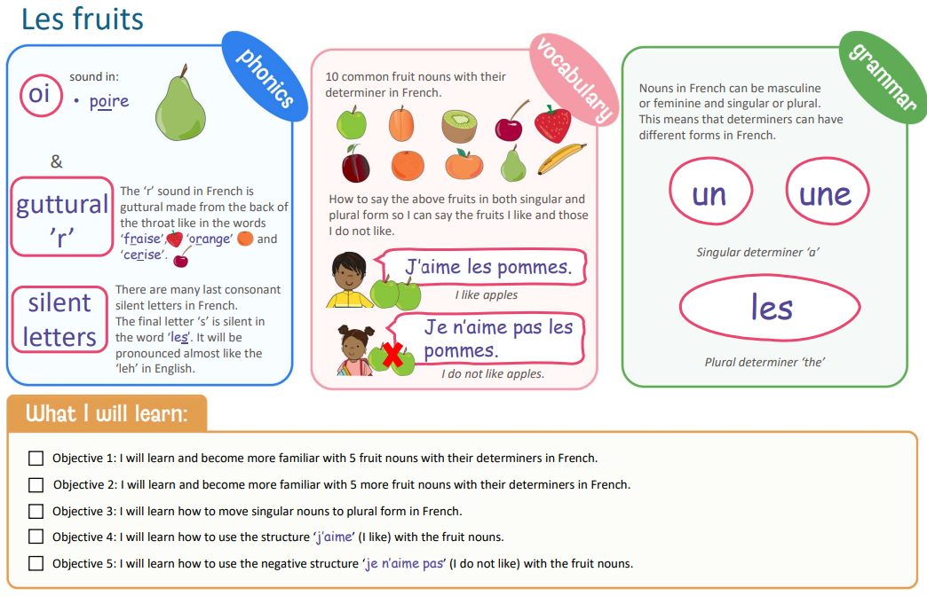
Year 3 – fruits

Slide 5
Year 3 – I am able…

Slide 6
Year 4

Slide 7
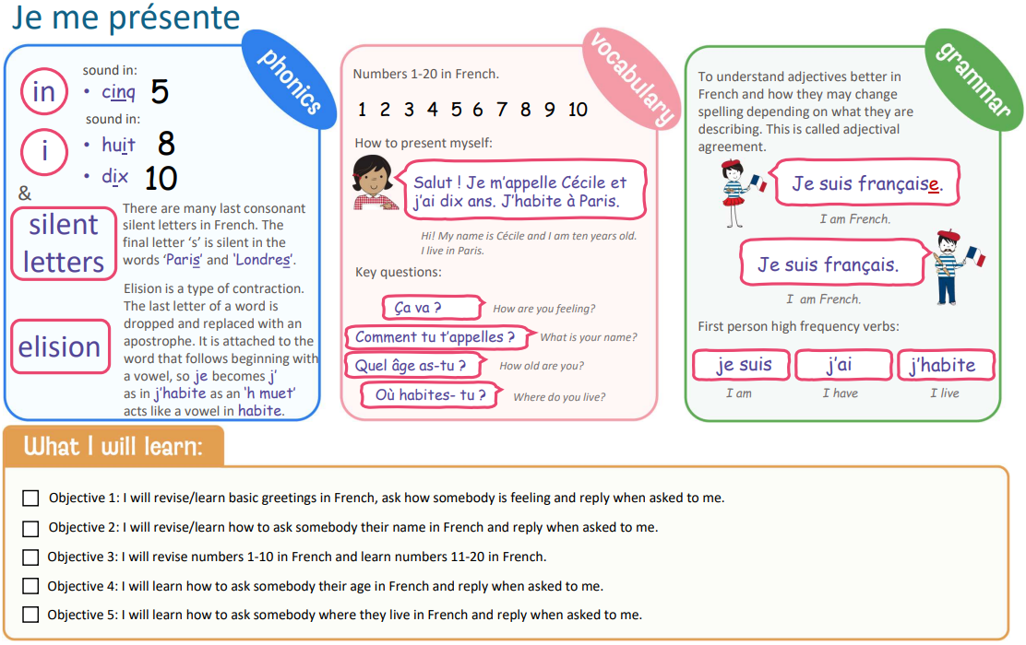
Year 4: Presenting myself

Slide 8
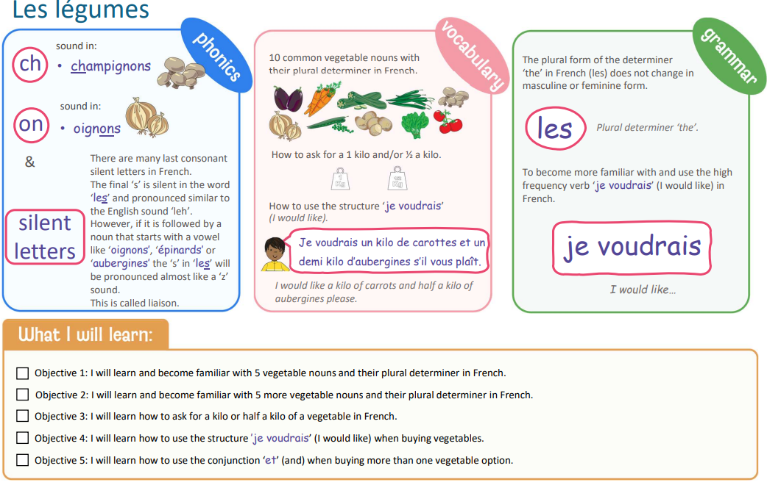
Year 4: vegetables

Slide 9
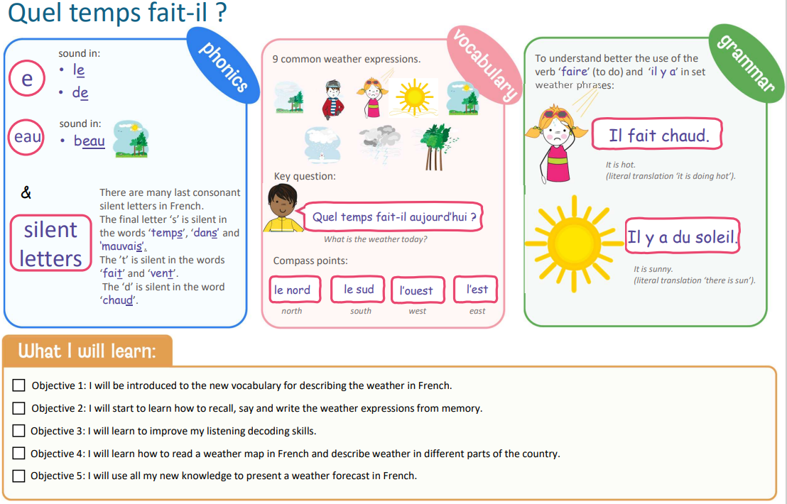
Year 4: Weather

Slide 10
Year 5

Slide 11
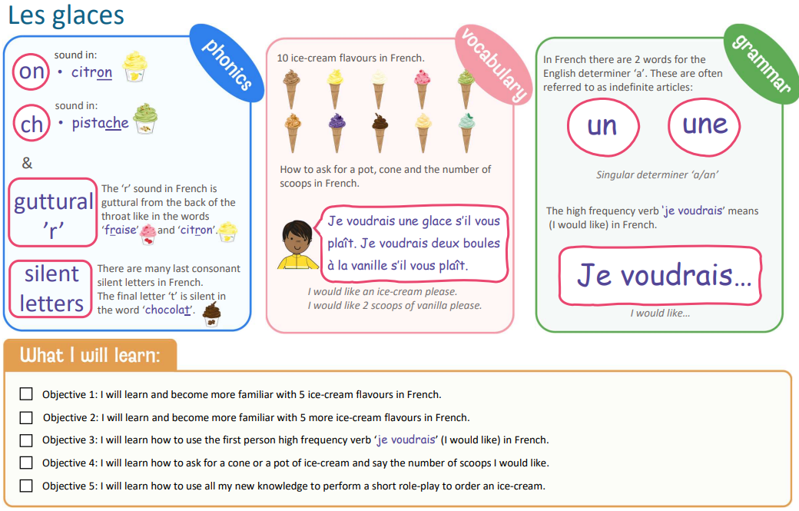
Year 5: Ice cream

Slide 12
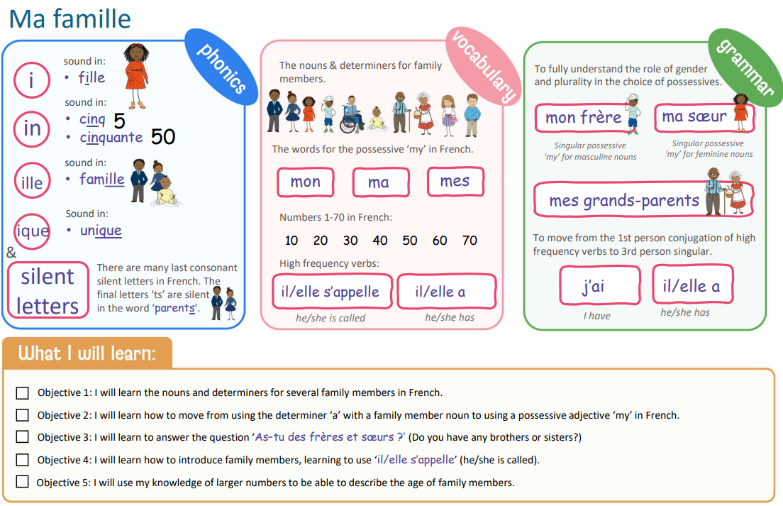
Year 5: Family

Slide 13
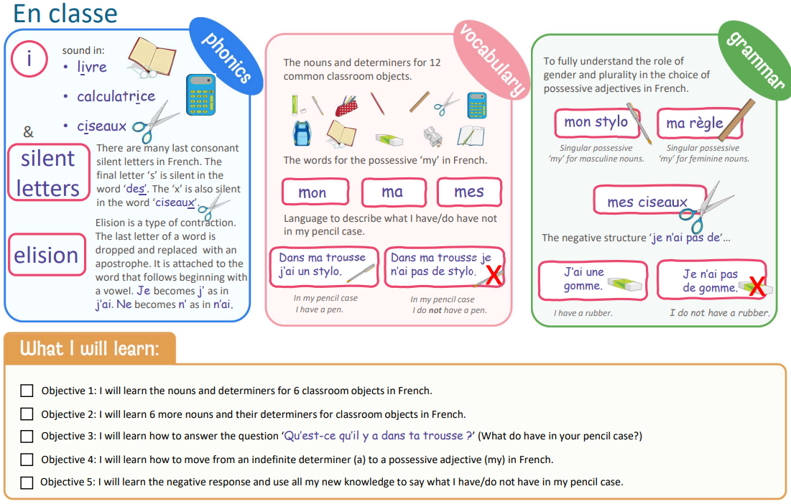
Year 5: In the classroom

Slide 14
Year 6

Slide 15
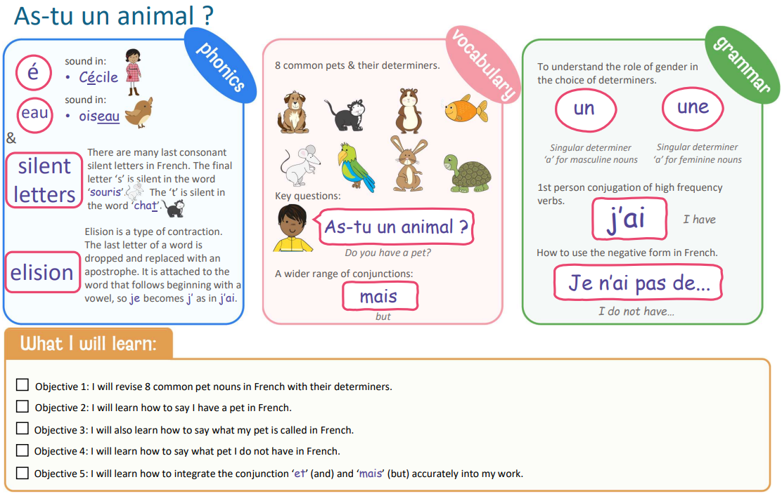
Year 6: Do you have a pet?

Slide 16
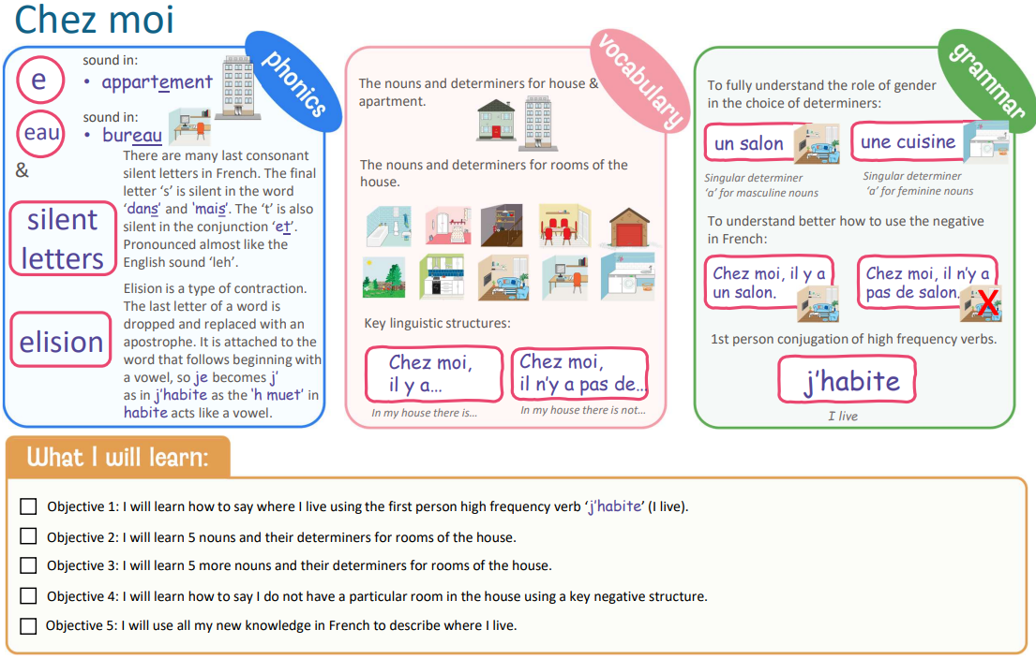
Year 6: My home

Slide 17
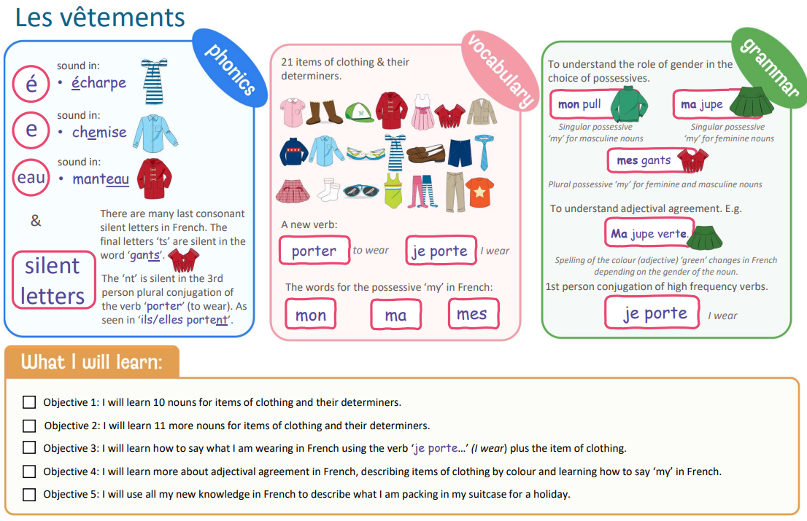
Year 6: Clothes

