Slide 1
Progression in
Design and Technology

Slide 2
Early Years – Laying the Foundations for Design and Technology
Throughout the reception year at PAWS I will be building on the foundations in DT that will allow me to…
Describe something that I want to make/ build/construct
Say who I am making/building/constructing for
Talk about what materials I am going to use when making/building/constructing
Make/build/construct objects using a variety of materials
Join materials together when making/ building/constructing
Talk about my constructions/products, and what I am pleased with
Talk about my constructions and say how it could be even better
Talk about everyday objects that I like and say why they are useful
Build/construct structures from a range of materials to a design brief that I have created or been given.
Build/construct structures that are tall or strong.
Know that tape and glue can join materials together and can make structures stronger.
Recognise different foods as either healthy or unhealthy
Know how to use basic cutlery and utensils to make and eat food
Follow simple instructions to make different foods
Know when we make food for other people that it needs to be appealing
The following activities will provide opportunities to develop the required knowledge I need;
Term 1 – My family.
Creating models of our family homes to use as dolls houses in the small world area.
Term 2 – My country
Create London landmarks in the small and large construction areas and junk modelling area.
Term 3 - My Planet
Upcycle plastic bags and crisp packets into kites and key rings.
Term 4 – My Universe
Create a space rocket in the role play area that is large enough to fit inside.
Term 5 - Looking after myself and others
Create a menu and follow a simple recipe for the healthy eating café.
Construct finger puppets following a simple design brief.
Term 6 - My next move
Plan and build a bug house within our mini beast area.
I will gain relevant experiences of art through the continuous and enhanced provision within the following areas;
Malleable, large and small construction (inside and outside), outdoor woodland and mark making (indoor and outdoor).
By the end of the reception year, I will have gained a good level of development in the following areas, which will sufficiently prepare me for the Year 1 Art curriculum at PAWS.
Physical development – Fine Motor.
C&L – Listening, attention and understanding.
C&L – Speaking
EAD – Creating with materials.
Knowledge and understanding of the world.

Slide 3
Early Years – Laying the Foundations for Design and Technology
I will widen my vocabulary as I become exposed to and encouraged to use the following words;
Talk, imagine, explain
Healthy, unhealthy, hygiene, clean, germs
Roll, pinch, pat, twist, squeeze, stretch, push, sculpt, thread
Join, stick, dab, press, print
Build, design, measure, sort, join, slot, plan, connect, instructions
These core texts will stimulate discussion and help me to make links within my understanding;
A practical present for Philippa pheasant
Lunch boxes – a guide to healthy eating
Moving Molly
The Giant Jam Sandwich
Martha Maps it Out
The Best Diwali ever
Hats of Faith
Someone Swallowed Stanley
Somebody crunched Colin
The Little Red Hen Makes a Pizza
Sam Plants a sunflower
How to Catch a Star
Supertato
I really want to win
These home learning links will help my parents and care givers support my learning at home:
https://www.exploratorium.edu/pie/ideas.html#page - Idea library for model making
http://www.foodafactoflife.org.uk/ - Food Technology activities
http://www.howstuffworks.com - Understanding how things work
https://www.lego.com/en-gb/themes/letsbuildtogether/365-activities​ - Links to Lego building
Spotlight on SEND – Inclusive and Adaptive teaching
Pupils with SEND are supported across the curriculum through Quality First Teaching informed by Inclusive and Adaptive teaching practices. This is part of our universal offer.
Subject specific inclusive and adaptive strategies can be found here.
Here are some examples of the work that we have created so far!; Hyperlink to DT evidence folder.

Slide 4
Cooking and Nutrition

Slide 5
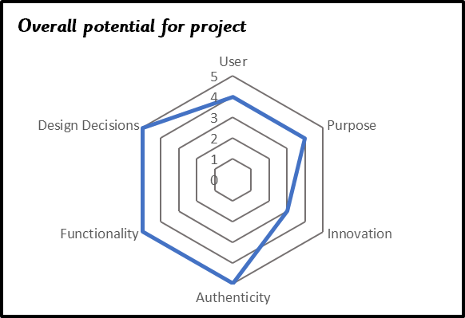
Year 1 Cooking and Nutrition – Design a healthy smoothie
D&T
Skills
Chop fruit and vegetables safely
Identifying if a food is a fruit or a vegetable
Know where and how fruits and vegetables grow
Taste and evaluate different food combinations
Describe appearance, smell and taste
Suggest information to be included on packaging
The Design Process
Design – developing ideas and planning:
Identify the user of a smoothie.
Explain what a smoothie is for.
Explain through talking how a smoothie will be made.
Make:
Use a range of tools and equipment.
Select from a range of ingredients.
Follow procedures for safety and hygiene.
Use a range of tools eg knives, blender.
combine ingredients
Evaluate:
Describe how smoothie tastes
Explain what they like and dislike about smoothie
End Points of Learning
Pupils making a good level of progress will be able to:
Chop fruit and vegetables safely
Name common fruits and vegetables and sort into fruit or vegetable
Describe appearance, smell and taste
Design a motif
Stitch a pattern using a running stitch
Make a product that moves using construction kits with wheels and axles
Explain the importance of making sure the axles run freely within the holders.
Cut and join materials and components correctly
Knowledge
Know that a fruit has seeds and a vegetable does not
Understand that some foods typically known as vegetables are actually fruits (e.g. cucumber)
Know that a blender is a machine which mixes ingredients together into a smooth liquid
Know that fruits grow on trees or vines
Know that vegetables can grow either above or below ground
Know that vegetables can come from different parts of the plant (e.g., roots: potatoes, leaves: lettuce, fruit: cucumber)
Building on EYFS
To recognise different foods as either healthy or unhealthy
To know how to use basic cutlery and utensils to make and eat food
To follow simple instructions to make different foods
To know when we make food for other people that it needs to be appealing
Spotlight on SEND – Inclusive and Adaptive teaching
Pupils with SEND are supported across the curriculum through Quality First Teaching informed by Inclusive and Adaptive teaching practices. This is part of our universal offer.
Subject specific inclusive and adaptive strategies can be found here.
Planning Resources
KAPOW planning on network

Slide 6
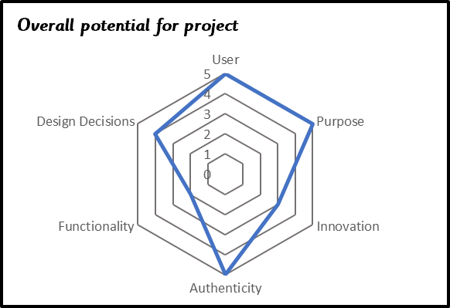
Year 2 Cooking and Nutrition – Design and prepare a healthy wrap for a snack
D&T
Skills
Slice food safely using the bridge or claw grip
Evaluating which grip was most effective
Construct a wrap that meets a design brief
Describe the taste, texture and smell of fruit and vegetables
Taste test food combinations and final products
Describe the information that should be included on a label
The Design Process
Design – developing ideas and planning:
Describe how they will make their products suitable for their intended users
Use simple design criteria to help develop their ideas
Generate ideas by drawing on their own experiences
Use knowledge of existing products to help design an appealing healthy wrap
Make:
Select from a range of ingredients explaining their choices
Measure and cut ingredients safely
Combine ingredients with increasing independence
Create an appealing looking finished wrap
Evaluate:
Make simple judgements about their wrap and ideas against design criteria
Suggest how their wrap could be improved
End Points of Learning
Pupils making a good level of progress will be able to:
Slice safely using bridge and claw grip
Create an appealing looking food which meets design brief
Describe the taste, texture and smell
Select, mark out, cut and join fabric pieces.
Cut neatly and use neat, even running stitch
Add finishing features
Communicate their ideas through talking and drawing
Measure, mark out, cut and shape materials and components
Assemble with increasing independence
Evaluate finished product and suggest improvements
Knowledge
Know that ‘diet’ means the food and drink that a person or animal usually eats
Understand what makes a balanced diet
Know where to find the nutritional information on packaging
Know that the five main food groups are: Carbohydrates, fruits and vegetables, protein, dairy and foods high in fat and sugar
Understand that I should eat a range of different foods from each food group, and roughly how much of each food group
Know that nutrients are substances in food that all living things need to make energy, grow and develop
Know that I should only have a maximum of five teaspoons of sugar a day to stay healthy
Know that many food and drinks we do not expect to contain sugar do; we call these ‘hidden sugars’
Spotlight on SEND – Inclusive and Adaptive teaching
Pupils with SEND are supported across the curriculum through Quality First Teaching informed by Inclusive and Adaptive teaching practices. This is part of our universal offer.
Subject specific inclusive and adaptive strategies can be found here.
Building on Year 1
Chop fruit and vegetables safely
Name common fruits and vegetables and sort into fruit or vegetable
Describe appearance, smell and taste
Planning Resources
KAPOW planning on network

Slide 7
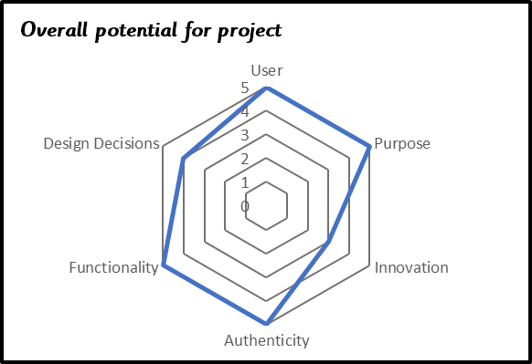
Year 3 Cooking and Nutrition – Design and prepare a seasonal tartlet
D&T
Skills
Know how to prepare themselves and a work space to cook safely in, learning the basic rules to avoid food contamination
Follow the instructions within a recipe
Establish and use design criteria to help test and review dishes
Describe the benefits of seasonal fruits and vegetables and the impact on the environment
The Design Process
Design – developing ideas and planning:
Explore where different foods come from in the world
Model and follow ‘fruity skewers with yogurt dip’ recipe
Explore the term ‘food miles’ and the effects of importing food.
Introduce design brief
Select own ingredients
Make:
Safely follow a recipe when cooking
Select ingredients, equipment and tools suitable for the task
With increasing accuracy, measure,, cut and combine ingredients
Review hygiene and health & safety considerations when cooking
Understand that our ideas will not always work as planned
Evaluate:
Evaluate finished produce against design brief
Identify the strengths and areas for development in their ideas
Evaluate positive effect that eating seasonal fruit and vegetables has on the environment.
End Points of Learning
Pupils making a good level of progress will be able to:
Prepare a safe work space including following rules to avoid food contamination
Follow a recipe
Describe health benefits of seasonal fruits and vegetable
Understand the negative affects of imported foods
Select, measure and mark out materials and components
Cut neatly and accurately
Use neat running and back stitch
Add detailed finishing design features
Join materials using appropriate methods
Identify strengths and areas for development
Knowledge
Know that cooking instructions are known as a ‘recipe’
Know safety rules for using, storing and cleaning a knife safely
Know that not all fruits and vegetables can be grown in the UK
Know that climate affects food growth
Know that vegetables and fruit grow in certain seasons
Know that imported food is food which has been brought into the country
Know that exported food is food which has been sent to another country.
Understand that imported foods travel from far away and this can negatively impact the environment
Understand that vitamins, minerals and fibre are important for energy, growth and maintaining health
Know that similar coloured fruits and vegetables often have similar nutritional benefits
Spotlight on SEND – Inclusive and Adaptive teaching
Pupils with SEND are supported across the curriculum through Quality First Teaching informed by Inclusive and Adaptive teaching practices. This is part of our universal offer.
Subject specific inclusive and adaptive strategies can be found here.
Building on Year 2
Slice safely using bridge and claw grip
Create an appealing looking food which meets design brief
Describe the taste, texture and smell
Communicate their ideas through talking and drawing
Planning Resources
KAPOW planning on network

Slide 8
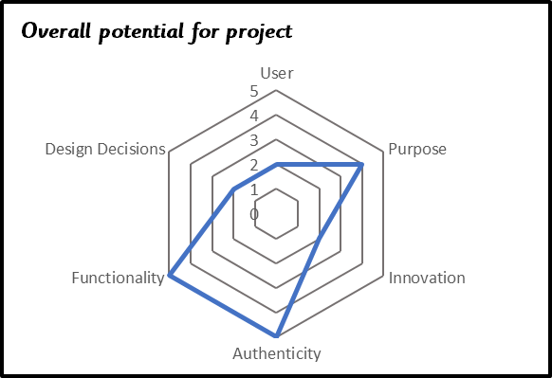
Year 4 Cooking and Nutrition – To adapt a biscuit recipe
D&T
Skills
Follow a baking recipe
Cook safely, following basic hygiene rules
Adapt a recipe
Evaluate a recipe, considering: taste, smell, texture and appearance
Describe the impact of the budget on the selection of ingredients
Evaluate and compare a range of products
Suggest modifications
The Design Process
Design – developing ideas and planning:
Introduce design brief
Follow simple recipe
Modify a recipe and make a simple prototype
Design final recipe within budget
Make:
Children to follow same basic recipe, adding their own ingredients to modify the recipe
In groups, children will make one batch of their final recipe
Use different food preparation techniques: sieving, creaming, rubbing method, cooling
Create packaging
Begin to show resilience and adapt work when original ideas do not work.
Evaluate:
Present product to panel of judges
Evaluate final product against design brief
End Points of Learning
Pupils making a good level of progress will be able to:
Work safety with a range of tools and hygienically
Adapt a recipe
Evaluate and compare based on taste, smell, texture and appearance
Plan and make a product within a given budget
Select appropriate stitches for strength
Use neat, consistently sized stitches
Measure, mark out, cut and shape materials and components with some accuracy
Assemble, join and combine materials and components with some accuracy
Use annotated sketches and cross-sectional drawings communicate ideas.
Consider the views of others, including intended users, to improve their work
Knowledge
Know that the amount of an ingredient in a recipe is known as the ‘quantity’
Know that it is important to use oven gloves when removing hot food from an oven
Know the following cooking techniques: sieving, creaming, rubbing method, cooling
Understand the importance of budgeting while planning ingredients for biscuits
Building on Year 3
Prepare a safe work space including following rules to avoid food contamination
Follow a recipe
Describe health benefits of seasonal fruits and vegetable
Understand the negative affects of imported foods
Identify strengths and areas for development
Spotlight on SEND – Inclusive and Adaptive teaching
Pupils with SEND are supported across the curriculum through Quality First Teaching informed by Inclusive and Adaptive teaching practices. This is part of our universal offer.
Subject specific inclusive and adaptive strategies can be found here.
Planning Resources
KAPOW planning on network

Slide 9
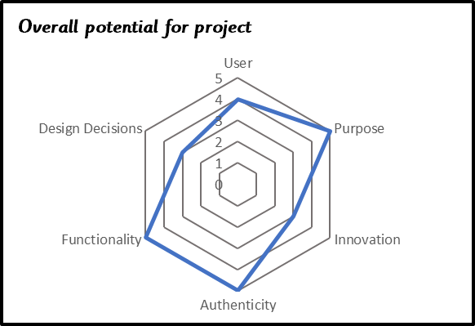
Year 5 Cooking and Nutrition – Make a bolognaise sauce for children that is full of favour, palatable for fussy eaters and healthy?
D&T
Skills
Cut and prepare vegetables safely and with increasing confidence
Use equipment safely, including knives, hot pans and hobs
Know how to avoid cross-contamination
Follow a step-by-step method carefully to make a recipe
Identify the nutritional differences between different products and recipes
Identify and describe healthy benefits of food groups
The Design Process
Design – developing ideas and planning:
Explore ingredients in a spaghetti bolognaise
Explore where the ingredients come from
Children recognise the nutritional differences between different products and recipes.
Introduce design brief – children to create an tasty, innovative and healthy bolognaise sauce
Design appealing and nutritious recipe
Make:
Formulate step-by-step recipe as a guide to making
Select appropriate tools and ingredients
Measure and combine ingredients accurately
Demonstrate resilience and adapt work when original ideas do not work.
Evaluate:
Evaluate their ideas and products against their original design brief
Evaluate how nutritious final product is
End Points of Learning
Pupils making a good level of progress will be able to:
Use equipment safely and hygienically
Identify and describe healthy benefits of different food groups
Explore and evaluate a range of existing products
Select ingredients for flavour and nutritional values
Sew a running and back stitch with increasing neatness
Sew a blanket stitch
Use a pattern/ template to design
Accurately measure, mark out, cut and shape materials and components
Accurately assemble, join and combine materials and components
Use annotated sketches cross-sectional drawings and exploded diagrams to communicate ideas.
Evaluate critically both the appearance and function against the original specifications
Knowledge
Understand where meat comes from - learning that beef is from cattle and how beef is reared and processed, including key welfare issues
Know that I can adapt a recipe to make it healthier by substituting ingredients
Know that I can use a nutritional calculator to see how healthy a food option is
Understand that ‘cross-contamination’ means that bacteria and germs have been passed onto ready-to-eat foods and it happens when these foods mix with raw meat or unclean objects
Building on Year 4
Work safety with a range of tools and hygienically
Adapt a recipe
Evaluate and compare based on taste, smell, texture and appearance
Plan and make a product within a given budget
Consider the views of others, including intended users, to improve their work
Spotlight on SEND – Inclusive and Adaptive teaching
Pupils with SEND are supported across the curriculum through Quality First Teaching informed by Inclusive and Adaptive teaching practices. This is part of our universal offer.
Subject specific inclusive and adaptive strategies can be found here.
Planning Resources
KAPOW planning on network

Slide 10
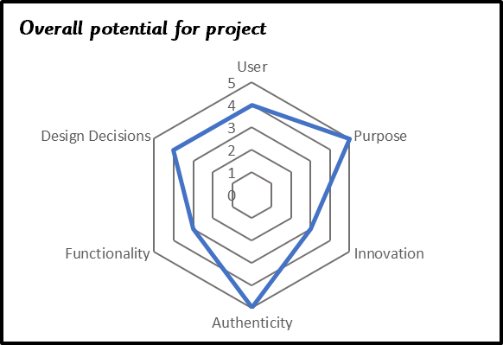
Year 6 Design Brief: To design and make a soup for a World War Two Tea Party
D&T
Skills
Follow a recipe, including using the correct quantities of each ingredient
Adapt a recipe based on research
Work to a given timescale
Work safely and hygienically with independence
Evaluate a recipe, considering: taste, smell, texture and origin of the food group
Taste test and score final products
Suggest and write up points of improvements in productions
Evaluate health and safety in production to minimise cross contamination
The Design Process
Design – developing ideas and planning:
Evaluate a range of existing products
Identify differences between potential ingredients
Select from available ingredients and write own recipes, considering taste, healthiness and dietary requirements
Make:
Select appropriately from range of tools
Select and use appropriate cutting techniques
Work safely and hygienically
Follow won written recipe
Demonstrate resourcefulness and resilience when planning improvements
Evaluate:
Critically evaluate the quality of the design, manufacture and fitness for purpose of their products as they design and make.
Consider views/ feedback of guests at World War Two tea party
End Points of Learning
Pupils making a good level of progress will be able to:
Work safely and hygienically
Adapt a recipe considering taste, healthiness and available ingredients
Select stitches appropriate to task
Use a pattern
Measure and cut fabric accurately
Join fabric with strong, consistent, neat stitches
Add finishing details e.g. pocket, initials, decorative detail
Generate innovative ideas drawing on research
Use an electrical system in their produce
Make improvements and adapt ideas during making process
Critically evaluate finished product
Knowledge
Know that ‘flavour’ is how a food or drink tastes
Know that many countries have ‘national dishes’ which are recipes associated with that country
Know that ‘processed food’ means food that has been put through multiple changes in a factory
Understand that it is important to wash fruit and vegetables before eating to remove any dirt and insecticides
Understand what happens to a certain food before it appears on the supermarket shelf (Farm to Fork)
Building on Year 5
Use equipment safely and hygienically
Identify and describe healthy benefits of different food groups
Explore and evaluate a range of existing products
Select ingredients for flavour and nutritional values
Evaluate critically both the appearance and function against the original specifications
Spotlight on SEND – Inclusive and Adaptive teaching
Pupils with SEND are supported across the curriculum through Quality First Teaching informed by Inclusive and Adaptive teaching practices. This is part of our universal offer.
Subject specific inclusive and adaptive strategies can be found here.
Planning Resources
Year group planning on network

Slide 11
Textiles

Slide 12
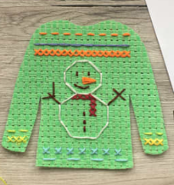
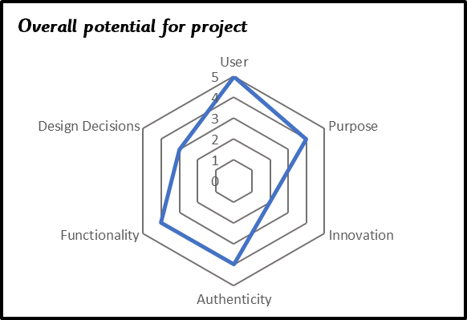
Year 1 Textiles: To design and sew a pattern for a greeting card
D&T
Skills
With support, begin to thread a needle independently
With support, tie a knot or overstitch to secure thread
Can use a running stitch in binca
With support, can start to use a
backstitch in binca
Can loop thread back through to
end stitching
The Design Process
Design – developing ideas and planning:
Make clear, labelled drawings of the card motif
Design a card for a purpose
Make:
Practise basic sewing techniques eg starting, ending, running stitch
Count and use stitches to create motif
Use different colour thread for effect
Evaluate:
Evaluate against the design criteria.
Evaluate quality of finished card
End Points of Learning
Pupils making a good level of progress will be able to:
Chop fruit and vegetables safely
Name common fruits and vegetables and sort into fruit or vegetable
Describe appearance, smell and taste
Design a motif
Stitch a pattern using a running stitch
Make a product that moves using construction kits with wheels and axles
Explain the importance of making sure the axles run freely within the holders.
Cut and join materials and components correctly
Knowledge
Recognize and name different types of textiles/fabric e.g., felt, velvet, cotton.
Can name a needle, stitch, thread, binca
Knows what a running stitch is.
Understand: strong, quality, features, strengthen, position, to, towards
Spotlight on SEND – Inclusive and Adaptive teaching
Pupils with SEND are supported across the curriculum through Quality First Teaching informed by Inclusive and Adaptive teaching practices. This is part of our universal offer.
Subject specific inclusive and adaptive strategies can be found here.
Building on EYFS
To talk about what materials they are going to use when making / building / constructing
To join materials together when making / building / constructing
To build / construct structures from a range of materials to a design brief that they have created or been given.
To know that tape and glue can join materials together and can make structures stronger.
Planning Resources

Slide 13
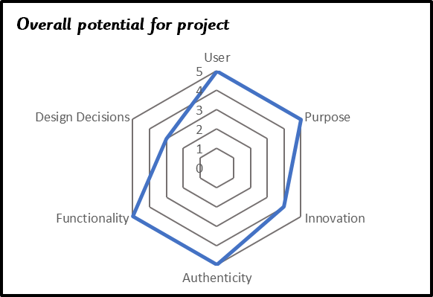
Year 2 Textiles: To design a Christmas tree decoration to display on a Christmas tree at St Mary’s Church
D&T
Skills
With increasing independence, thread a needle
Stitch two pieces of fabric using a overstitch.
Select from and use a range of tools and equipment to perform practical tasks such as marking out, cutting, joining and finishing.
Select from and use textiles according to their characteristics.
Understand how to join fabrics using different techniques e.g., running stitch, glue, over stitch, stapling.
Explore and attach different finishing techniques e.g. using painting, fabric crayons, stitching, sequins, buttons and ribbons.
The Design Process
Design – developing ideas and planning:
Investigate and evaluate a range of existing textile tree decorations
Explore and compare e.g. fabrics, joining techniques, finishing techniques
Design a fabric tree decoration to hang on a Christmas tree
Make
• Select from and use textiles according to their characteristics.
• select from and use a range of tools and equipment to perform practical tasks such as marking out, cutting, joining and finishing.
• use neat, even running stitch to join
• use stuffing to add 3D shape, before finishing stitching
• select and add finishing techniques and ribbon to hang
Evaluate:
Evaluate their ideas throughout and their final products against original design criteria
Suggest how their product could be improved
End Points of Learning
Pupils making a good level of progress will be able to:
Slice safely using bridge and claw grip
Create an appealing looking food which meets design brief
Describe the taste, texture and smell
Select, mark out, cut and join fabric pieces.
Cut neatly and use neat, even running stitch
Add finishing features
Communicate their ideas through talking and drawing
Measure, mark out, cut and shape materials and components
Assemble with increasing independence
Evaluate finished product and suggest improvements
Knowledge
• Know the skills needed for threading a needle
• Knows what a overstitch is.
• Know that some joining techniques are stronger/weaker than others
Spotlight on SEND – Inclusive and Adaptive teaching
Pupils with SEND are supported across the curriculum through Quality First Teaching informed by Inclusive and Adaptive teaching practices. This is part of our universal offer.
Subject specific inclusive and adaptive strategies can be found here.
Building on Year 1
Design a motif
Stitch a pattern using a running stitch
Planning Resources

Slide 14
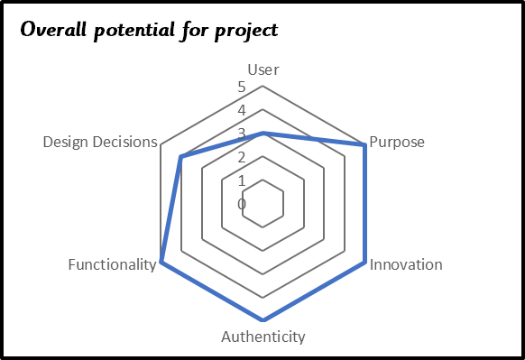
Year 3 Textiles: To make a hand puppet to tell a story
D&T
Skills
Thread a needle independently.
Use a running stitch independently.
Understand how to securely join two pieces of fabric together.
Understand how simple 3-D textile products are made, using a template to create two identical shapes.
Understand the need for patterns and seam allowances.
Apply decoration using beads, buttons, feathers etc. considering the aesthetics
The Design Process
Design – developing ideas and planning:
Investigate a range of textile products that have a selection of stitches, joins, fabrics, finishing techniques, fastenings and purposes, linked to the product they will design, make and evaluate.
Disassemble appropriate textiles products to gain an understanding of 3-D shape, patterns and seam allowances, different fabrics
Teach and practice running stitch
Discuss the intended user, purpose and appeal of their product. Create a set of design criteria.
Make
• Select and use a range of appropriate tools with some accuracy e.g. cutting, joining and finishing.
• Select stitches, fabrics and fastenings according to their functional characteristics e.g. strength, and aesthetic qualities e.g. pattern
• use neat, even stitches to join
• select and add finishing techniques e.g. sequins for eyes
Evaluate:
•. Test their product against the original design criteria and with the intended user.
• Take into account others’ views.
End Points of Learning
Pupils making a good level of progress will be able to:
Prepare a safe work space including following rules to avoid food contamination
Follow a recipe
Describe health benefits of seasonal fruits and vegetable
Understand the negative affects of imported foods
Select, measure and mark out materials and components
Cut neatly and accurately
Use neat running and back stitch
Add detailed finishing design features
Join materials using appropriate methods
Identify strengths and areas for development
Knowledge
• Know what a running is.
Building on Year 2
Select, mark out, cut and join fabric pieces.
Cut neatly and use neat, even running stitch
Add finishing features
Communicate their ideas through talking and drawing
Evaluate finished product and suggest improvements
Spotlight on SEND – Inclusive and Adaptive teaching
Pupils with SEND are supported across the curriculum through Quality First Teaching informed by Inclusive and Adaptive teaching practices. This is part of our universal offer.
Subject specific inclusive and adaptive strategies can be found here.
Planning Resources

Slide 15
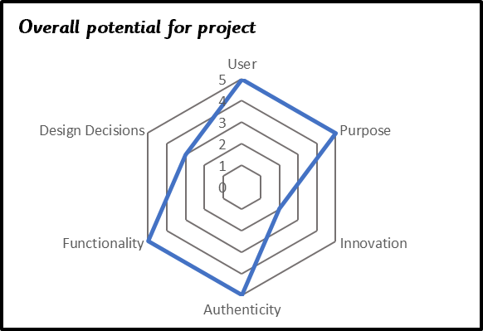
Year 4 Textiles: Design and make a bendy bag to store a chosen item
D&T
Skills
Thread a needle and tie a knot independently.
Learn to sew a backstitch and use running stitch with independence
Understand the need for strong, even stitches and seam allowances.
Know how to strengthen, stiffen and reinforce existing fabrics.
Apply decoration using needle and thread: buttons, sequins.
Use decorative techniques e.g., appliqué, embroidery or fabric paints considering the aesthetics
The Design Process
Design – developing ideas and planning:
Examine carefully a collection of simple textile containers e.g. purses, wallets, spectacle cases, draw–string bags. Focus the children’s attention on the seams and seam
Learn to sew a backstitch
allowance, size, fitness for purpose
Use simple paper bags to create a prototype.
Investigate a range of fastenings
Decide the purpose and user of the ‘bendy bag’ - draw up a simple design specification stating clearly what will be kept in the bag
Make
Produce drawings with labels to show what they intend to make and the sequence of their work
Order the sequence of their work
Select from given range of tools, equipment, materials and components
Construct their ‘bendy bag’ with some accuracy, selecting appropriate strong stitches
Evaluate:
Evaluate the finished bags by testing in use, discussing strengths and areas for development of both appearance and function suggesting improvements.
Take into account others’ views.
End Points of Learning
Pupils making a good level of progress will be able to:
Work safety with a range of tools and hygienically
Adapt a recipe
Evaluate and compare based on taste, smell, texture and appearance
Plan and make a product within a given budget
Select appropriate stitches for strength
Use neat, consistently sized stitches
Measure, mark out, cut and shape materials and components with some accuracy
Assemble, join and combine materials and components with some accuracy
Use annotated sketches and cross-sectional drawings communicate ideas.
Consider the views of others, including intended users, to improve their work
Knowledge
• Know how different fastenings work.
• Understand that joining needs to be secure and strong
Know that a back stitch is stronger than a running stitch
Building on Year 3
Prepare a safe work space
Select, measure and mark out materials and components
Cut neatly and accurately
Use neat running and back stitch
Add detailed finishing design features
Identify strengths and areas for development
Spotlight on SEND – Inclusive and Adaptive teaching
Pupils with SEND are supported across the curriculum through Quality First Teaching informed by Inclusive and Adaptive teaching practices. This is part of our universal offer.
Subject specific inclusive and adaptive strategies can be found here.
Planning Resources

Slide 16
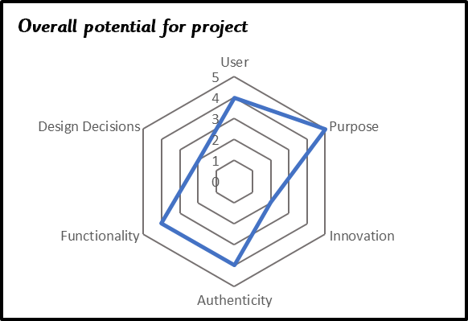
Year 5 Textiles: To design and make a bag to store wash kit at camp
D&T
Skills
Continue to use a running stitch and back stitch and select appropriate stitch for strength.
Introduce a blanket stitch
Use a pattern/template in designing a product.
Pin, sew and stitch materials together to create a product;
To allow for seam allowance
Sew casing for and thread cord.
The Design Process
Design – developing ideas and planning:
Research and develop design criteria to inform design
evaluate bags considering appearance, function, cost and safety, functional and decorative products;
Learn to sew a blanket stitch
Generate, model and communicate ideas through discussion, sketches and pattern pieces,
Create working drawing and pattern of the chosen idea, including measurements, stitch types and fabric swatches.
Make
Select from and use a wider range of tools, equipment, materials and components
Make a prototype for their bag, allowing for seam allowances of 1–1.5cm (plain paper or grid paper can be used). And larger top seam for drawstring
Pin the pattern onto the fabric allowing minimal wastage
Cut and join material using appropriate stitches
Add cord for drawstring
Add decorative detail, considering aesthetic quality
Evaluate:
Evaluate bag against the design specification (including user testing). What do the users think of the bags? Do they meet their needs well? How could they be made better? What would you change? What are you pleased with?
End Points of Learning
Pupils making a good level of progress will be able to:
Use equipment safely and hygienically
Identify and describe healthy benefits of different food groups
Explore and evaluate a range of existing products
Select ingredients for flavour and nutritional values
Sew a running and back stitch with increasing neatness
Sew a blanket stitch
Use a pattern/ template to design
Accurately measure, mark out, cut and shape materials and components
Accurately assemble, join and combine materials and components
Use annotated sketches cross-sectional drawings and exploded diagrams to communicate ideas.
Evaluate critically both the appearance and function against the original specifications
Knowledge
• Understand that a pattern/template ca be used to make a bag.
• Know that when using a pattern, you need to make allowances for the seam.
• Knows what a blanket stitch is.
• Knows that a blanket stitch be used to hold two edges together, to neaten edges or to produce a decorative effect.
Building on Year 4
Work safety with a range of tools
Select appropriate stitches for strength
Use neat, consistently sized stitches
Measure, mark out, cut and shape materials and components with some accuracy
Assemble, join and combine materials and components with some accuracy
Use annotated sketches and cross-sectional drawings communicate ideas.
Consider the views of others, including intended users, to improve their work
Spotlight on SEND – Inclusive and Adaptive teaching
Pupils with SEND are supported across the curriculum through Quality First Teaching informed by Inclusive and Adaptive teaching practices. This is part of our universal offer.
Subject specific inclusive and adaptive strategies can be found here.
Planning Resources

Slide 17
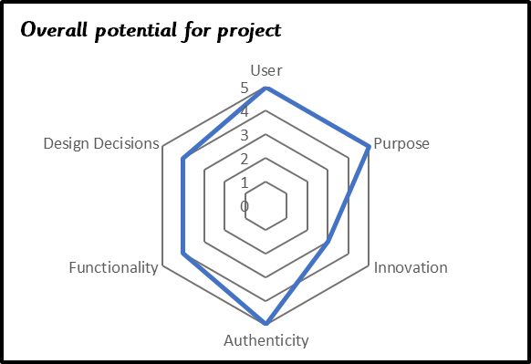
Year 6 textiles: To make an apron to wear for our World War Two tea party
D&T
The Design Process
Design – developing ideas and planning:
Generate and develop innovative ideas by carrying out research including evaluating existing products, surveys, interviews
Develop, model and communicate ideas through discussion, drawing, templates, mock-ups and prototypes and, where appropriate, computer-aided design.
Design purposeful, functional, appealing products for the intended user that are fit for purpose based on a simple design specification.
Make
Produce detailed lists of equipment and fabrics relevant to their tasks.
Formulate step-by-step plans
Select from and use a range of tools and equipment to make products that are accurately assembled and well finished.
Work within the constraints of time, resources and cost.
Evaluate:
Investigate and analyse textile products linked to their final product.
Compare the final product to the original design specification.
Test products with intended user and critically evaluate the quality of the design, manufacture, functionality and fitness for purpose.
Consider the views of others to improve their work
Skills
• Use a range of stitches creatively, selecting the most appropriate to specific task, e.g., consider strength/aesthetics
• Develop skills of sewing textiles by joining right side together and making seams.
• Start and finish off a row of stitches.
• Pin a pattern on to fabric ensuring limited wastage
• Know to leave a seam allowance and different cutting techniques.
• Experiment with a variety of techniques.
• Recognise different forms of textiles and express opinions on them.
End Points of Learning
Pupils making a good level of progress will be able to:
Work safely and hygienically
Adapt a recipe considering taste, healthiness and available ingredients
Select stitches appropriate to task
Use a pattern
Measure and cut fabric accurately
Join fabric with strong, consistent, neat stitches
Add finishing details e.g. pocket, initials, decorative detail
Generate innovative ideas drawing on research
Use an electrical system in their produce
Make improvements and adapt ideas during making process
Critically evaluate finished product
Knowledge
• Understand how a 3-D textile product can be made from a combination of accurately made pattern pieces, fabric shapes and different fabrics.
• Know that fabrics can be strengthened, stiffened and reinforced where appropriate.
Building on Year 5
Use equipment safely
Sew a running and back stitch with increasing neatness
Sew a blanket stitch
Use a pattern/ template to design
Accurately measure, mark out, cut and shape materials and components
Accurately assemble, join and combine materials and components
Use annotated sketches cross-sectional drawings and exploded diagrams to communicate ideas.
Evaluate critically both the appearance and function against the original specifications
Spotlight on SEND – Inclusive and Adaptive teaching
Pupils with SEND are supported across the curriculum through Quality First Teaching informed by Inclusive and Adaptive teaching practices. This is part of our universal offer.
Subject specific inclusive and adaptive strategies can be found here.
Planning Resources

Slide 18
Workshop

Slide 19
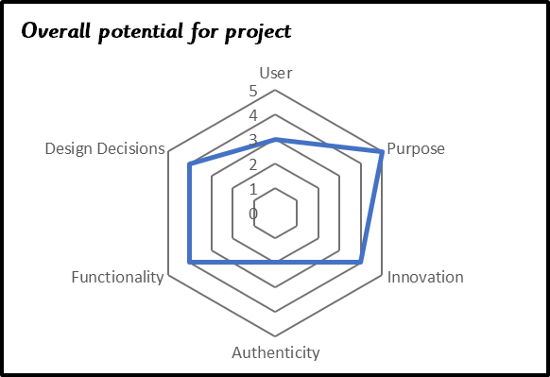
Year 1 Wheels and Axels – Design and create a moving vehicle (moon buggy)
D&T
Skills
Using construction kits with wheels and axles
Investigate and understand how parts are put together in order to make a moving vehicle
Recognise the importance of correct position of wheels and axels in making a vehicle run smoothly
Test and evaluate the vehicle considering purpose and suitability
The Design Process
Design – developing ideas and planning:
Identify the user of a product.
Explain what a product is for.
Generate initial ideas and simple design criteria through talking and using own experiences.
Develop and communicate ideas through drawings and mock-ups.
Make:
Select from and use a range of tools and equipment to perform practical tasks such as cutting and joining to allow movement and finishing.
Select from and use a range of materials and components such as paper, card, plastic and wood according to their characteristics.
Evaluate:
Explore and evaluate a range of products with wheels and axles.
Evaluate their ideas throughout and their products against original criteria.
Explain what they like and dislike about products
Spotlight on SEND – Inclusive and Adaptive teaching
Pupils with SEND are supported across the curriculum through Quality First Teaching informed by Inclusive and Adaptive teaching practices. This is part of our universal offer.
Subject specific inclusive and adaptive strategies can be found here.
End Points of Learning
Pupils making a good level of progress will be able to:
Chop fruit and vegetables safely
Name common fruits and vegetables and sort into fruit or vegetable
Describe appearance, smell and taste
Design a motif
Stitch a pattern using a running stitch
Make a product that moves using construction kits with wheels and axles
Explain the importance of making sure the axles run freely within the holders.
Cut and join materials and components correctly
Knowledge
Understand that wheels and axels can be assembled in different ways
Distinguish between fixed and freely moving axles
Building on EYFS
To describe something they want to make / build / construct
To say who they are making / building / constructing for
To talk about what materials they are going to use when making / building / constructing
To make / build / construct objects using a variety of materials
To join materials together when making / building / constructing
To know that tape and glue can join materials together and can make structures stronger.
Planning Resources
D&T Association Planning on a Page

Slide 20
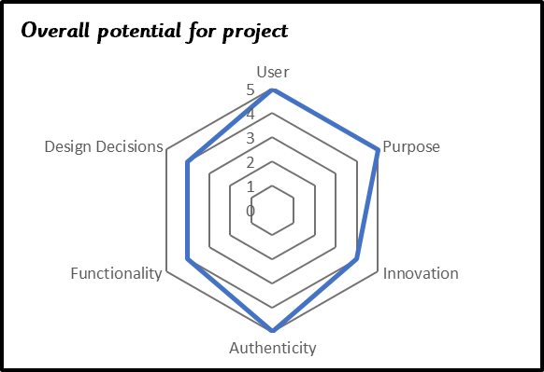
D&T
Year 2 Freestanding structures – Design and make a bug house
Skills
Identify similarities and differences in free standing structures.
Experiment with different assembly techniques for strength and stability.
Know how to make freestanding structures stronger, stiffer and more stable.
The Design Process
Design – developing ideas and planning:
Describe how they will make their products suitable for their intended users
Generate ideas based on simple design criteria and their own experiences, explaining what they could make.
Develop, model and communicate their ideas through talking, mock-ups and drawings.
Make:
Select from a range of materials explaining their choices
Select from a range of tools
Measure, mark out, cut and shape materials and components
Assemble, join and combine materials and components with increasing independence
Use finishing techniques, select from a range of tools
Evaluate:
Make simple judgements about their products and ideas against design criteria
Suggest how their products could be improved
End Points of Learning
Pupils making a good level of progress will be able to:
Slice safely using bridge and claw grip
Create an appealing looking food which meets design brief
Describe the taste, texture and smell
Select, mark out, cut and join fabric pieces.
Cut neatly and use neat, even running stitch
Add finishing features
Communicate their ideas through talking and drawing
Measure, mark out, cut and shape materials and components
Assemble with increasing independence
Evaluate finished product and suggest improvements
Knowledge
Identify free standing structures and explain how they know they are freestanding
Building on Year 1
Make a product that moves using construction kits with wheels and axles
Explain the importance of making sure the axles run freely within the holders.
Cut and join materials and components correctly
Spotlight on SEND – Inclusive and Adaptive teaching
Pupils with SEND are supported across the curriculum through Quality First Teaching informed by Inclusive and Adaptive teaching practices. This is part of our universal offer.
Subject specific inclusive and adaptive strategies can be found here.
Planning Resources
D&T Association Planning on a Page

Slide 21
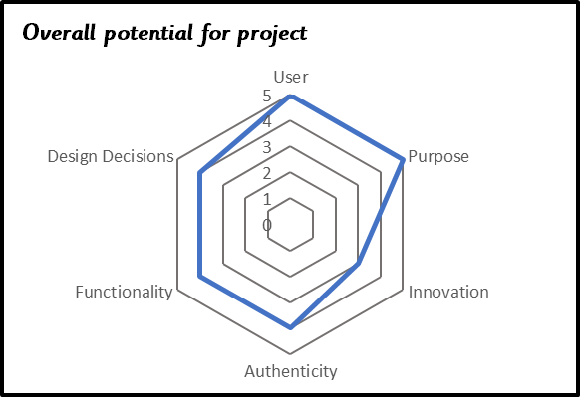
Year 3 Shell Structures – To design and make a pencil pot for a family member
D&T
Skills
Evaluate a range of shell structures identifying their purpose and intended user
Explain how materials have been stiffened.
Develop and use knowledge of nets of cubes and cuboids and, where appropriate, more complex 3D shapes structures
Create a shell structure to protect another product
Demonstrate how to use different ways of stiffening and strengthening their shell structures e.g., folding and shaping, corrugating, ribbing, laminating.
The Design Process
Design – developing ideas and planning:
Generate realistic ideas, focusing on the needs of the user
Explain how particular parts of their products will work
Share and clarify ideas through discussion
Use annotated sketches to communicate their ideas
Use computer-aided design to develop and communicate their ideas
Make:
Order the main stages of making
Select materials, equipment and tools equipment suitable for the task
With increasing accuracy, measure, mark out, cut and shape materials and components
Join materials together using the best method for the material
Explain their choice of materials and components according to functional properties and aesthetic qualities
Understand that our ideas will not always work as planned
Evaluate:
Refer to their design criteria as they design and make
Identify the strengths and areas for development in their ideas and products
End Points of Learning
Pupils making a good level of progress will be able to:
Prepare a safe work space including following rules to avoid food contamination
Follow a recipe
Describe health benefits of seasonal fruits and vegetable
Understand the negative affects of imported foods
Select, measure and mark out materials and components
Cut neatly and accurately
Use neat running and back stitch
Add detailed finishing design features
Join materials using appropriate methods
Identify strengths and areas for development
Knowledge
Know that shell structures are hollow shapes made from nets.
Know that there are a range of shell structure products which have been designed, produced and evaluated.
Understand that shell structures can be made of different materials.
Recognise that shell structures can present, protect or contain another product.
Building on Year 2
Communicate their ideas through talking and drawing
Measure, mark out, cut and shape materials and components
Assemble with increasing independence
Evaluate finished product and suggest improvements
Spotlight on SEND – Inclusive and Adaptive teaching
Pupils with SEND are supported across the curriculum through Quality First Teaching informed by Inclusive and Adaptive teaching practices. This is part of our universal offer.
Subject specific inclusive and adaptive strategies can be found here.
Planning Resources
D&T Association Planning on a Page

Slide 22
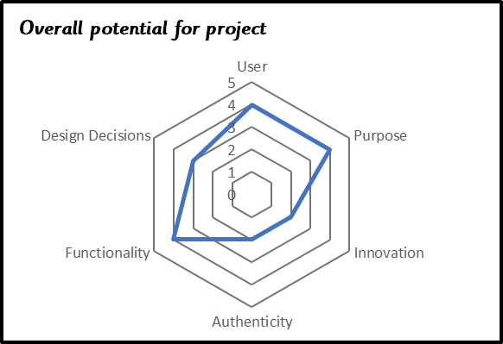
Year 4 Pneumatics – Design and create a pneumatic toy for a KS1 child
D&T
Skills
Demonstrate how to assemble the systems using syringes, tubing, balloons and plastic bottles
Understand and use pneumatic mechanisms.
The Design Process
Design – developing ideas and planning:
Indicate the design features of their products that will appeal to intended users
Gather information about the needs and wants of particular individuals and groups
Use annotated sketches and cross-sectional drawings communicate ideas.
Make design decisions within a set budget
Make:
Measure, mark out, cut and shape materials and components with some accuracy
Assemble, join and combine materials and components with some accuracy
Apply a range of finishing techniques, including those from art and design, with some
Begin to show resilience and adapt work when original ideas do not work.
Evaluate:
Consider the views of others, including intended users, to improve their work
Use their design criteria to evaluate their completed products
End Points of Learning
Pupils making a good level of progress will be able to:
Work safety with a range of tools and hygienically
Adapt a recipe
Evaluate and compare based on taste, smell, texture and appearance
Plan and make a product within a given budget
Select appropriate stitches for strength
Use neat, consistently sized stitches
Measure, mark out, cut and shape materials and components with some accuracy
Assemble, join and combine materials and components with some accuracy
Use annotated sketches and cross-sectional drawings communicate ideas.
Consider the views of others, including intended users, to improve their work
Knowledge
Identify the use of pneumatics in real world contexts
Building on Year 3
Select, measure and mark out materials and components
Cut neatly and accurately
Join materials using appropriate methods
Identify strengths and areas for development
Spotlight on SEND – Inclusive and Adaptive teaching
Pupils with SEND are supported across the curriculum through Quality First Teaching informed by Inclusive and Adaptive teaching practices. This is part of our universal offer.
Subject specific inclusive and adaptive strategies can be found here.
Planning Resources
D&T Association Planning on a Page

Slide 23
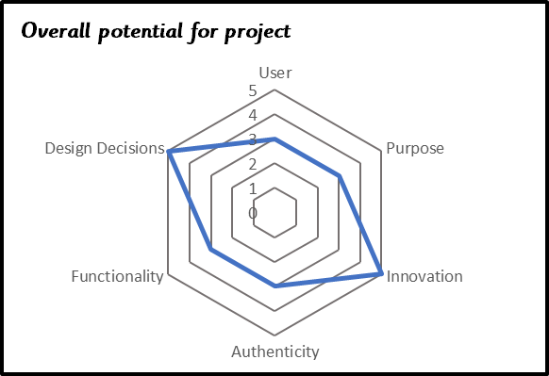
Year 5 Design a bridge for students at PaWS to cross the railway line to reduce the number of pupils who are late
D&T
Skills
Evaluate a range of frame structures including towers, bridges, buildings, etc.
Identifying how the structures have been made and how materials have been stiffened and strengthened
Design a frame structure product for an intended user and purpose
The Design Process
Design – developing ideas and planning:
Identify the needs, wants, preferences and values of particular individuals and groups
Model their ideas using prototypes and pattern pieces
Use annotated sketches, cross-sectional drawings and exploded diagrams to communicate ideas.
Make:
Produce appropriate lists of tools, equipment and materials that they need
Formulate step-by-step plans as a guide to making
Accurately measure, mark out, cut and shape materials and components
Accurately assemble, join and combine materials and components
Demonstrate resilience and adapt work when original ideas do not work.
Evaluate:
Evaluate their ideas and products against their original design specification
Consider how innovative products are
Evaluate how sustainable the materials in products are
End Points of Learning
Pupils making a good level of progress will be able to:
Use equipment safely and hygienically
Identify and describe healthy benefits of different food groups
Explore and evaluate a range of existing products
Select ingredients for flavour and nutritional values
Sew a running and back stitch with increasing neatness
Sew a blanket stitch
Use a pattern/ template to design
Accurately measure, mark out, cut and shape materials and components
Accurately assemble, join and combine materials and components
Use annotated sketches cross-sectional drawings and exploded diagrams to communicate ideas.
Evaluate critically both the appearance and function against the original specifications
Knowledge
Identify a range of frame structures
Know the names and buildings associated with established architects.
Building on Year 4
Work safety with a range of tools
Select appropriate stitches for strength
Use neat, consistently sized stitches
Measure, mark out, cut and shape materials and components with some accuracy
Assemble, join and combine materials and components with some accuracy
Use annotated sketches and cross-sectional drawings communicate ideas.
Consider the views of others, including intended users, to improve their work
Spotlight on SEND – Inclusive and Adaptive teaching
Pupils with SEND are supported across the curriculum through Quality First Teaching informed by Inclusive and Adaptive teaching practices. This is part of our universal offer.
Subject specific inclusive and adaptive strategies can be found here.
Planning Resources
D&T Association Planning on a Page

Slide 24
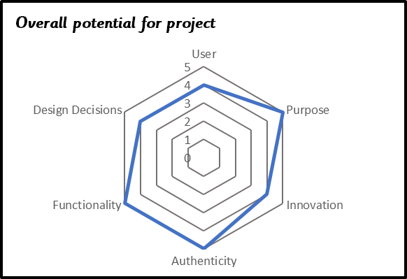
Year 6 Switches and circuits – To make an alarm to protect the school vegetable patch
D&T
Skills
Evaluate electrical products that respond to changes in the environment using a computer control program.
Design and make an electrical product for an intended user and purpose
Use a computer control program to control
The Design Process
Design – developing ideas and planning:
Carry out research, using surveys, interviews, questionnaires and web-based resources
Generate innovative ideas, drawing on research
Make design decisions, taking account of constraints such as time, resources and cost
Make:
Accurately apply a range of finishing techniques, including those from art and design
Use techniques that involve an increasing number of steps
Demonstrate resourcefulness when tackling practical problems
Demonstrate resilience and recognise the opportunities for making improvements when adapting ideas when original ideas do not work.
Evaluate:
Critically evaluate the quality of the design, manufacture and fitness for purpose of their products as they design and make.
End Points of Learning
Pupils making a good level of progress will be able to:
Work safely and hygienically
Adapt a recipe considering taste, healthiness and available ingredients
Select stitches appropriate to task
Use a pattern
Measure and cut fabric accurately
Join fabric with strong, consistent, neat stitches
Add finishing details e.g. pocket, initials, decorative detail
Generate innovative ideas drawing on research
Use an electrical system in their produce
Make improvements and adapt ideas during making process
Critically evaluate finished product
Knowledge
Identify the purpose of different electrical products.
Know how different types of switches are operated and how they work.
Building on Year 5
Use equipment safely
Accurately measure, mark out, cut and shape materials and components
Accurately assemble, join and combine materials and components
Use annotated sketches cross-sectional drawings and exploded diagrams to communicate ideas.
Evaluate critically both the appearance and function against the original specifications
Spotlight on SEND – Inclusive and Adaptive teaching
Pupils with SEND are supported across the curriculum through Quality First Teaching informed by Inclusive and Adaptive teaching practices. This is part of our universal offer.
Subject specific inclusive and adaptive strategies can be found here.
Planning Resources
D&T Association Planning on a Page

Slide 25
D&T – Inclusive and Adaptive teaching strategies
D&T
In addition to the generic inclusive and adaptive teaching strategies at PaWS, in D&T, teachers consider the following:
● Ensure demonstration areas are decluttered, are clearly laid out and give all
● Learners have a clear view.
● Use visuals or symbols to show the order to carry out a sequence of activities
● Clarify technical terms that have different meanings in other contexts
● Appropriate risk assessments are completed and additional support provided where required to enable access.
● Sensitive pairings and groupings
● Break down the designing and making stages into small manageable steps.

