Slide 1
Year 1

Slide 2
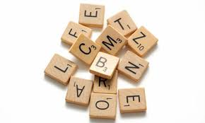
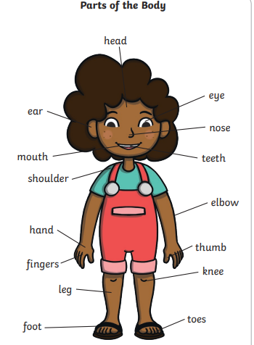
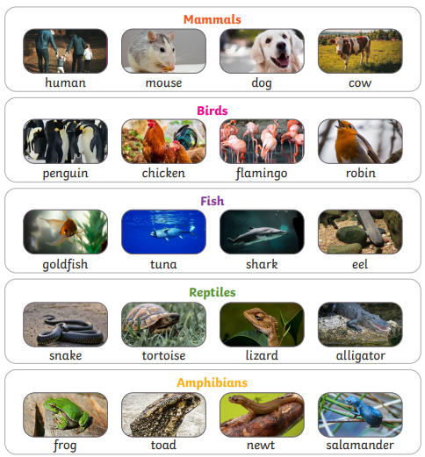
Year 1 – Animals including humans
Science
Learning sequence
1. Identify and name a variety of common animals including fish, amphibians, reptiles, birds and mammals
2. Identify and name a variety of common animals that are carnivores, herbivores and omnivores
3. Describe and compare the structure of a variety of common animals (fish, amphibians, reptiles, birds and mammals including pets)
4. Identify, name, draw and label the basic parts of the human body and say which part of the body is associated with each sense
Vocabulary
birds
fish
reptiles
sight
hearing
touch
taste
smell
mammals amphibians
herbivore
carnivore
omnivore
Knowledge
Scientific enquiry and investigation
Senses experiments

Slide 3
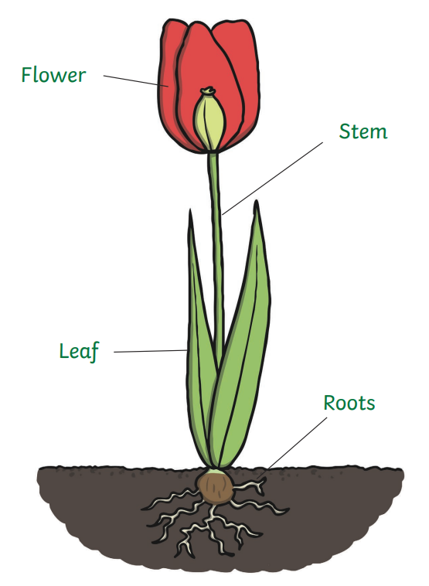
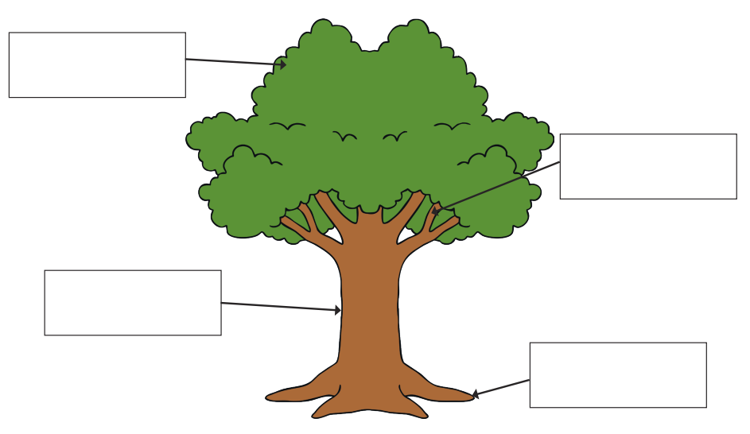
Year 1 – Plants
Science
Learning sequence
To identify and name a variety of common wild and garden plants, including deciduous and evergreen trees.
To identify and describe the basic structure of a variety of common flowering plants, including trees.
Vocabulary
trunk blossom
petals stem
deciduous trees
evergreen trees
habitat
buds roots bulb
plants
environment
leaves
fruit
flowers
branches seed
Knowledge
Scientific enquiry and investigation
Plant own seed. Observe and record the changes over time.

Slide 4
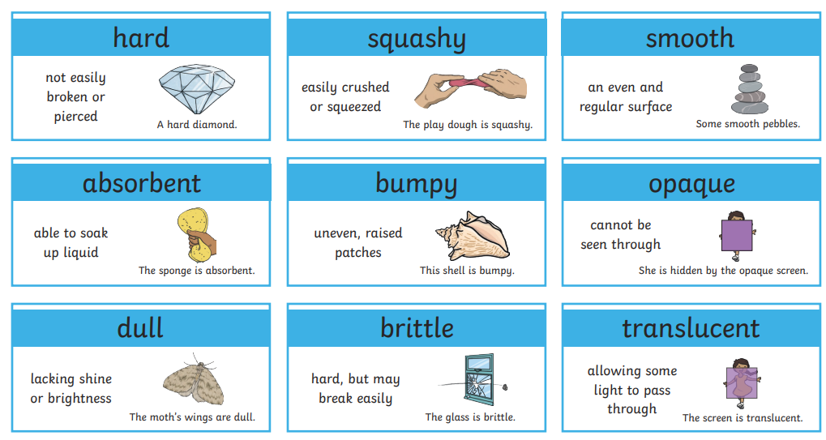
Year 1 – Everyday materials
Science
Learning sequence
To distinguish between an object and the material from which it is made.
To identify and name a variety of everyday materials, including wood, plastic, glass, metal, water, and rock.
To describe the simple physical properties of a variety of everyday materials.
To compare and group together a variety of everyday materials on the basis of their simple physical properties.
Vocabulary
object rock
group water
wood
plastic
brick
glass
metal
paper
elastic
rough/ smooth
materials
properties
bendy/ not bendy
waterproof
hard / soft
stretchy / stiff
Shiny / dull
absorbent
fabric
foil
Knowledge
Scientific enquiry and investigation
Design a house. Which materials would be best? Why?
(Connections with the weather).

Slide 5
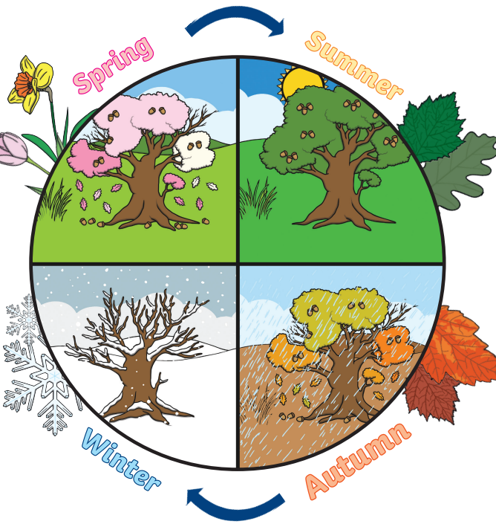
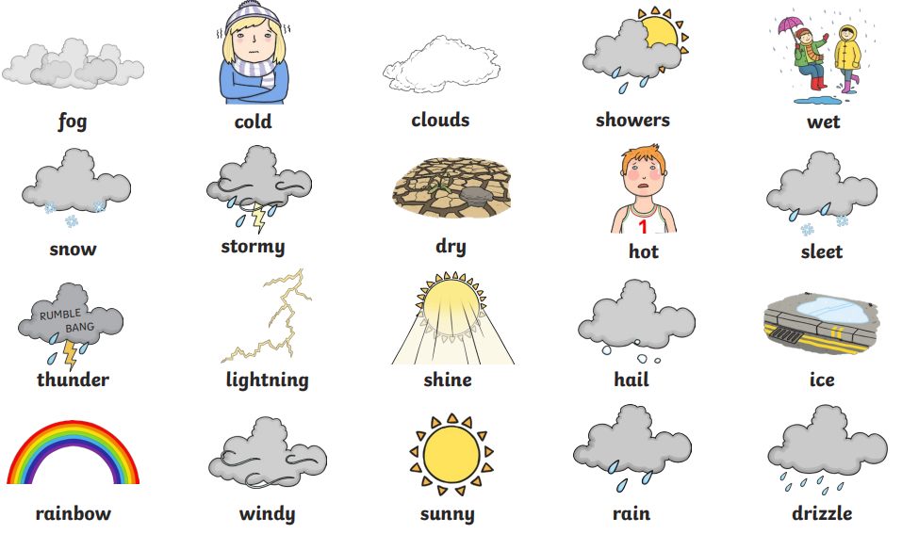
Year 1 – Seasonal changes
Science
Learning sequence
To observe changes across the 4 seasons.
To observe and describe weather associated with the seasons and how day length varies.
Vocabulary
seasons
weather
day
night
rain
cloud
wind
snow
spring
summer
autumn
winter
sun
moon
day length
Knowledge
Scientific enquiry and investigation
What happens to nature in different seasons?

Slide 6
Year 2

Slide 7
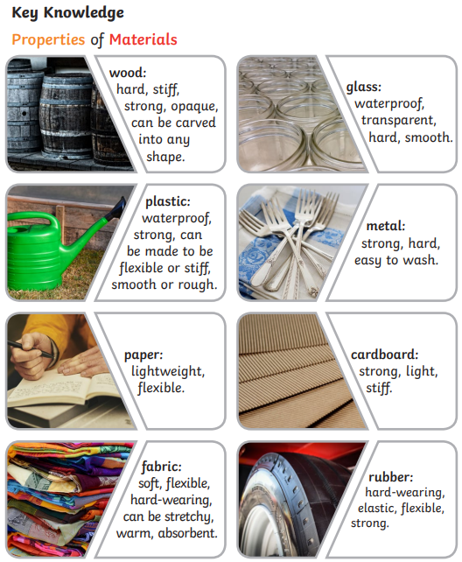
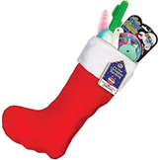
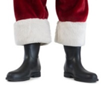
Year 2 – Uses of everyday materials
Science
Learning sequence
Identify and compare the suitability of a variety of everyday materials, for particular uses.
Find out how the shapes of solid objects made from some materials can be changed by squashing, bending, twisting and stretching.
I can identify and discuss the uses of different everyday materials.
I know that materials can be used for more than one thing.
I know that different materials can be used for the same thing.
I can identify the properties of different materials and how they are suitable for their use.
Vocabulary
wood
metal
plastic
glass
brick
rock
cardboard
strong
squashing
bending
twisting
stretching
rough
smooth
hard
soft
material
property
suitable
absorbent
waterproof
rigid
flexible
transparent
translucent
opaque
durable
lightweight
Scientific enquiry and investigation
Which materials are best suited for a Christmas stocking, Santa’s boots and a Christmas tree decoration?

Slide 8
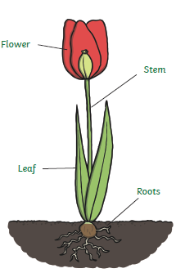
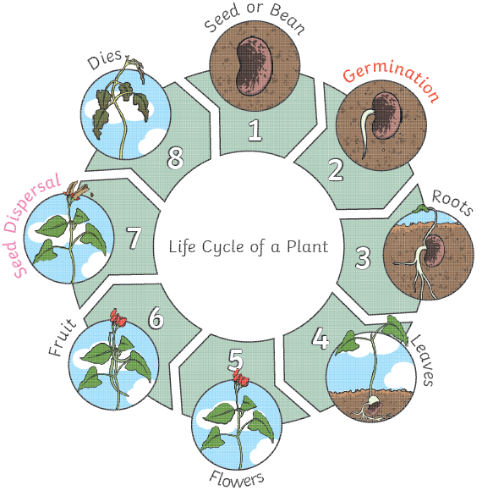
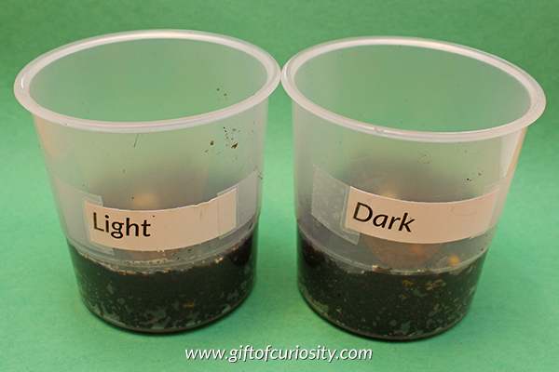
Year 2 – Plants
Science
Learning sequence
Observe and describe different seeds.
Observe and describe how seeds and bulbs grow into mature plants.
Take measurements and record observations in tables
Investigate what plants need to grow and stay healthy.
Vocabulary
deciduous trees
evergreen tress
leaf
flower
petals
fruit
bulb
seed
roots
trunk
branches
growth
germinate
sprout
light
temperature
reproduce
lifecycle
Knowledge
Scientific enquiry and investigation
Do plants need light so that they can grow?

Slide 9
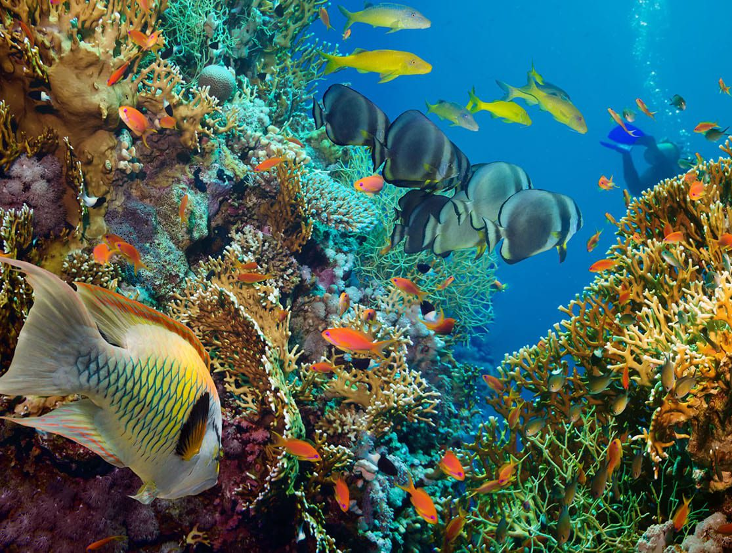
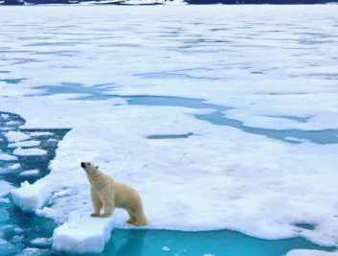
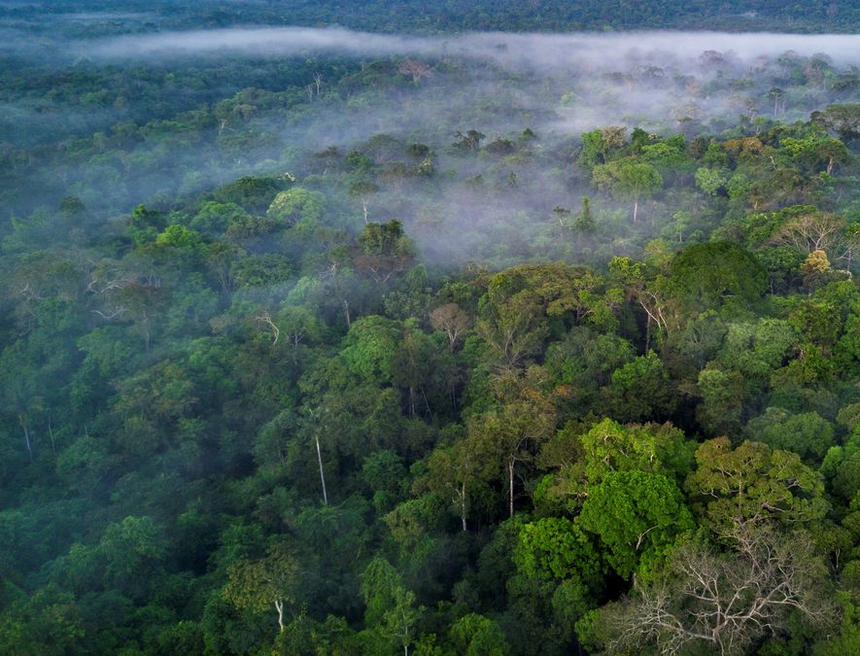
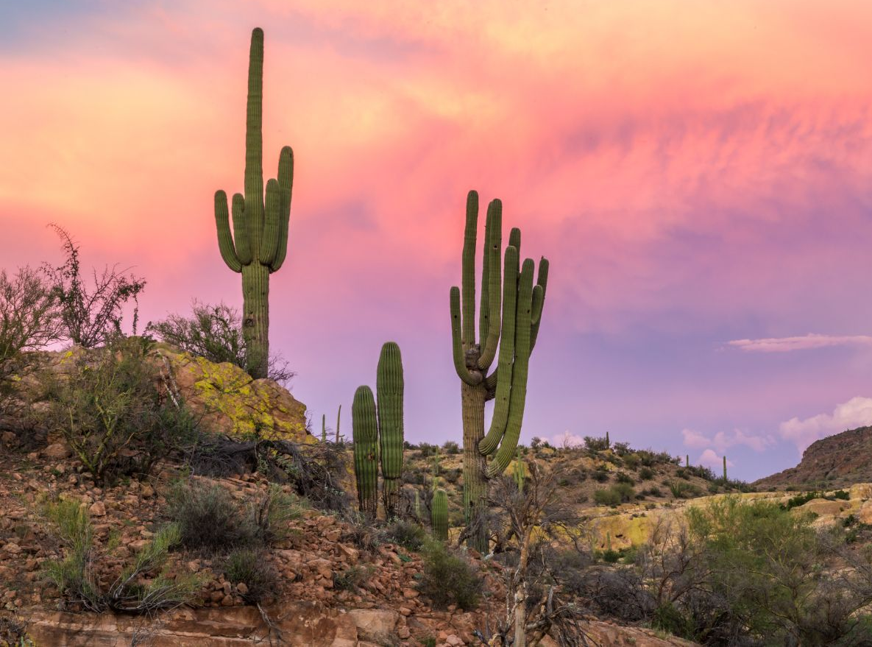
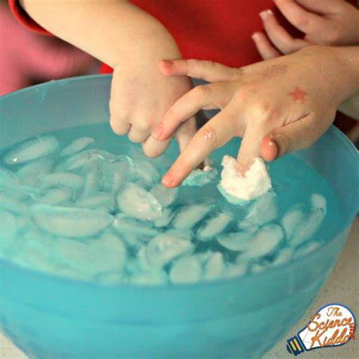
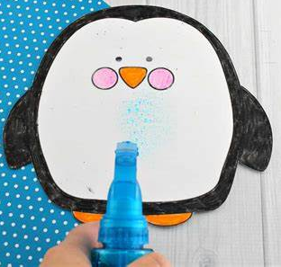
Year 2 – Living things and their habitats
Science
Learning sequence
1) Compare differences between living and non-living things.
2) Understand what a habitat is and name a variety of habitats.
3) Identify and name a variety of animals within different habitats.
4) Understand how some animals are suited to live in their habitats.
5) Recognise different food chains
6) Understand how humans can impact animals’ habitats.
Vocabulary
habitat
microhabitat
adaptation
rainforest
polar region
depend
survive
living
life processes
dead
food chain
food source
prey
predator
climate
ocean
desert
food
animal
plant
woods
Knowledge
Scientific enquiry and investigation
ocean
polar region
rainforest
desert
food chain

Slide 10
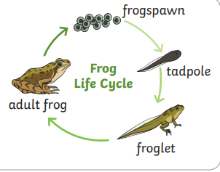
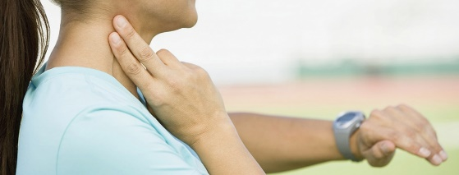
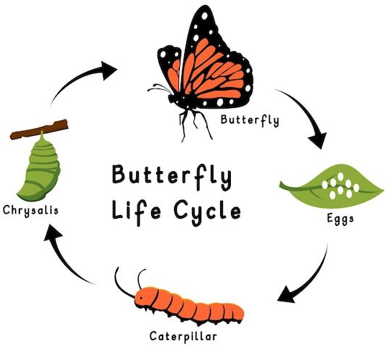
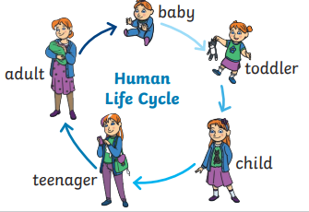
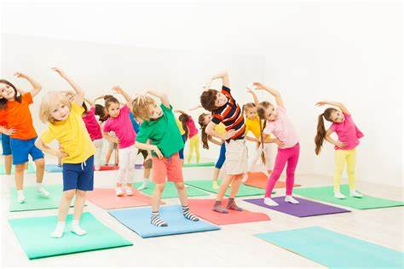
Year 2 – Animals including humans
Science
Learning sequence
Understand that living things need water, food and air to survive.
Understand and explain the life cycle of humans.
Understand and explain the life cycle of animals.
Describe the importance for humans of exercise.
Vocabulary
amphibians
birds
fish
mammals
reptiles
animal
diet
living
non-living
human
balanced
exercise
offspring
life-cycle
growth
develop
live young
pulse
heart rate
survive
Knowledge
Scientific enquiry and investigation

Slide 11
Year 3

Slide 12
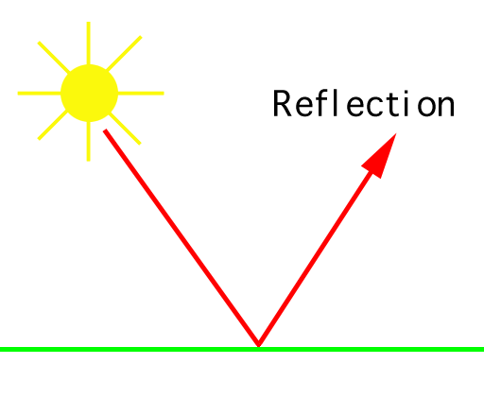
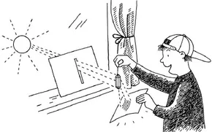
Science
Year 3 – Light
Learning sequence
Recognise that they need light in order to see things and that dark is the absence of light
Notice that light is reflected from surfaces
Recognise that light from the sun can be dangerous and that there are ways to protect their eyes
Recognise that shadows are formed when the light from a light source is blocked by an opaque object
Find patterns in the way that the size of shadows change.
Vocabulary
Light, Shadows, Mirror, Reflective, Dark, Reflection
shadow
blocked
light source
mirror
beams
UV Ultra Violet
reflect
reflective
reflection
transparent translucent
opaque
Knowledge
Scientific enquiry and investigation
What happens to the height of a shadow when the light source is further away from the object?

Slide 13
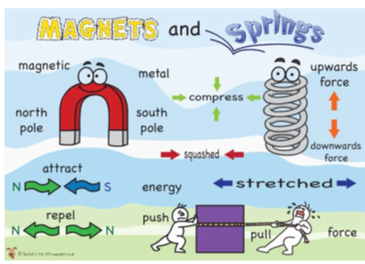
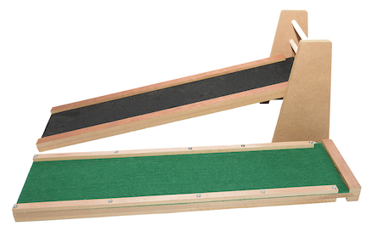
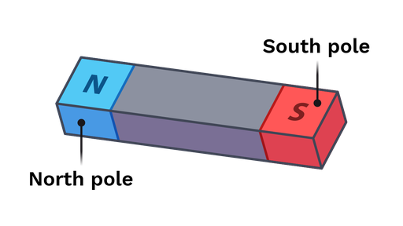
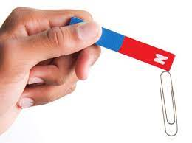
Science
Year 3 – Forces and magnets
Learning sequence
Notice that some forces need contact between two objects by identifying the different types of forces acting on objects.
Compare how things move on different surfaces
Notice that magnetic forces can act at a distance and attract some materials and not others
Compare and group materials according to whether they are magnetic
Observe how magnets attract or repel each other and attract some materials and not others
Describe magnets as having two poles and to predict whether two magnets will attract or repel each other, depending on which poles are facing
Observe how magnets attract or repel each other and attract some materials and not others
Vocabulary
north
south
push/repel
pull /attract
magnet
poles
friction
forces
investigation
magnetic force
gravity
fair test
Knowledge
Scientific enquiry and investigation
How does surface material effect how far a car travels on a ramp?
How does the type of magnet effect how many paperclips it can hold?

Slide 14
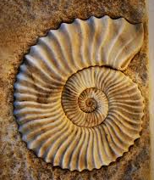
Science
Year 3 – Rocks
Learning sequence
Compare and group together different kinds of rocks on the basis of their appearance and simple physical properties
Describe in simple terms how fossils are formed when things that have lived are trapped within rock
Recognise that soils are made from rocks and organic matter.
Vocabulary
Light, Shadows, Mirror, Reflective, Dark, Reflection
rock
ground
environment
lava
layers
soil
mountains
volcano
volcanoes
metamorphic
sedimentary
igneous
fossils
magma
crystals
permeable
impermiable
organism
Knowledge
Scientific enquiry and investigation
How permeable are different types of rocks and soil?

Slide 15
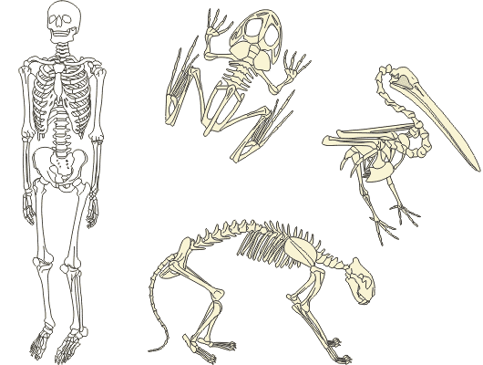
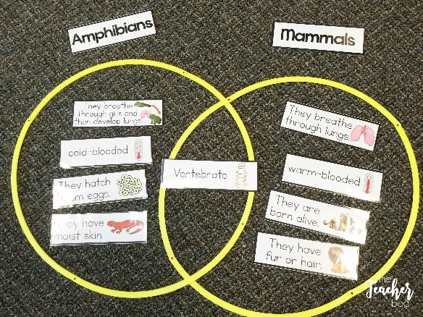
Science
Year 3 – Animals including humans
Learning sequence
Recap session covering herbivore, carnivore, omnivore, producer, predator and prey
Identify that animals including humans need the right amount of nutrition and that they cannot make their own food and get nutrition from what they eat.
Identify that humans and some other animals have skeletons and muscles for support, protection and movement. .
Group animals with and without skeletons (vertebrates and invertebrates) and discus what humans would be like without a skeleton.
Vocabulary
herbivore
carnivore
omnivore
producer
predator
prey
mammal
reptile
amphibian
insect
vertebrate
invertebrate
protein
carbohydrate
vitamins
minerals
nutrition
skeleton
support
protect
move
Knowledge
Scientific enquiry and investigation
How can we classify and group animals?

Slide 16
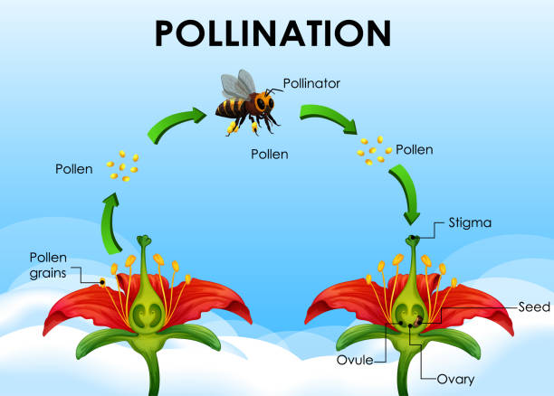
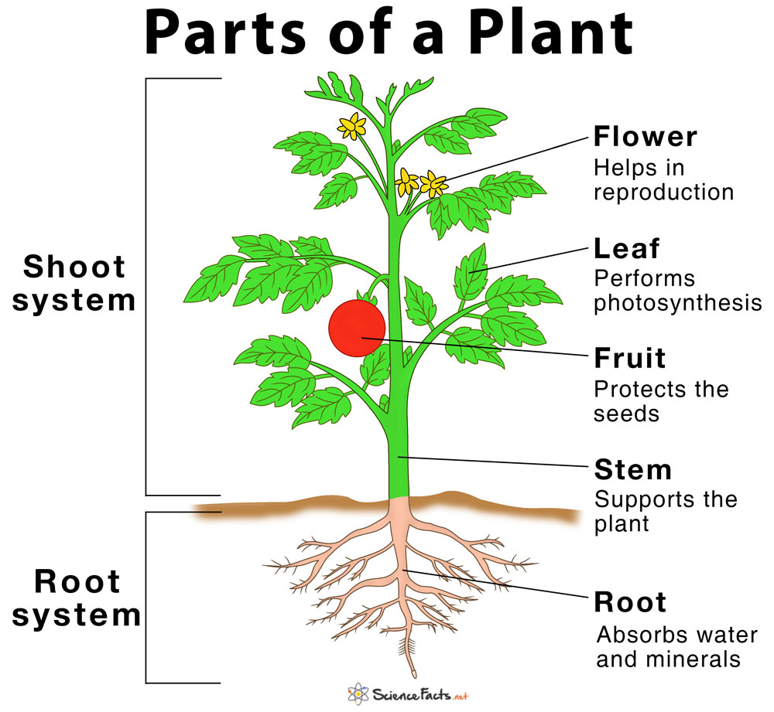
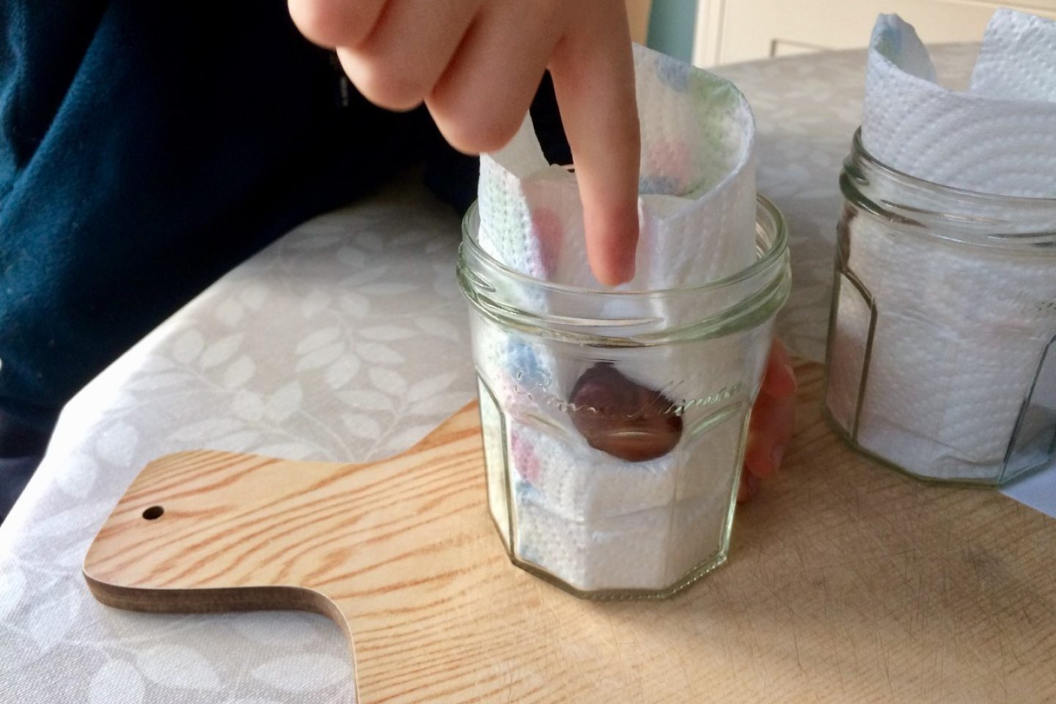
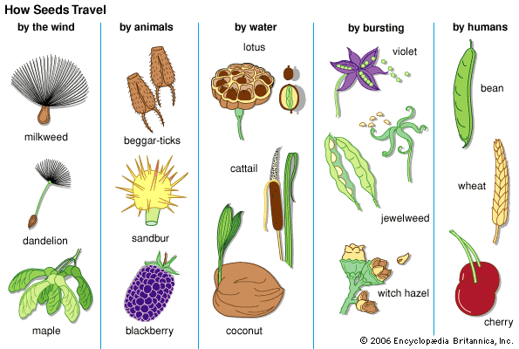
Year 3 – Plants
Science
Learning sequence
Identify and describe the functions of different parts of flowering plants:
Set up an investigation to find out what plants need to grow well.
Record my observations and give reasons for my findings.
Explore the requirements of plants for life and growth and how they vary from plant to plant.
Investigate the way in which water is transported within plants
Explore the life cycle of flowering plants, including pollination, seed formation and seed dispersal
Vocabulary
stem
leaves
roots
flower
growth germinate
light
temperature
reproduce lifecycle
air
water
soil
transportation nutrients
reproduction
seed formation seed dispersal pollination
Knowledge
Scientific enquiry and investigation
What does a plant need to germinate and grow?

Slide 17
Year 4

Slide 18
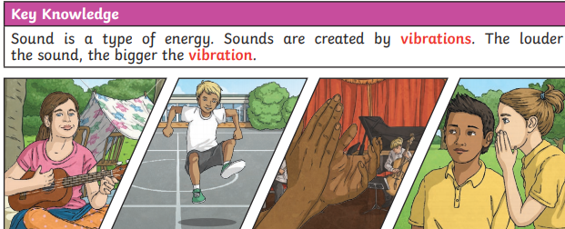
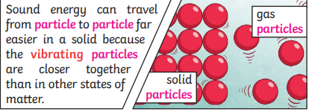
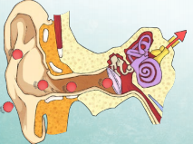
Year 4 – Sound
Science
Learning sequence
Identify how sounds are made, associating some of them with something vibrating.
Recognise that vibrations from sounds travel through a medium to the ear.
Find patterns between the pitch of a sound and features of the object that produced it.
Find patterns between the volume of a sound and the strength of the vibrations that produced it.
Recognise that sounds get fainter as the distance from the sound source increases.
Vocabulary
sound
loud
quiet
ear
distance
high
low
vibration
sound wave
volume
amplitude
pitch
particles
soundproof
absorb
vacuum
eardrum
cochlea
Knowledge
Investigation
Investigate how I can change the pitch of an instrument.

Slide 19
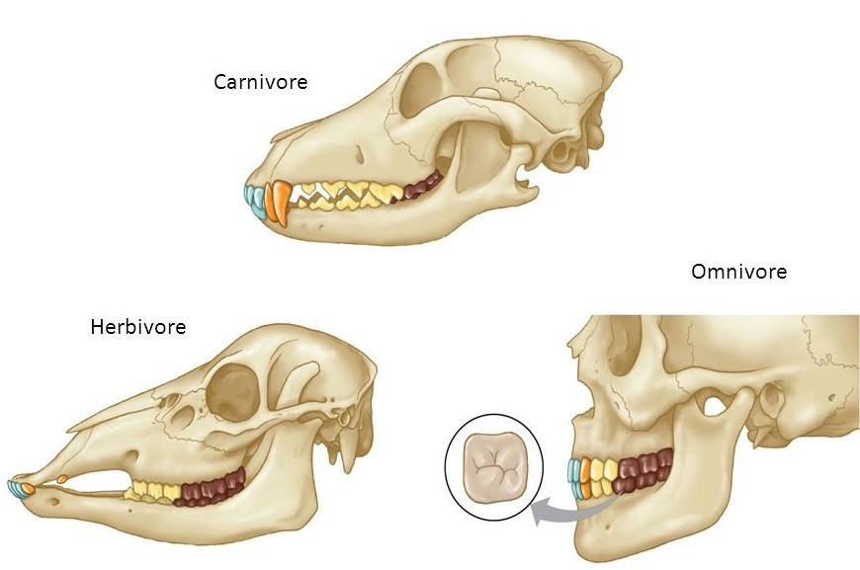
Year 4 – Animals including humans
Science
Learning sequence
Describe the simple functions of the basic parts of the digestive system in humans.
Identify the different types of teeth in humans and their simple functions.
Compare the different teeth of carnivores and herbivores and suggest reasons for their differences.
Find out what damages teeth and how to look after them.
Construct and interpret a variety of food chains, identifying producers, predators and prey.
Vocabulary
herbivore
carnivore
omnivore
producer
predator
prey
digest
oesophagus
stomach
small intestine
large intestine
rectum
incisor
molar
pre-molar
canine
plaque
decay
Knowledge
Scientific enquiry and investigation
Exploring the different skeletal structures of mammals.

Slide 20
Year 4 – Electricity
Science
Learning sequence
Identify common appliances that run on electricity.
Construct a simple series electrical circuit, identifying and naming its basic parts, including cells, wires, bulbs, switches and buzzers.
Identify whether or not a lamp will light in a simple series circuit, based on whether or not the lamp is part of a complete loop with a battery.
Recognise that a switch opens and closes a circuit and associate this with whether or not a lamp lights in a simple series circuit.
Recognise some common conductors and insulators, and associate metals with being good conductors.
Vocabulary
materials
metal
non-metal
wood
plastic
glass
electricity
generate
renewable
non-renewable
appliances
switch
wire
battery / cell
motor
buzzer
circuit
bulb
conduction / conductors
insulation / insulators
Knowledge
Scientific enquiry and investigation
Create and explore simple circuits.

Slide 21
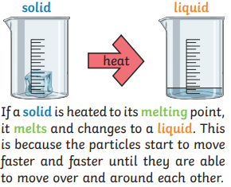
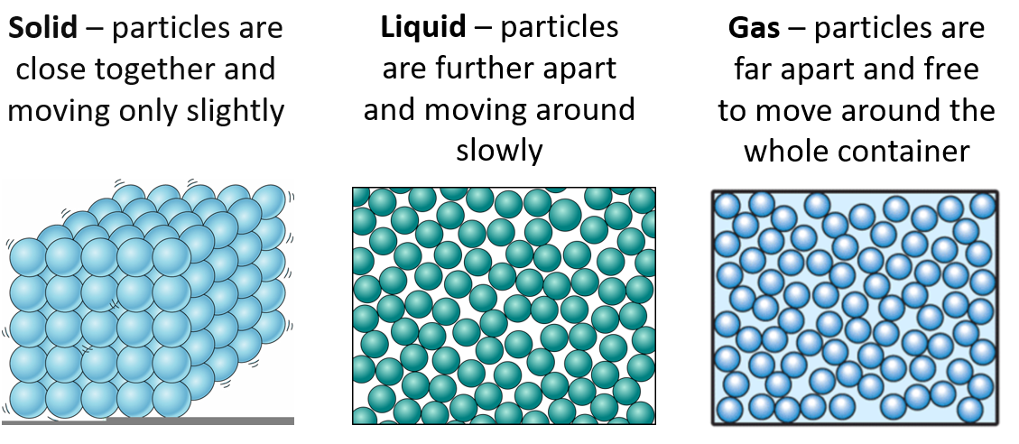
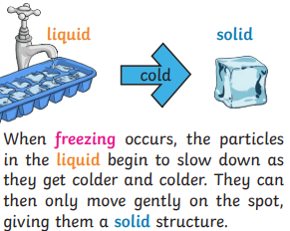
Year 4 – States of Matter
Science
Learning sequence
Compare and group materials together, according to whether they are solids, liquids or gases.
Observe that some materials change state when they are heated or cooled, and measure or research the temperature at which this happens in degrees Celsius (°C).
Identify the part played by evaporation and condensation in the water cycle and associate the rate of evaporation with temperature.
Vocabulary
solids
liquids
gas
melt
freeze
water cycle
melting
freezing
evaporate
condense
precipitation
water vapour
Knowledge
Scientific enquiry and investigation
Investigate how temperature effects evaporation.

Slide 22
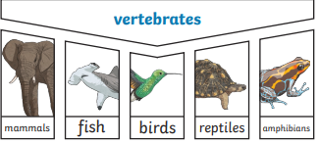
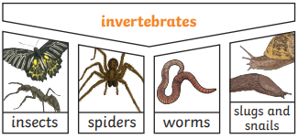
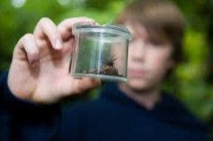
Year 4 – Living things and their habitats
Science
Learning sequence
Recognise that living things can be grouped in a variety of ways.
Explore and use classification keys to help group, identify and name a variety of living things in their local and wider environment.
Recognise that environments can change and that this can sometimes pose dangers to living things.
Vocabulary
vertebrate
invertebrate
habitat
environment
reproduction
nutrition
organisms
life processes
respiration
sensitivity
excretion
endangered species
extinct
classification
specimen
characteristics
Knowledge
Scientific enquiry and investigation
Invertebrate classification hunt
classification key

Slide 23
Year 5

Slide 24
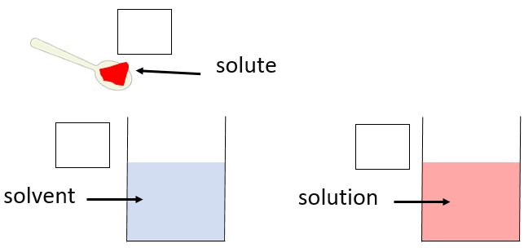
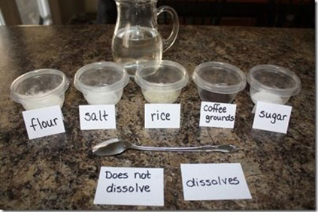
Year 5 – Properties and change of materials
Science
Learning sequence
Recognise properties of materials
Investigate dissolving materials
Alien Soup!
Understand evaporation
Using everyday materials
Identify reversible and irreversible changes
Vocabulary
electricity
transparent
sieve
translucent
opaque
magnetic
solid
liquid
gas
states of matter
evaporation
condensation
melting
freezing
properties
materials
solubility
filter
conductor
insulator
reversible
irreversible
Knowledge
Scientific enquiry and investigation

Slide 25
Science
Year 5 – Forces
Learning sequence
Vocabulary
1. What is density?
2. What is gravity?
3. What is air resistance? How can it be changed?
4. What is friction? How can it be changed?
5. How much force is needed to lift different objects?
6. What effect do pulleys, levers and gears have on the amount of force needed to lift an object?
weight
mass
parachute
opposite
surface
friction
gravity
gravitational field
air resistance
accelerate
surface area
force
newtons (N)
constant
pulleys
levers
gears
Knowledge
Scientific enquiry and investigation
Isaac Newton

Slide 26
Science
Year 5 – Animals, including humans
Learning sequence
Vocabulary
How do humans develop from birth to old age?
What is gestation? How do babies develop?
How do gestation periods of animals and humans compare?
What is puberty? Are older children always taller?
What happens to adults when they get older?
sexual
reproduction
child
adult
toddler
baby
gestation
foetus
fertilisation
species
infancy
adolescent
puberty
hormones
pituitary gland
testosterone
larynx
Knowledge
Scientific enquiry and investigation

Slide 27
Year 5 – Living things and their habitats
Science
Learning sequence
What is the life cycle of a plant?
Why do plants have flowers?
What is the life cycle of a mammal?
What is the life cycle of a amphibian?
What is the life cycle of an insect?
Why are Jane Goodall and David Attenborough significant individuals? (Computing)
Vocabulary
reproduction
male
female
pollen
pollination
sexual
ovary
mammal
warm-blooded
egg
endangered
life cycles
asexual
fertilisation
identical
clones
plantlets
offspring adolescent
adult
metamorphosis
transforms
embryo
expeditions
naturalist
Knowledge
Scientific enquiry and investigation

Slide 28
Year 5 – Earth and Space
Science
Learning sequence
Vocabulary
1. How do we learn about Space? (Properties Recap)
2. What is the Solar System?
3. How do the different bodies in the Solar System compare?
4. How does the Earth interact with the Sun and the Moon?
5. Why does the Moon appear to change shape in the night sky?
moon
sun
Earth
spin
spherical
gravity
light source
Mercury
Venus
Mars
Jupiter
Saturn
Uranus
Neptune
Pluto
orbit
gravitational force
axis
phases
crescent
atmosphere
Knowledge
Scientific enquiry and investigation

Slide 29
Year 6

Slide 30
Year 6 – Light
Science
Learning sequence
Understand that light appears to travel in straight lines.
Understand reflections.
Understand the human eye.
Understand how shadows work.
Understand refraction.
Understand mirrors.
Vocabulary
wave
source
natural / artificial
opaque
translucent
transparent
shadow
reflect
bounce mirror
reflection
absorption
refraction
prism
visible spectrum
elongated
Knowledge
Scientific enquiry and investigation
Investigate how the length of a shadow changes in relation to the distance from a light source.
refraction
Light travels in straight lines
Light travels very, very fast - 186,282 miles per second. (that’s like travelling around the world over 7 times in a second)
It is because light travels in straight lines that objects are seen, as they give out or reflect light into the eye
If something gets in the way of light, a shadow is formed

Slide 31
Year 6 – Living things and their habitats
Science
Learning sequence
Classifying animals
Classification keys
Classifying plants
Micro-organism investigation
Classifying micro-organisms
Linneaus Classification
Vocabulary
classification keys
characteristics
habitats
environnent
mammal
reptile
amphibian
micro-organisms
petri-dish
bacteria
fungi
virus
bacteria
non-flowering plant
Knowledge
Scientific enquiry and investigation
How do we know if micro-organisms are living things?
Carl Linnaeus

Slide 32
Year 6 – Electricity
Science
Learning sequence
Use symbols to draw a simple circuit diagram.
Associate the brightness of a lamp with the number and voltage of cells used in the circuit.
Investigate how components function.
Name renewable and non-renewable sources.
Vocabulary
appliance
battery/cell
circuit
series
conductor
insulator
electrical insulator
mains power
portable
pylon
renewable
non-renewable
components
electrons
voltage
Knowledge
Scientific enquiry and investigation
What is the impact of changes making changes to the components within a circuit?

Slide 33
Science
Year 6 – Animals, including humans
Learning sequence
1. Identify and name human circulatory system
2. Explain the functions of the blood .
3. Investigate effect of exercise on the body
4. Describe how water and nutrients are transported around the body.
5. Explain the effects of drugs and alcohol on the body.
Vocabulary
system
blood
drugs
alcohol
smoking
nutrients
arteries
veins
blood vessels
capillaries
circulatory system
oxygenated
deoxygenated
respiration
Knowledge
Scientific enquiry and investigation
What impact do different exercises have on your heart rate?
Heart Rate Over Time

Slide 34
Year 6 – Evolution and Inheritance
Science
Learning sequence
Recognise that living things have changed over time and that fossils provide information about living things that inhabited the Earth millions of years ago
Recognise that living things produce offspring of the same kind, but normally offspring vary and are not identical to their parents
Identify how animals and plants are adapted to suit their environment in different ways and that adaptation may lead to evolution
Vocabulary
vertebrate
invertebrate
mammal
reptile
amphibian
fossils
classification
organisms
environment
adaptation evolution characteristic
reproduction genetics
Knowledge
Scientific enquiry and investigation
Investigate how different animals have adapted to their environments and explain how these adaptations have enabled them to survive.

